Slide 1
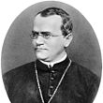
Mendelian Genetics
Mr. Davis

Slide 2
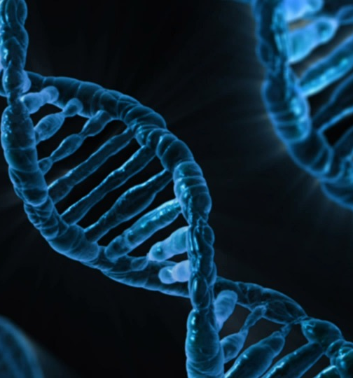
Genetic Terms
Genetics: is the scientific study of heredity.
Heredity: transmission of genetic traits from parent to offspring.
Traits: specific characteristics that can be passed from parent to offspring that varies from one individual to another.
Example: the pea plant’s seed shape, color, height, flower position

Slide 3
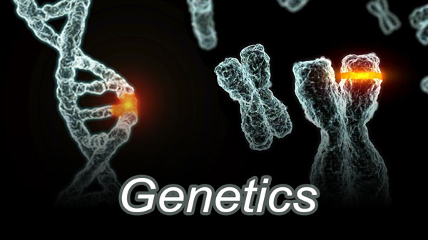
Genetic Terms
Gene – section of chromosome that codes for a trait
Allele – distinct form of a gene
Dominant allele – form of a gene, which is fully expressed
Recessive allele – form of a gene, which is not expressed when paired with a dominant allele

Slide 4
The Study of Genetics
Gregor Mendel – “Father of Genetic”
Austrian Monk in the Czech Republic
Mendel worked in the monastery garden
Mendel worked with ordinary garden peas
Mendel studied the structure of the flowers of pea plants
Mendel observed the distinct traits of pea plants

Slide 5
Gregory Mendel

Slide 6
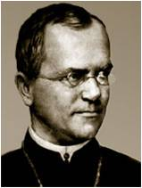
Mendelian Genetics
3 reasons why Mendel studied genetics
He selected the pea because of its distinguishable traits. Example: flower color, seed color, seed shape
He knew from prior experiments that one of the traits would disappear in one generation
Plant as easy to grow

Slide 7
Mendel studied

Slide 8
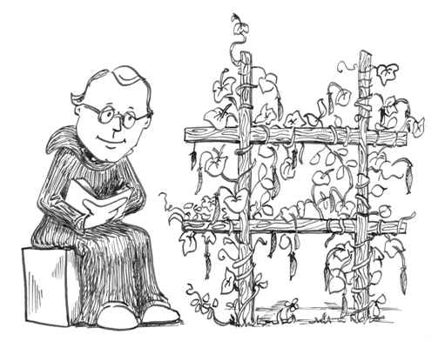
Mendelian Genetics
Fertilization: the process that occurs during sexual reproduction where by male & female reproductive parts join. Fertilization produces a new cell which develops into a tiny embryo.
True-Breeding: occurs in both animals & plants where by they produce offspring identical to themselves.

Slide 9
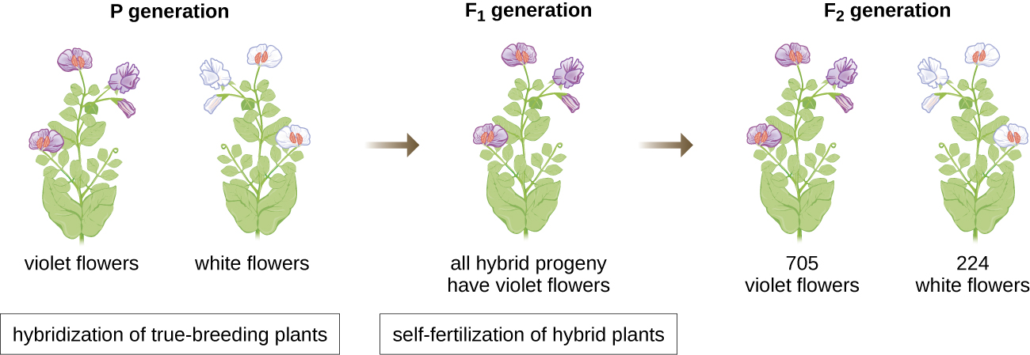
Mendel’s Experiment
Gregor Mendel studied garden peas. Pea plants are usually self-pollinating.
Self-pollination: a plant fertilizes itself.
This means that the pollen (sperm) of one plant will fertilize the egg of the same plant.
The seeds produced will inherit all of their characteristics from the single plant that bore them.
These self-pollinating pea plants produced true-breeding or pure offspring.
They would produce offspring identical to themselves.

Slide 10
Mendelian Pea Plant Experiments

Slide 11
Laws of Genetics
Law of segregation – each pair of (homologous) genes separates (segregates) during meiosis.
Law of independent assortment – each member of a pair of homologous chromosomes separates independently of the members of other pairs so the results are random.

Slide 12
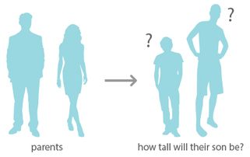
Laws of Genetics
Law of Dominance – the dominant allele is expressed and the recessive allele can be hidden.
Probability – likelihood of an event happening.
Punnett Square – grid for organizing genetic material, shows probabilities not results.

Slide 13
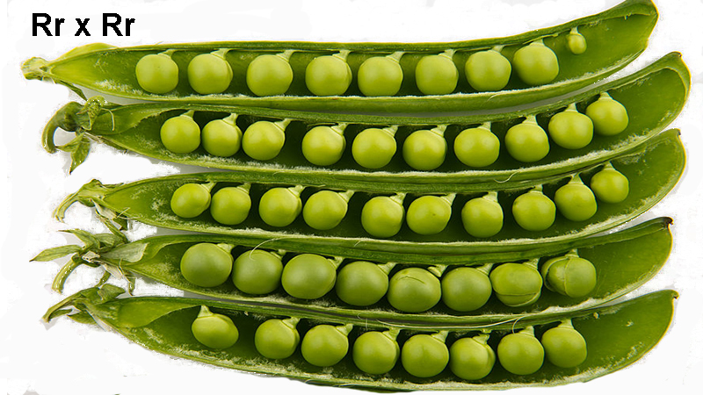
Laws of Genetics
Monohybrid cross – studying the inheritance of only one trait at a time “cross” refers to mating between male and female.
Dihybrid cross- studying the inheritance of two traits at a time.
Test cross – if you don’t know if a trait expression is from genotype which is homozygous dominant or heterozygous, you cross it with a homozygous recessive so expression of recessive trait would occur if it existed.

Slide 14
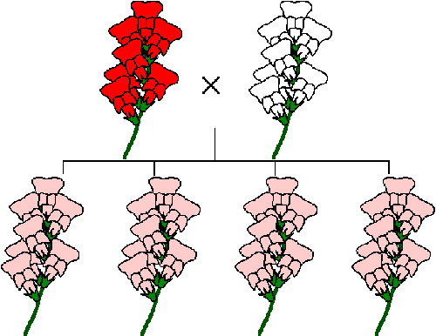
Laws of Genetics
Complete Dominance: when the one allele completely masked by another allele.

Slide 15
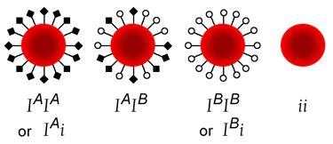
Laws of Genetics
Codominance is a form of dominance wherein the alleles of a gene pair in a heterozygote are fully expressed. This results in offspring with a phenotype that is neither dominant nor recessive.
A typical example showing codominance is the ABO blood group system.

Slide 16
Incomplete Dominance & Co-dominance

Slide 17
Punnett Square

Slide 18
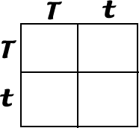
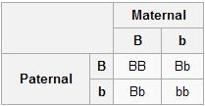
Punnett Squares

Slide 19
Monohybrid Cross

