Slide 1
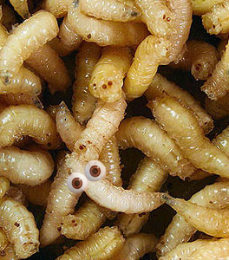
Chapter 13 Insect Entomology
Mr. Davis

Slide 2
Insect Biology
Insects are the most diverse and abundant forms of life on earth.
There are over a million described species- more than 2/3 of all known organisms
There is more total biomass of insects than of humans.
Insects undergo either incomplete or complete metamorphosis (Egg to larva to pupa to insect)
Larva have a soft tubular body and look like worms. Fly species larvae are “maggots”

Slide 3

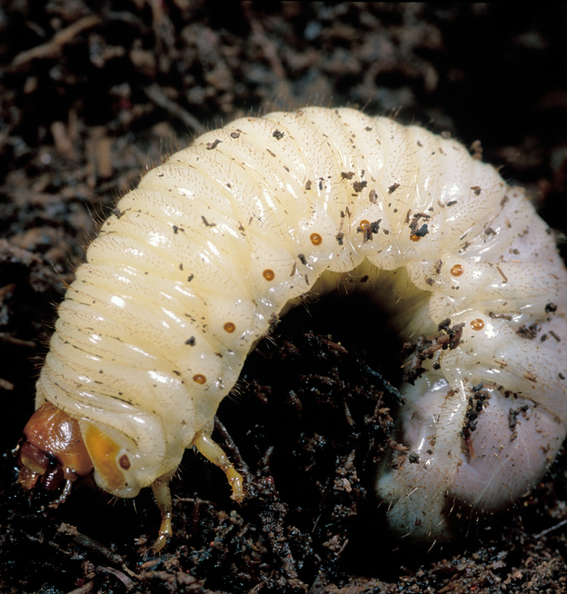
Vocabulary
Forensic Entomology is the use of the insects, and their arthropod relatives that inhabit decomposing remains to aid legal investigations.
The broad field of forensic entomology is commonly broken down into three general areas: medicolegal, urban, and stored product pests.

Slide 4
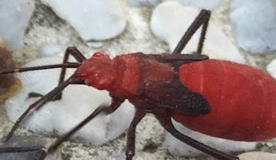
What is Forensic Entomology?
Forensic Entomology is the use of the insects and other arthropods that feed on decaying remains to aid legal investigations.
  Medicolegal (criminal)
  Urban (criminal and civil)
    “legal proceedings involving insects and related animals that affect manmade structures and other aspects of the human environment”
  Stored product pests (civil)

Slide 5

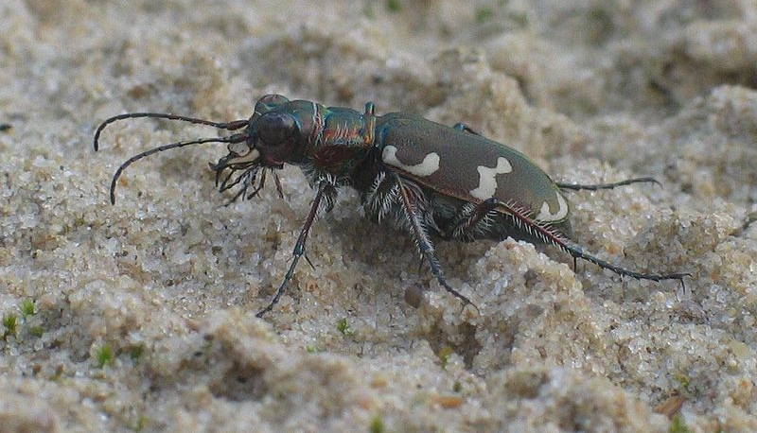
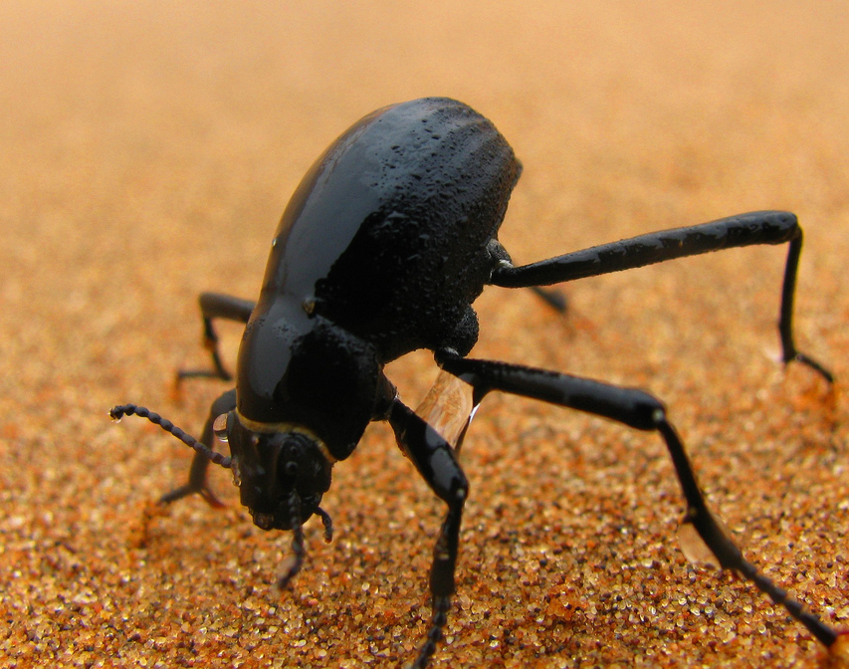
3 General Areas of
Forensics Entomology
The medicolegal section focuses on the criminal component of the legal system and deals with the necrophagous (or carrion) feeding insects that typically infest human remains.
The urban aspect deals with the insects that affect man and his immediate environment. This area has both criminal and civil components as urban pests may feed on both the living and the dead. The damage caused by their mandibles (or mouthparts) as they feed can produce markings and wounds on the skin that may be misinterpreted as prior abuse. Urban pests are of great economic importance and the forensic entomologist may become involved in civil proceedings over monetary damages.

Slide 6

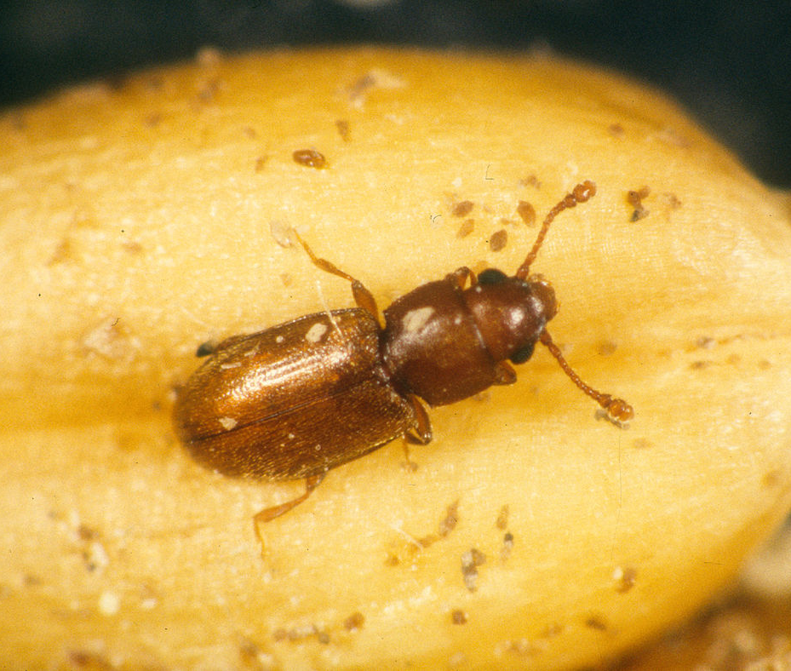
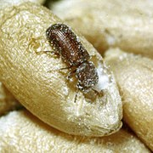
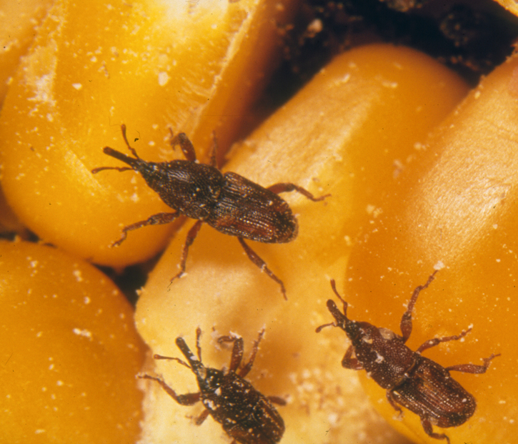
3 General Areas of Forensics Entomology
Lastly, stored product insects are commonly found in foodstuffs and the forensic entomologist may serve as an expert witness during both criminal and civil proceedings involving food contamination

Slide 7
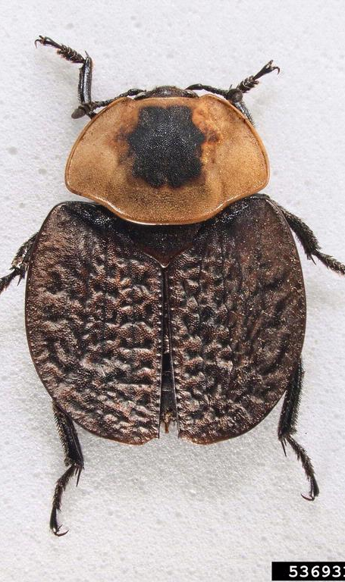
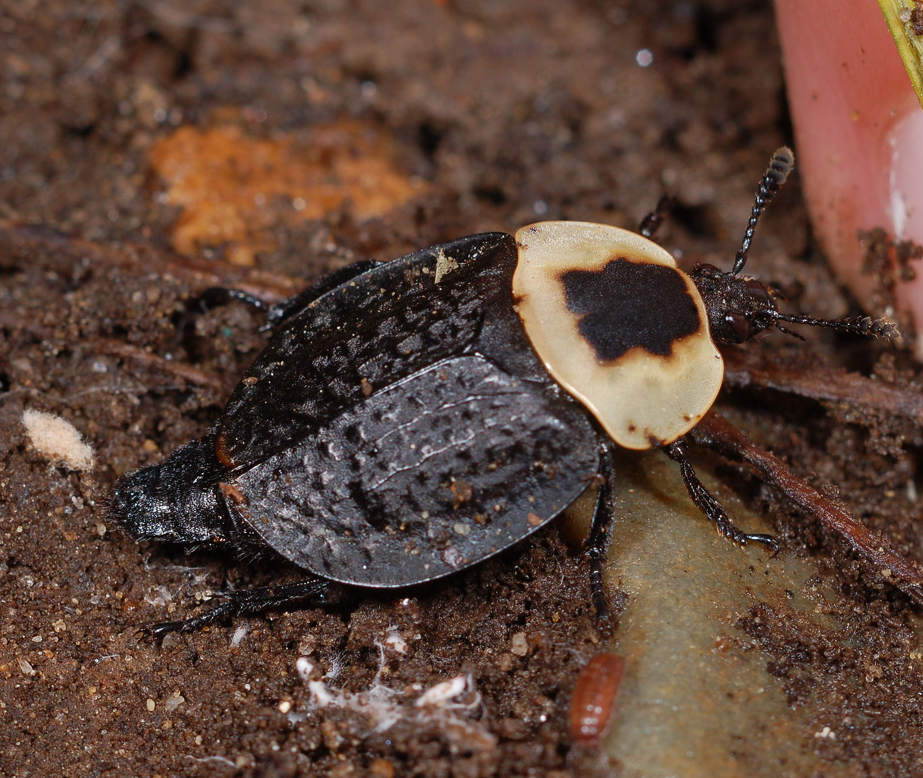
Vocabulary
Insects – are the largest groups of arthropods. Insects have three main body segments: head, thorax, and abdomen.
Arthropods - is an invertebrate animal having an exoskeleton (external skeleton), a segmented body, and paired jointed appendages. (six legs & a three-segment body).
Carrion – the carcass of a dead or decaying animal.

Slide 8



Necrophagous – (Dead-Flesh eating) phase of insect invasion of a corpse found in or around he body.
Molt – (Shedding their skin) - shed old feathers, hair, or skin, or an old shell, to make way for a new growth.
Instar –is the name given to the developmental stage of an arthropod between molts. Instar can be used for insects undergoing complete and incomplete metamorphosis. For example, a butterfly caterpillar can go through several instars before pupation.

Slide 9
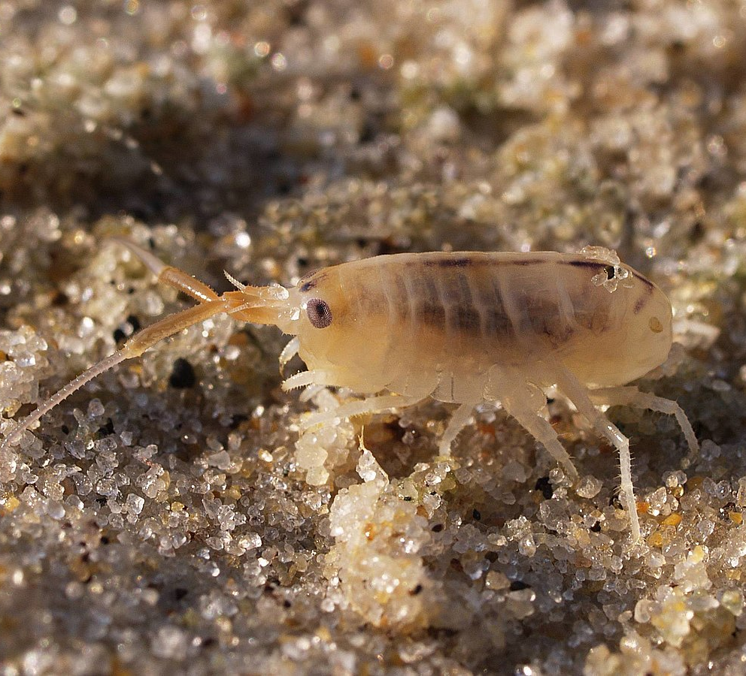
Mites - are small arthropods belonging to the class Arachnida .The term "mite" refers to the members of several groups in Acari.
Most mites are tiny, less than 1 mm (0.04 in) in length, and have a simple, unsegmented body plan.
Their small size makes them easily overlooked; some species live in water, many live in soil as decomposers, others live on plants, sometimes creating galls, while others again are predators or parasites.

Slide 10

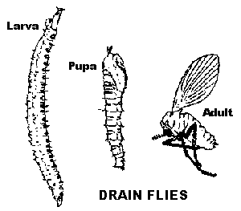
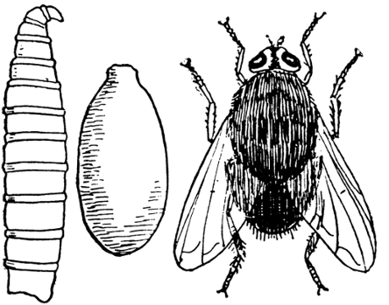
Insect Development
Ametabolous – first pattern of growth “without change.” Insects have immature forms that appear to be small adults.
Paurometabolous – second pattern of change “gradual.” Insects emerge from hatching into a nymph form.
Holometabolous – third pattern of change “complete.” Insects develop from eggs into larvae which go through a separate growth stage to reach the adult form.

Slide 11
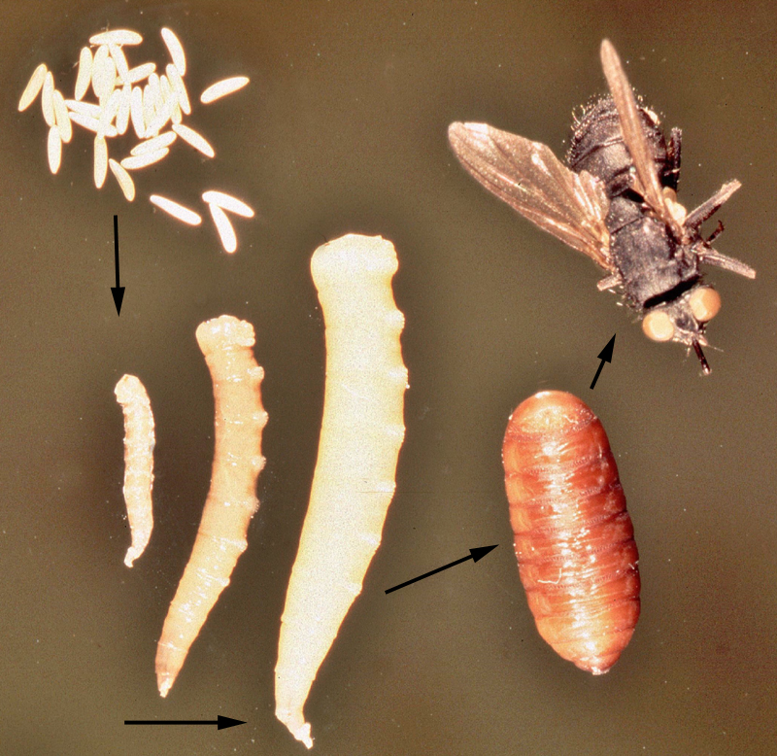
Metamorphosis
the process of transformation from an immature form to an adult form in two or more distinct stages.
The house fly has a complete metamorphosis with distinct egg, larval or maggot, pupal and adult stages. The house fly overwinters in either the larval or pupal stage under manure piles or in other protected locations.

Slide 12
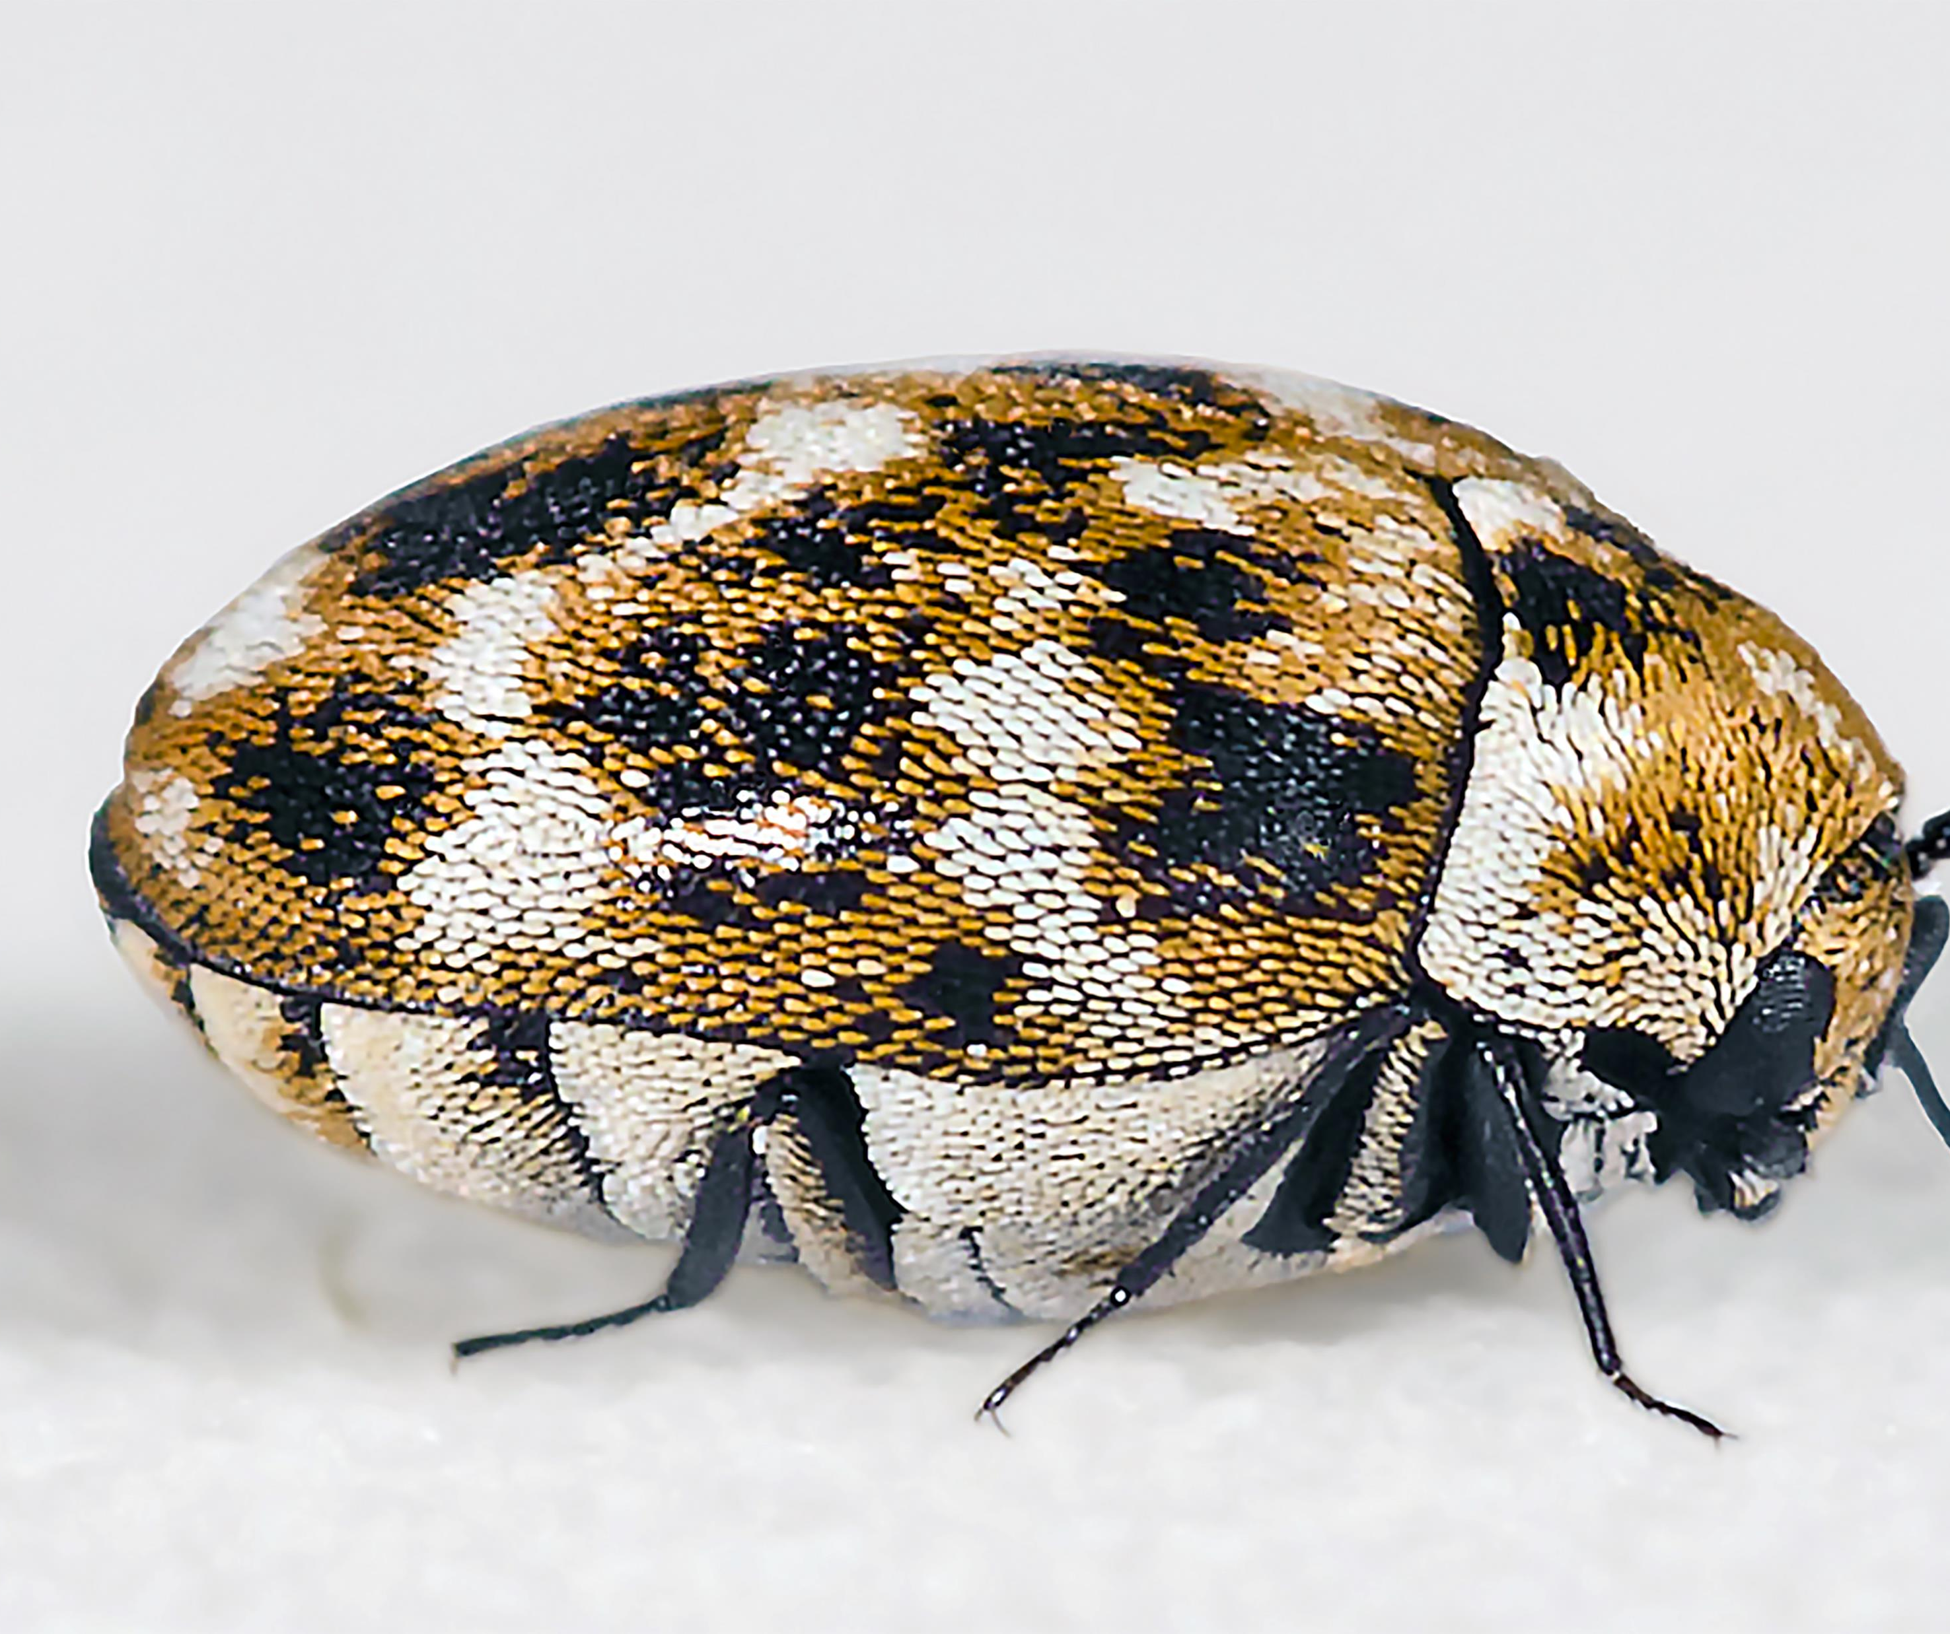
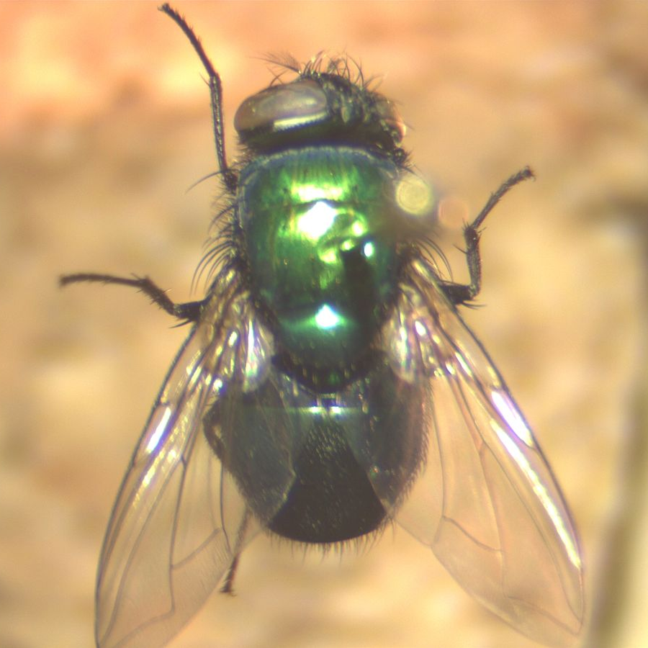
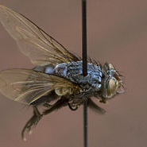
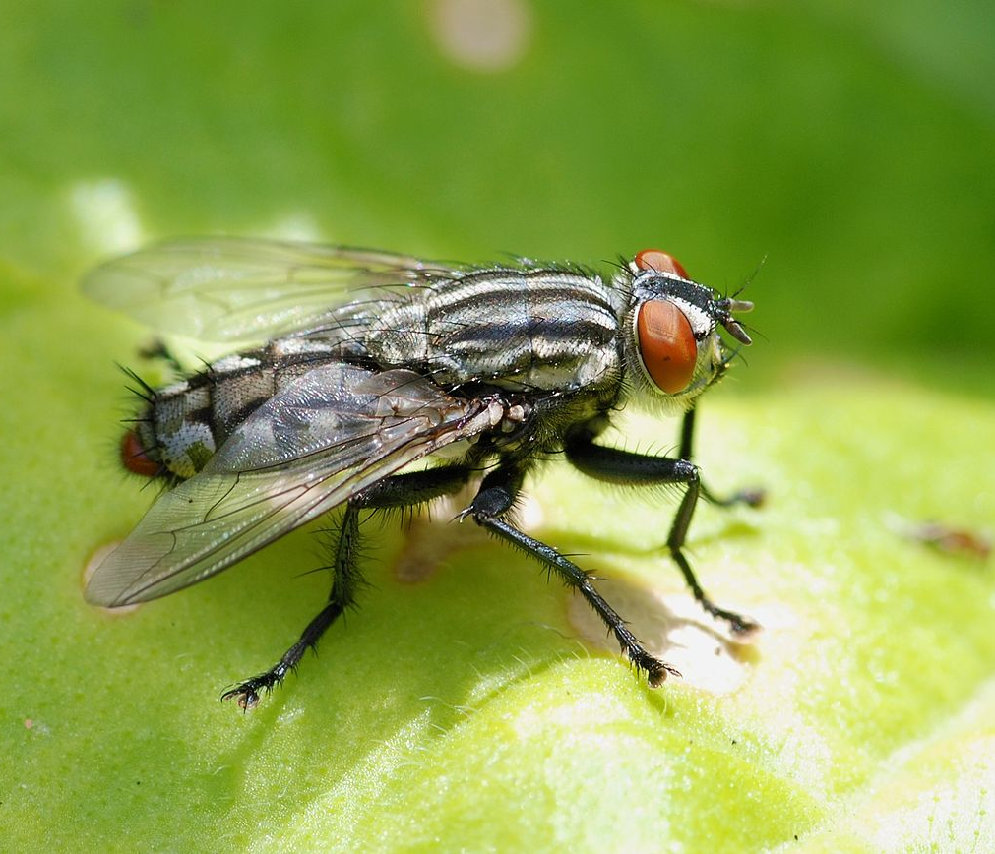
Taxonomy
the branch of science concerned with classification, especially of organisms; systematics.

Slide 13
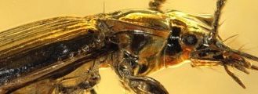
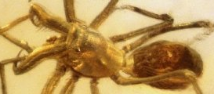
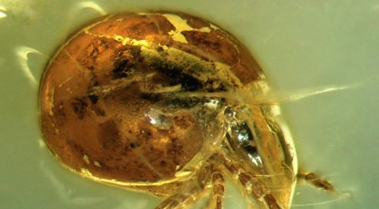
Dichotomous
A dichotomous key is a tool that allows the user to determine the identity of items in the natural world, such as trees, wildflowers, mammals, reptiles, rocks, and fish.
Keys consist of a series of choices that lead the user to the correct name of a given item. "Dichotomous" means "divided into two parts".

Slide 14
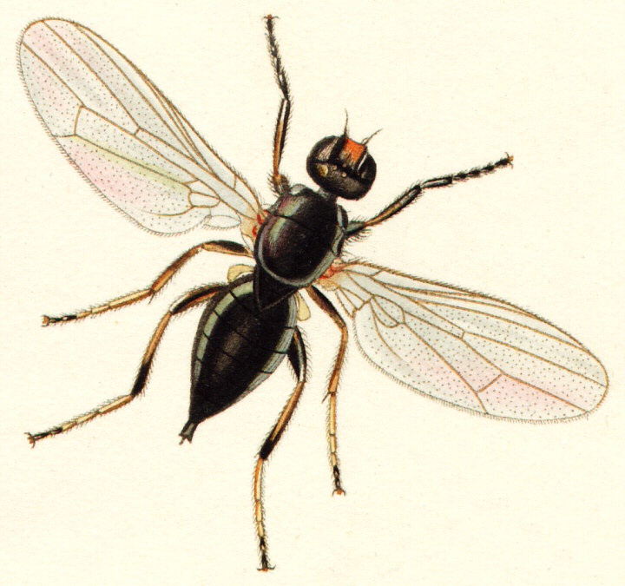
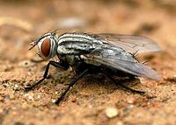
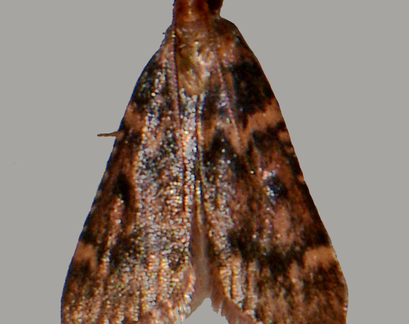
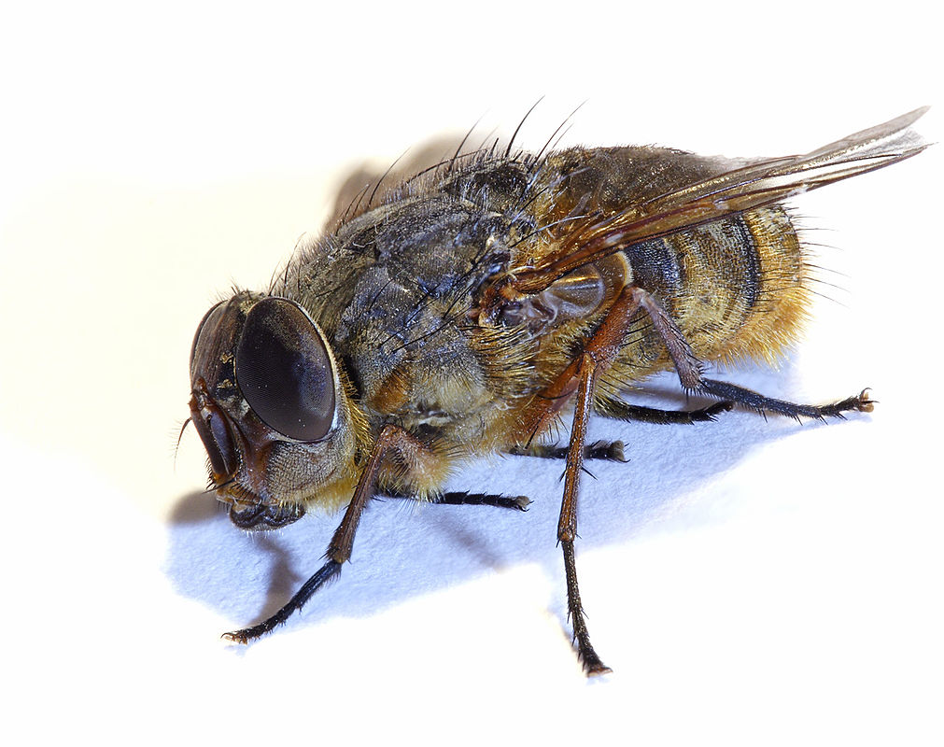
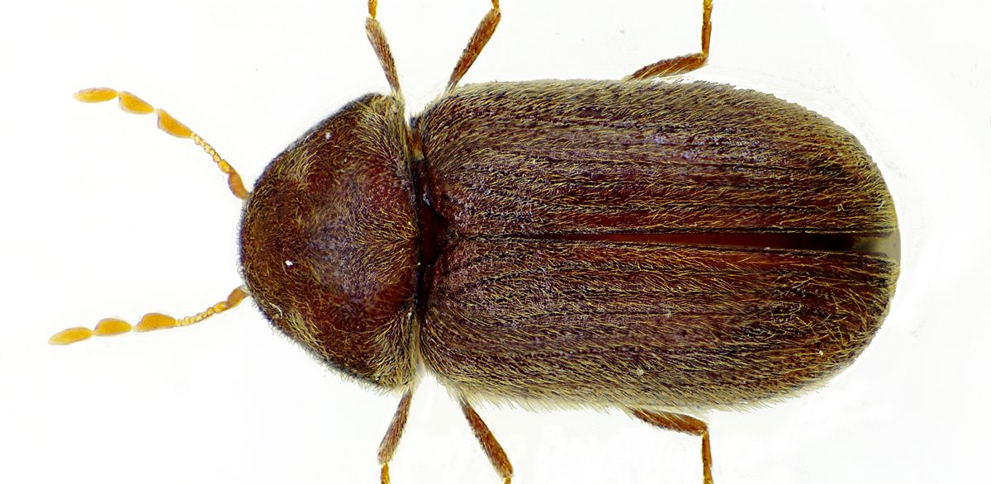
Predatory Species:
Blow Fly
Flesh Flies
Hide Beetles
Pyralid Moth
Cheese Skipper
Carrion Feeders (mainly flies and beetles)

Slide 15
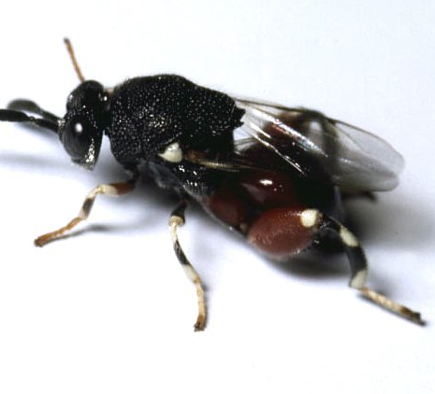
Parasitic Species
Chiggers
sarcoptic itch mites

Slide 16
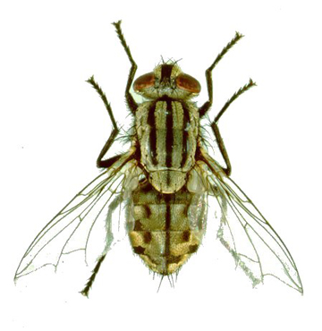
Flesh fly

Slide 17
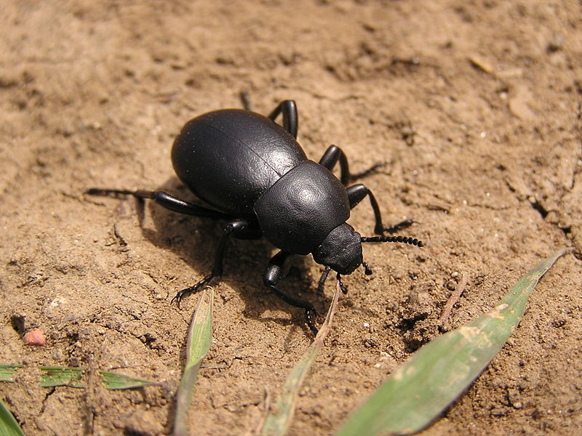
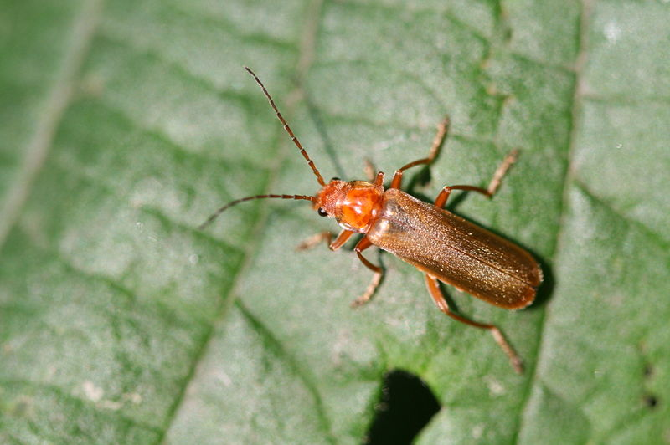
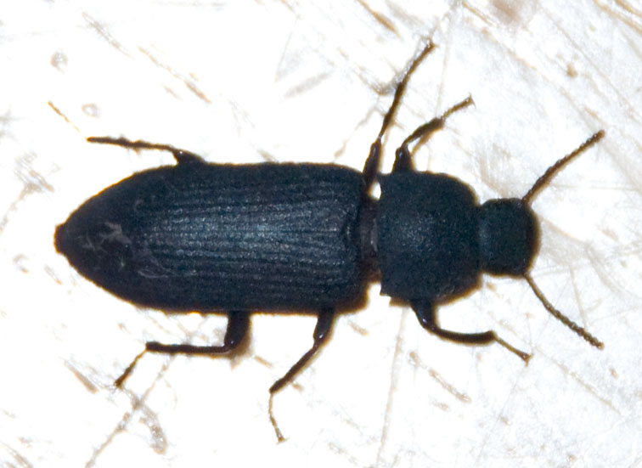
Forensic Entomology - Beetles
Coleoptera (beetles)
Arrive early or late in decomposition process, depending on species

Slide 18
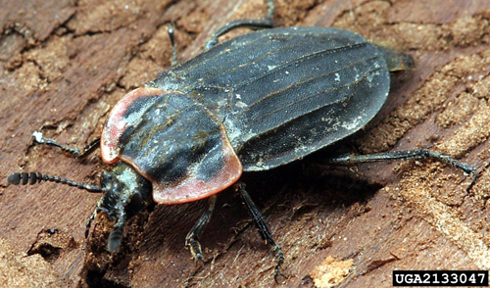
Carrion beetle

Slide 19
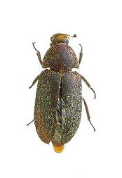
Hide beetle

Slide 20

Daubert Ruling
In United States federal law, the Daubert standard is a rule of evidence regarding the admissibility of expert witness testimony. A party may raise a Daubert motion, a special motion in limine raised before or during trial, to exclude the presentation of unqualified evidence to the jury.

Slide 21
Daubert Ruling
The Court defined "scientific methodology" as the process of formulating hypotheses and then conducting experiments to prove or falsify the hypothesis, and provided a set of illustrative factors (i.e., not a "test") in determining whether these criteria are met:
Whether the theory or technique employed by the expert is generally accepted in the scientific community;
Whether it has been subjected to peer review and publication;
Whether it can be and has been tested;
Whether the known or potential rate of error is acceptable; and
Whether the research was conducted independent of the particular litigation or dependent on an intention to provide the proposed testimony

Slide 22
Postmortem interval (PMI)
Postmortem Interval or PMI is used to determine time since death (the time between death and corpse discovery)
This is called).
Other uses include
  movement of the corpse
  manner and cause of death
  association of suspects with the death scene
  detection of toxins, drugs, or even the DNA of the victim through analysis of insect larvae.

Slide 23
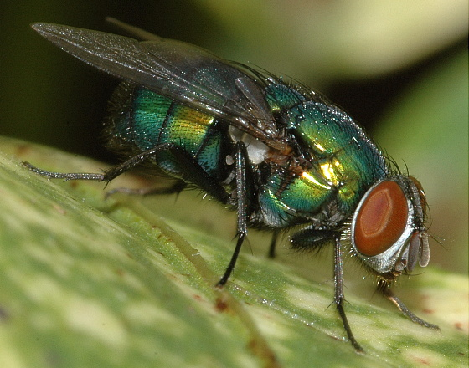
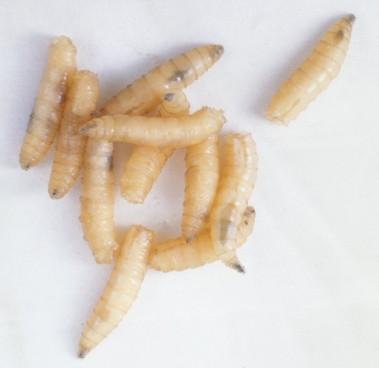
Estimating the PMI
Once insects are collected (both adults and immature), they are used to estimate the postmortem interval (PMI).

Slide 24
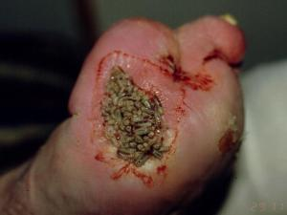
Estimating the PMI
Collection of Insect Samples
Can be collected at the crime scene
Can be collected during autopsy

Slide 25
Succession of Insects on the Corpse
Estimates of postmortem intervals based on insects present on the remains are based on:
  The time required for a given species to reach a particular stage of development.
  Comparisons of all insect species present on the remains at the time of examination.
Ecological succession occurs as an unexploited habitat (like a corpse) is invaded by a series of different organisms.
The first invasion is by insect species which will alter the habitat in some form by their activities. These changes make the habitat attractive to a second wave of organisms which, in turn, alter the habitat for use by yet another organisms.

Slide 26
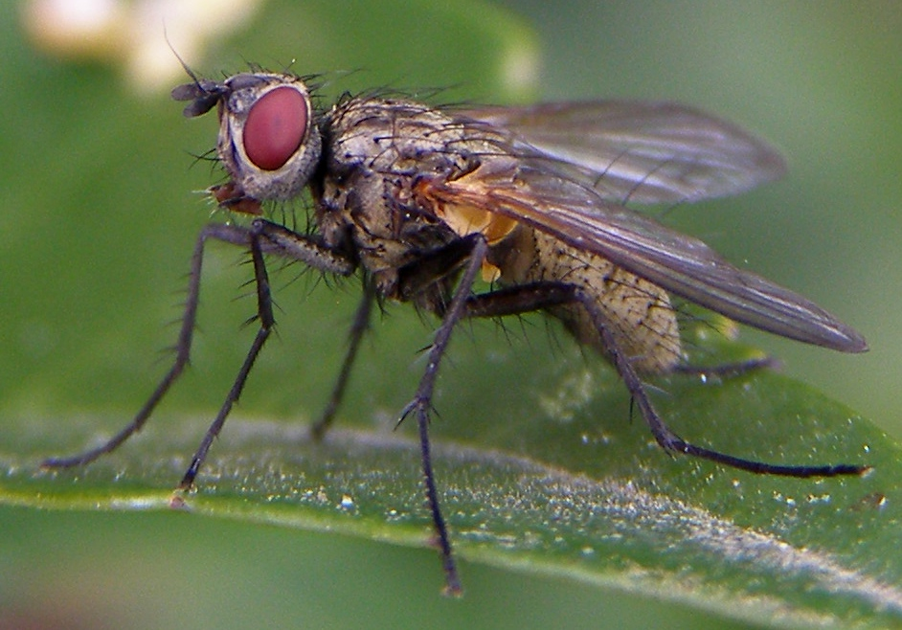

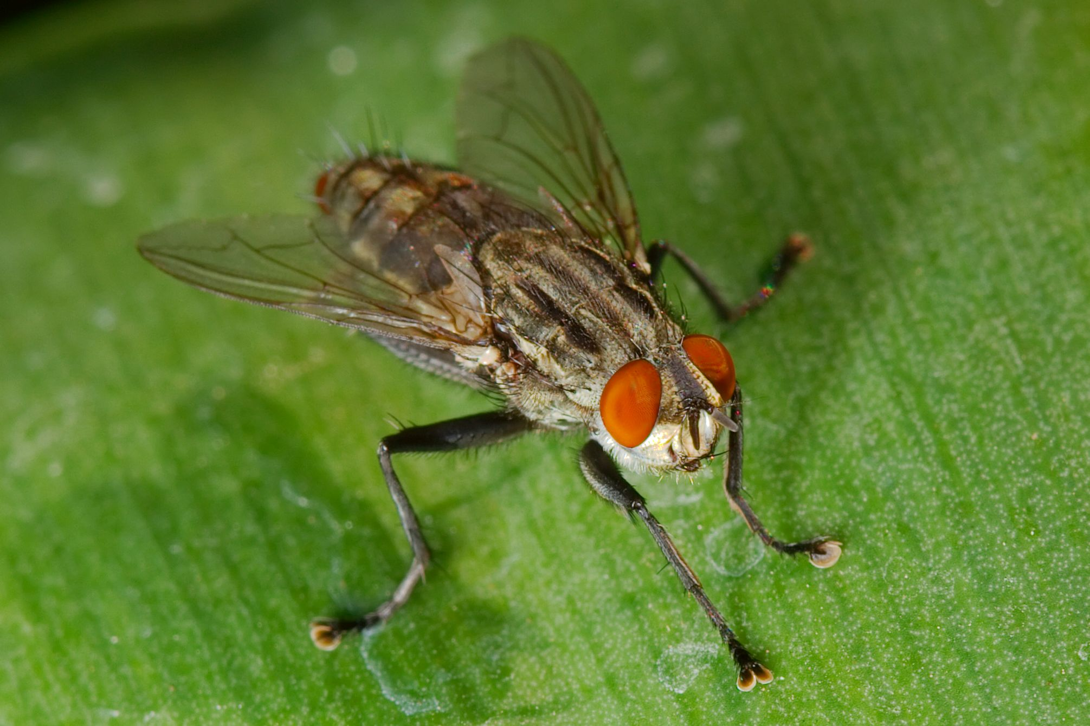
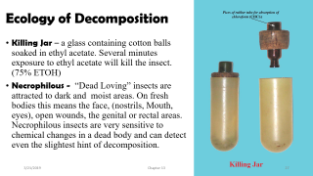
Ecology of Decomposition
Necrophages - the first species feeding on corpse tissue. Includes rue flies (Diptera) and beetles (Coleoptera).
Omnivores - species such as ants, wasps, and some beetles that feed on both the corpse and associated maggots. Large populations of omnivores may slow the rate of corpse’s decomposition by reducing populations of necrophagous species.
Parasites and Predators - beetles, true flies and wasps that parasitize immature flies.
Incidentals – pill bugs, spiders, mites, centipedes that use the corpse as an extension of their normal habitat

Slide 27
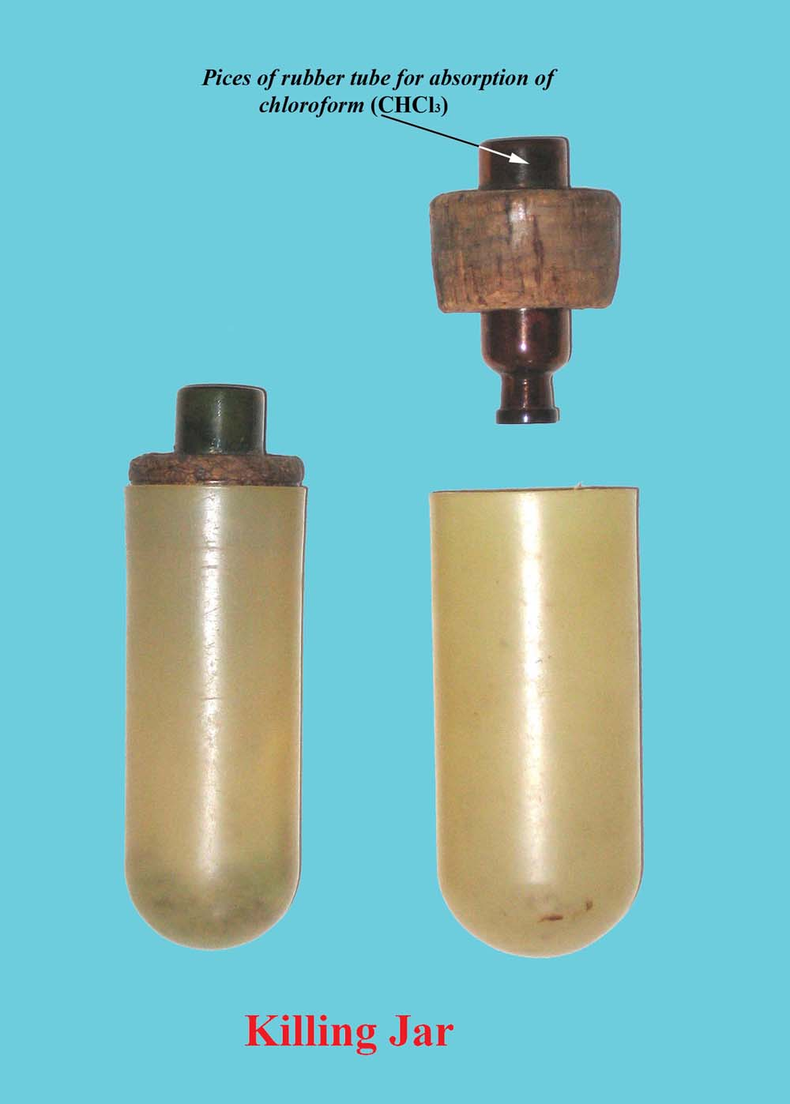
Ecology of Decomposition
Killing Jar – a glass containing cotton balls soaked in ethyl acetate. Several minutes exposure to ethyl acetate will kill the insect. (75% ETOH)
Necrophilous - “Dead Loving” insects are attracted to dark and moist areas. On fresh bodies this means the face, (nostrils, Mouth, eyes), open wounds, the genital or rectal areas. Necrophilous insects are very sensitive to chemical changes in a dead body and can detect even the slightest hint of decomposition.

Slide 28
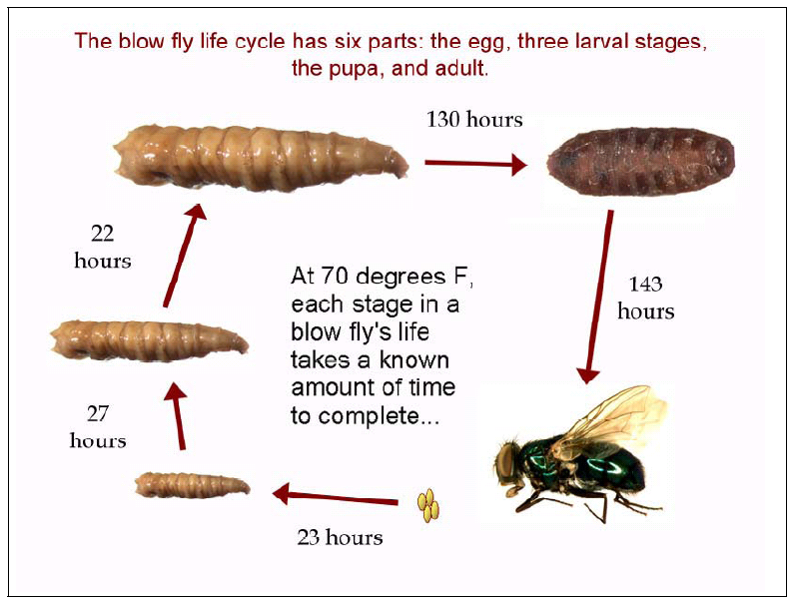

Slide 29
Decay Rates Are Variable
Studies of decay rates of 150 human corpses at in the Anthropological Facility in Tennessee (The Body Farm)
Most important environment factors in corpse decay:
  Temperature
  Access by insects
  Depth of burial
Other Factors
  Chemical-- embalming agent, insecticides, lime, etc.
  Animals disrupting the corpse

Slide 30
Postmortem Interval
Five general stages are used to describe the process of decomposition in vertebrate animals: fresh, bloat, active decay, advanced decay, and dry/remains. The general stages of decomposition are coupled with two stages of chemical decomposition: autolysis and putrefaction.
Several of the most frequent factors affecting PMI estimates such as temperature, burial depth and access of the body to insects are fully reviewed. On account of their activity and world wide distribution, Diptera are the insects of greatest forensic interest.

Slide 31
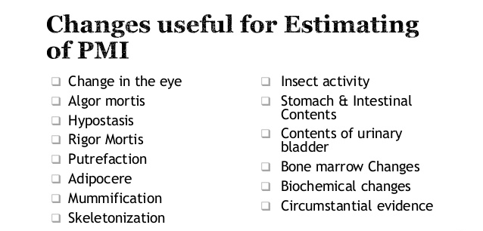

Slide 32
Calculating PMI from - Accumulated Degree Hours (ADH)
From | To | Temp | Hours | ADH | Cumulative ADH
Egg | 1st Instar | 70° F | 23 | 23 x 70= 1610 ADH | 1610
1st Instar | 2nd Instar | 70 ° F | 27 | 27 x 70= 1890 ADH | 1610+ 1890
2nd Instar | 3rd Instar | 70 ° F | 22 | 22 x 70= 1540 ADH | 1610+1890+ 1540
3rd Instar | Pupa | 70 ° F | 130 | 130 x 70= 9100 ADH | 1610+1890+ 1540+9100
Pupa | Adult Fly | 70 ° F | 143 | 143 x 70= 10010 ADH | 1610+1890+ 1540+9100 +10010
Notes:
24100 ADH

Slide 33
Calculating ADH from Climate Data

Slide 34
Using the Data
3928 ADH in these three days (952+1488+1488).
How many ADH of 70º are there in these 3 days?
3928/70=56.11 hours
72 hours at 70º would have the insects passing to the 3rd instar. But 72 hours at colder temperatures and insects will only be at 2nd instar stage.

Slide 35
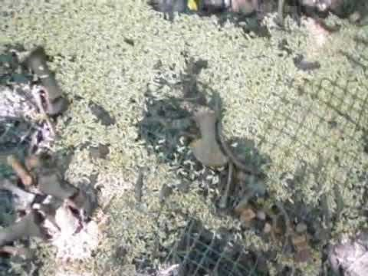
Maggot Mass
Maggots generate heat as they consume a body. They generate enough heat that there are multiple cases of maggots continuing to develop in refrigerated morgues.

Slide 36
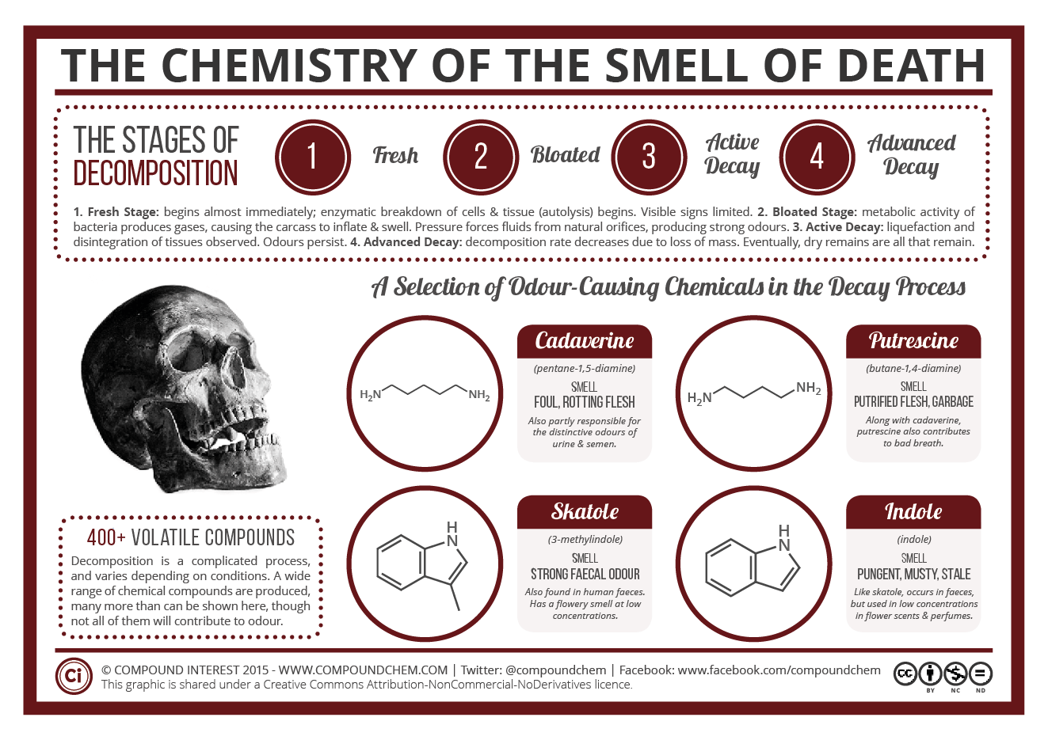

Slide 37


The 5 Smells of Death
Cadaverine and putrescine smell like rotting flesh
Skatole has a strong feces odor
Indole has a mustier, mothball-like smell
Hydrogen sulfide smells like rotten eggs
Methanethiol smells of rotting cabbage
Dimethyl disulfide and trisulfide have a foul, garlic-like odor

