Slide 1
The
4
Macromolecules
Foldable

Slide 2
Carbohydrates
Monomer: monosaccharide sugar
Polymer: polysaccharides
Food Source: sugar, plant products (fruits,
vegetables, rice, pasta)
Function: quick energy

Slide 3
Lipids
Monomer: 1 glycerol & 3 Fatty Acids
Polymer: lipid
Food Source: fats, oils, waxes ( butter, margarine, and greasy food)
Function: long term energy storage

Slide 4
Proteins
Monomer: Amino Acids
Polymer: Polypeptides, (After the polypeptide folds into a 3 dimensional protein
Food Source: meat (Beef, chicken, fish) legumes (peanuts and soybeans)
Function:
carries out chemical reactions (enzymes)
builds bone & muscle
transports materials in and out of the cells
fight some diseases.

Slide 5
Nucleic Acids
Monomer: Nucleotide
Polymer: Nucleic Acid (DNA & RNA)
Function:
involved in heredity
The making of proteins
Carries genetic information

Slide 6
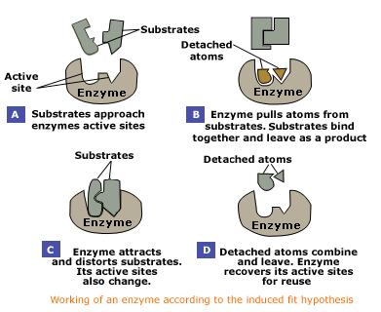
Enzymes

