Slide 1
Electromagnetic Spectrum
Mr. Davis| Broughton High School

Slide 2
Electromagnetic Wave
one of the waves that are propagated by simultaneous periodic variations of electric and magnetic field intensity and that include radio waves, infrared, visible light, ultraviolet, X-rays, and gamma rays
Notes:
This is the question that your experiment answers

Slide 3
Gamma Rays
Gamma ray: Doctors use gamma-ray imaging to see inside your body. The biggest gamma-ray generator of all is the Universe.

Slide 4
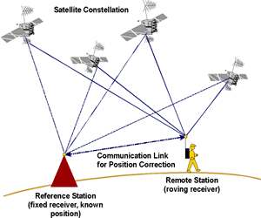
Global Positioning System
Notes:
Summarize your research in three to five points.

Slide 5
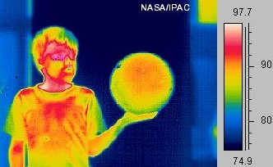
Infrared Waves
Infrared: Night vision goggles pick up the infrared light emitted by our skin and objects with heat. In space, infrared light helps us map the dust between stars.

Slide 6
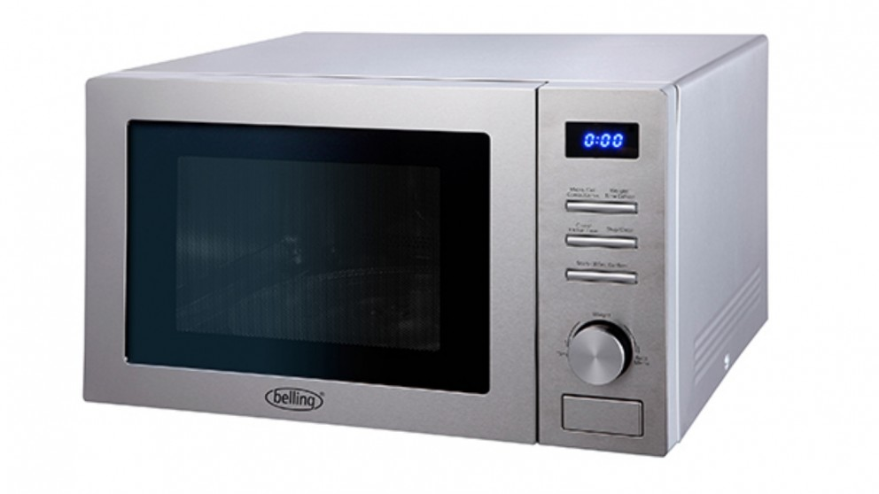
Microwaves
an electromagnetic wave with a wavelength in the range 0.001–0.3 m. Microwaves are used in radar, in communications, and for heating in microwave ovens .
Microwave: Microwave radiation will cook your popcorn in just a few minutes, but is also used by astronomers to learn about the structure of nearby galaxies.
Notes:
Establish hypothesis before you begin the experiment. This should be your best educated guess based on your research.

Slide 7
Photon
The photon is the fundamental particle of visible light. In some ways, visible light behaves like a wave phenomenon, but in other respects it acts like a stream of high-speed, submicroscopic particles.

Slide 8
Radiant Energy
Radiant energy is energy that travels by waves or particles, particularly electromagnetic radiation such as heat or x-rays. An example of radiant energy is the source of energy used in radiation therapy.
Notes:
List all of the steps used in completing your experiment.
Remember to number your steps.

Slide 9
Radio Waves
Radio: Your radio captures radio waves emitted by radio stations, bringing your favorite tunes. Radio waves are also emitted by stars and gases in space.

Slide 10
Transceiver
device that can both transmit and receive communications, in particular a combined radio transmitter and receiver.

Slide 11
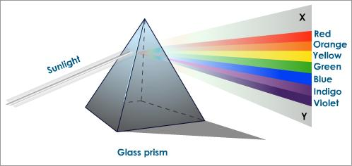
Visible Light
Visible: Our eyes detect visible light. Fireflies, light bulbs, and stars all emit visible light.

Slide 12
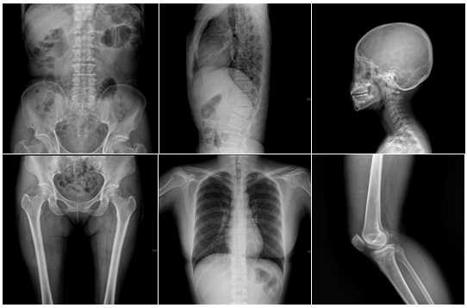
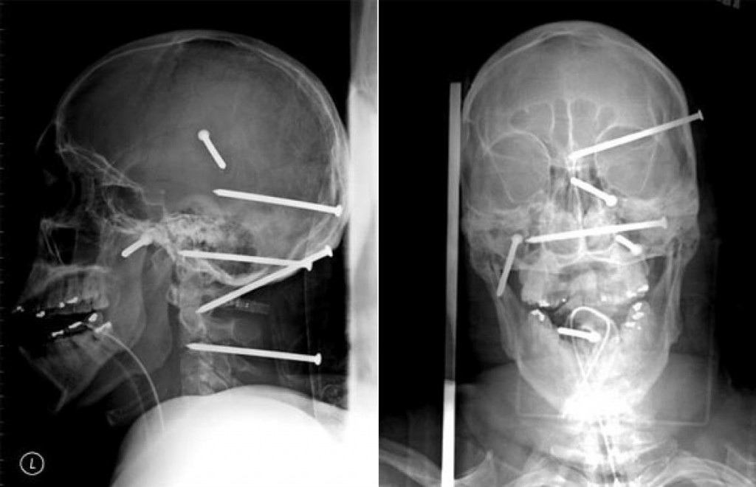
X-Rays
X-ray: A dentist uses X-rays to image your teeth, and airport security uses them to see through your bag. Hot gases in the Universe also emit X-rays.

Slide 13
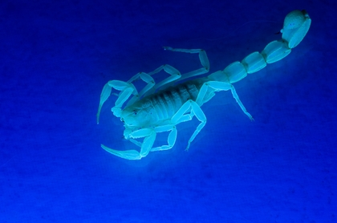
Ultraviolet Light
Ultraviolet: Ultraviolet radiation is emitted by the Sun and are the reason skin tans and burns. "Hot" objects in space emit UV radiation as well.

