Slide 1
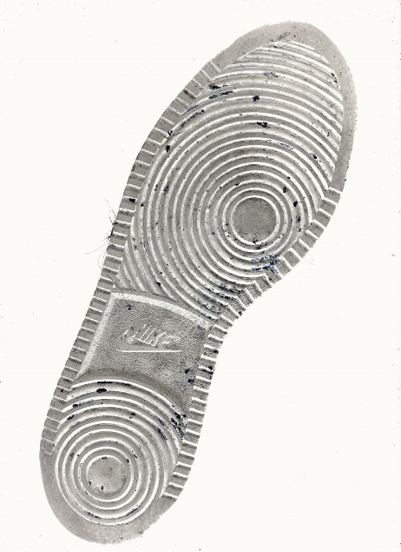
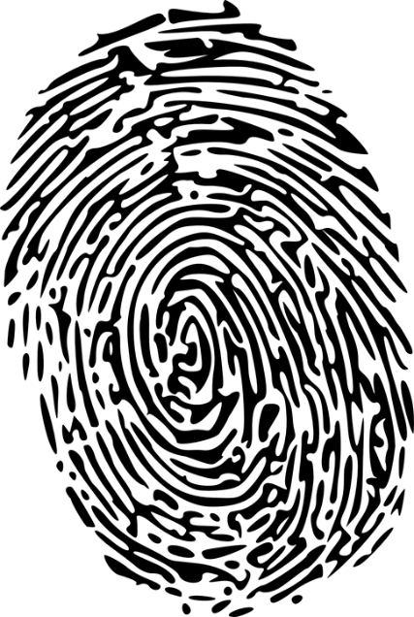
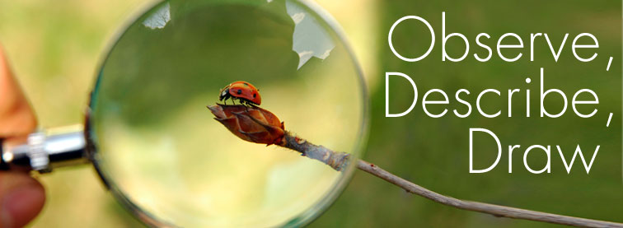
Chapter 1 Observation Skills
Mr. Davis

Slide 2
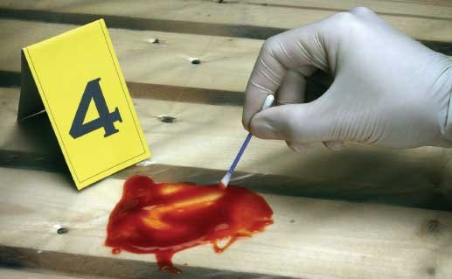

Slide 3
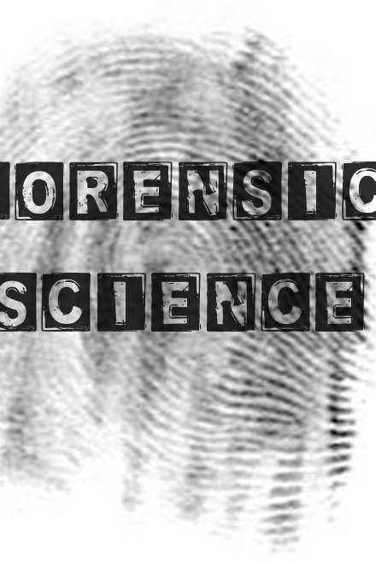
Forensic Science
the application of science to criminal and civil laws, mainly—on the criminal side—during criminal investigation, as governed by the legal standards of admissible evidence and criminal procedure.
Forensic scientists collect, preserve, and analyze scientific evidence during the course of an investigation. While some forensic scientists travel to the scene of the crime to collect the evidence themselves, others occupy a laboratory role, performing analysis on objects brought to them by other individuals. Forensic science can be used to identify and incriminate suspects, by studying fingerprints, blood.

Slide 5
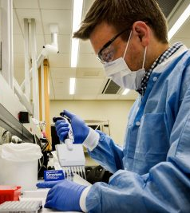
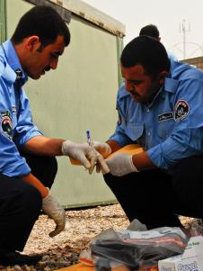
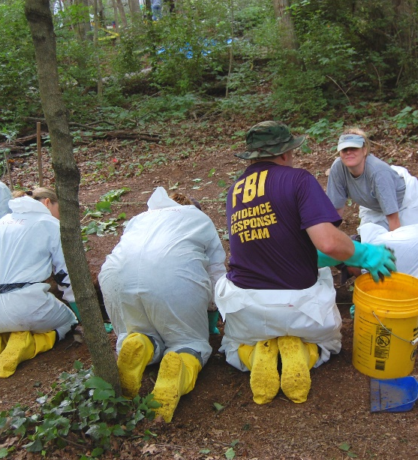
Data - facts and statistics collected together for reference or analysis.
Analytical skill - is the ability to visualize, articulate, conceptualize or solve both complex and uncomplicated problems by making decisions that are sensible given the available information.

Slide 6
Interpret to give or provide the meaning of; explain
Predict to declare or tell in advance; prophesy; foretell: to foretell the future; make a prediction

Slide 7
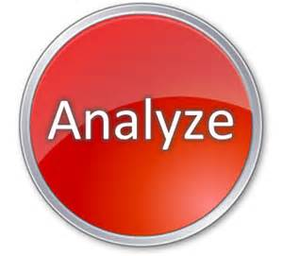
Analyze
to examine critically, so as to bring out the essential elements or give

Slide 8
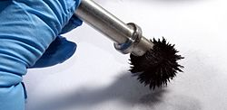
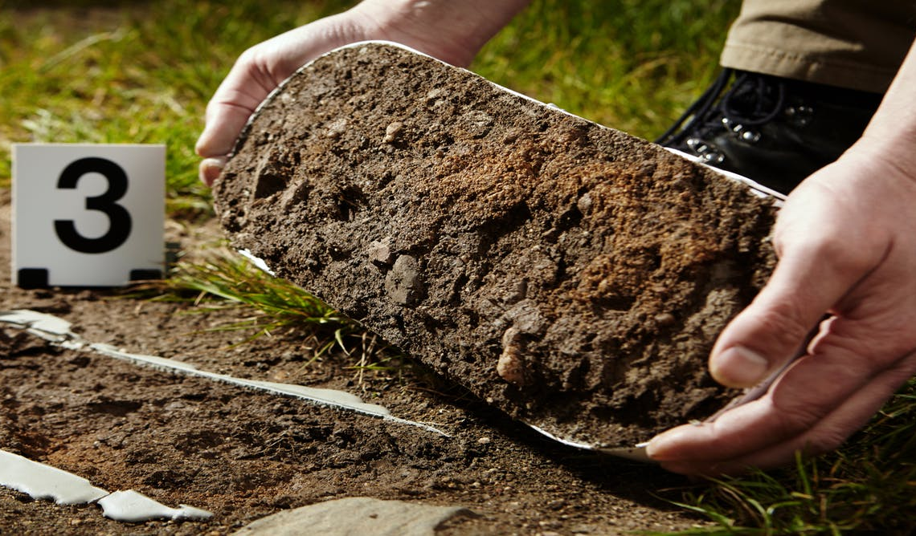
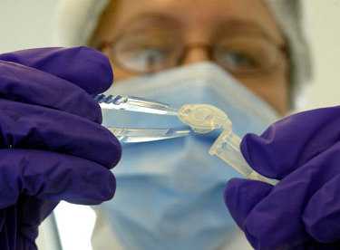
Evidence
Information drawn from personal testimony, a document, or a material object, used to establish facts in a legal investigation or admissible as testimony in a law court.
The available body of facts or information indicating whether a belief or proposition is true or valid.

Slide 9
Variables
The independent variable (Manipulated Variable) is typically the variable representing the value being manipulated or changed.
The dependent variable (Responding Variable) is the observed. The dependent variable is the variable that is being measured in an experiment

Slide 10
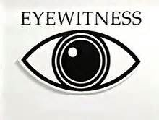
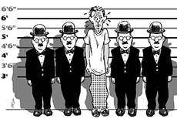
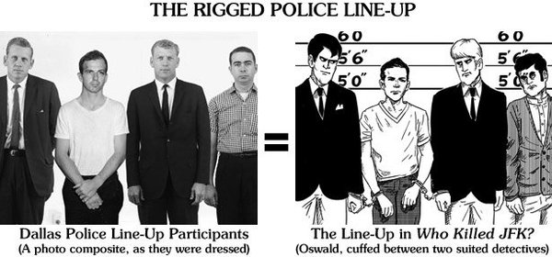
Eyewitness
a person who has personally seen something happen and so can give a first-hand description of it.
(observer, onlooker, witness, bystander, spectator, watcher, Passerby.)

Slide 11
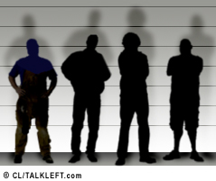
Eyewitness Accounts
Eyewitness – a person who has seen someone or something related to a crime and can communicate his or her observations.
A percipient witness or eyewitness is one who testifies what they perceived through his or her senses (ex: seeing, hearing, smelling, touching). That perception might be either with the unaided human sense or with the aid of an instrument, ex: microscope or stethoscope, or by other scientific means, ex: a chemical reagent which changes color in the presence of a particular substance.

Slide 12
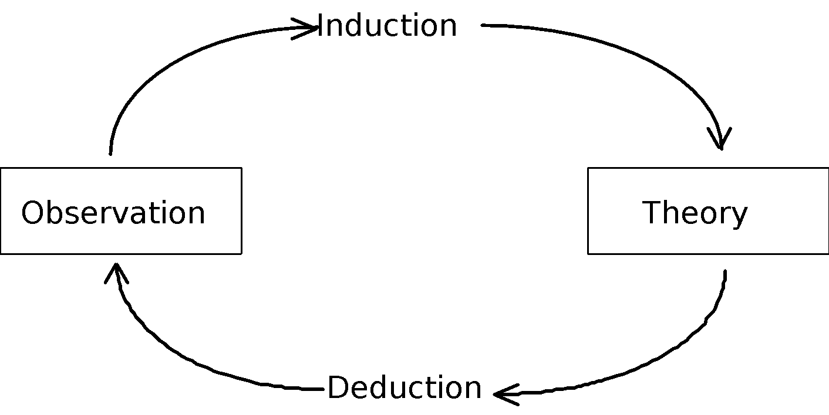
The Cycle of Science
Scientific reasoning must use both inductive and deductive reasoning

Slide 13
The Cycle of Science
Inductive reasoning – moving from specific observations to broader generalizations and theories
Begin with specific observations and measurements; then detect patterns and regularities
Formulate some tentative hypothesis that we can explore
Finally develop some general conclusions or theories

Slide 14
The Cycle of Science
Deductive reasoning – works from general to specific
Begin with creating a theory about a topic of interest
Narrow that down into a more specific hypothesis that we can test
Narrow that down even further when we collect observations to address the hypothesis
Test the hypothesis with specific data

Slide 15
How Scientists Reason
Scientists use the scientific method to generate hypotheses, create experiments to test them, comprehend patterns of data, and form theories.

Slide 16
What is an Observation?
A. When you observe, you become aware of something using one of your senses. Your five senses are smell, taste, sight, touch, and sound. I an observation you simply describe something as it appears. An observation is a statement describing a fact.

Slide 17
Observation Skills

Slide 18
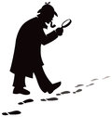
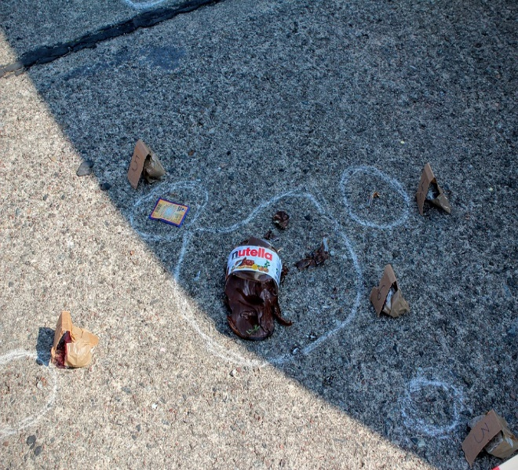
Qualitative Observation
B. Sometimes scientists must make very careful observations. Often their senses are not good enough. There are some things that cannot be observed using just your senses. (Examples: radiation, sound waves, planets, cells, etc.)

Slide 19
What is an inference?
A. When you infer, you make a mental judgment based on observations. Inferences cannot be directly observed. They require thought. For example, if you get up in the morning, look up at the sky and observe dark clouds, observe the air is cool and humid, and observe puddles on the ground, you might infer that it has recently rained. Note: you did not see rain; you decided that it rained based on your observations. An inference is a statement based on your interpretation of the facts.

Slide 20
What is an observation?
A. When you observe, you become aware of something using one of your senses. Your five senses are smell, taste, sight, touch, and sound. In an observation you simply describe something as it appears. An observation is a statement describing a fact.

Slide 21
Qualitative Observation
B. Sometimes scientists must make very careful observations. Often their senses are not good enough. There are some things that cannot be observed using just your senses. (Examples: radiation, sound waves, planets, cells, etc.)

Slide 22
What is an Inference?
A. When you infer, you make a mental judgment based on observations. Inferences cannot be directly observed. They require thought. For example, if you get up in the morning, look up at the sky and observe dark clouds, observe the air is cool and humid, and observe puddles on the ground, you might infer that it has recently rained. Note: you did not see rain; you decided that it rained based on your observations. An inference is a statement based on your interpretation of the facts.

Slide 23
Observations Vs. Inferences

Slide 24
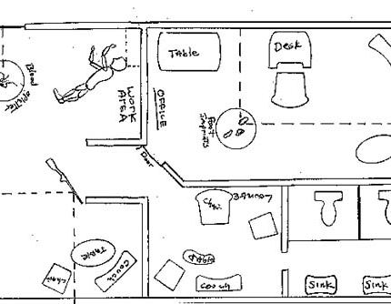
Observation vs. Perception
Observation – what a person perceives using his or her senses. Every moment we gather information though our senses: sight, taste, hearing, smell, and touch.
Perception – the way we view our surroundings may not accurately reflect what is really there. Perception is faulty, it is not always accurate, and it does not always reflect reality.

Slide 25
What observations can we make from these pictures?

Slide 27
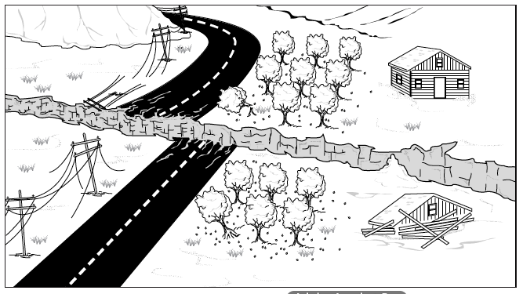
Inference Vs. Observations

Slide 28
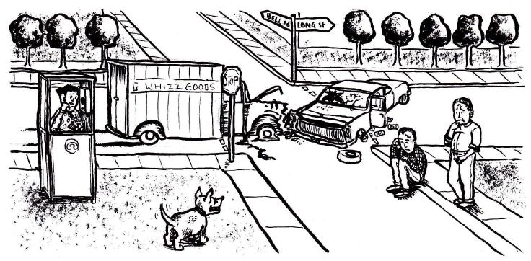
Inference Vs. Observations

Slide 29
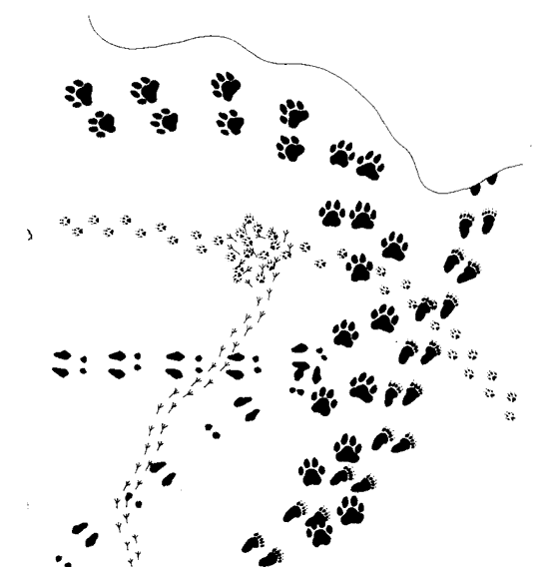
Tracks in the Snow
Observation 1
Observation 2
Observation 3

Slide 30
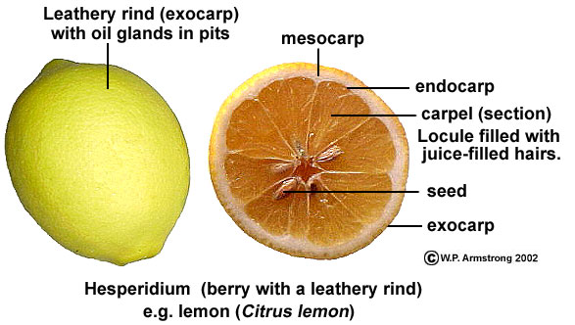
Parts of an Orange

Slide 31
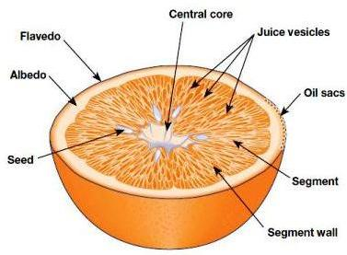
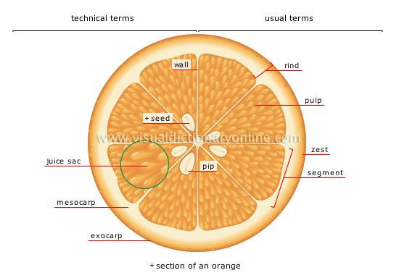
Parts of an Orange

Slide 32
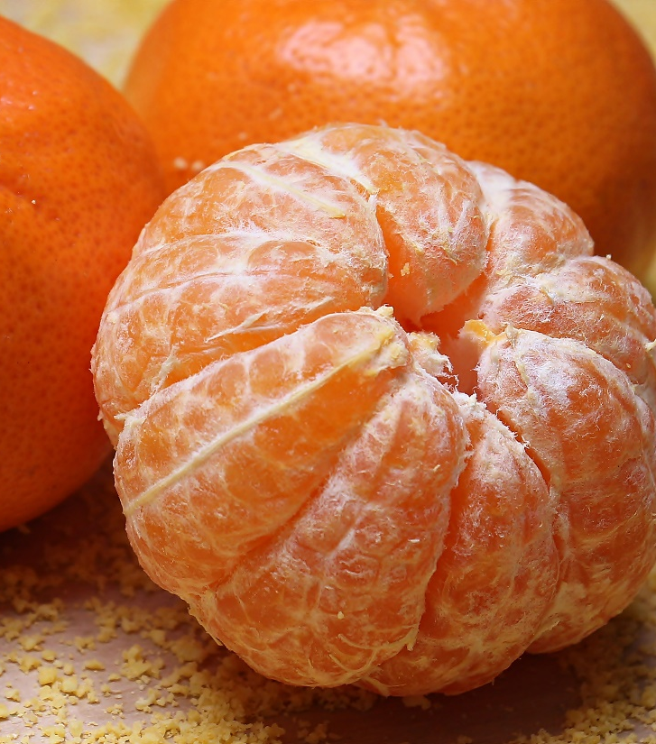
Description of an Orange
Firm, heavy for size, and have fine-textured skin. Oranges have bright, colorful skins. Orange may be ripe even though they may have green spots. Oranges can have bruised, wrinkled or have discolored skins; this indicates the fruit is old or has been stored incorrectly. Citrus scent.

Slide 33
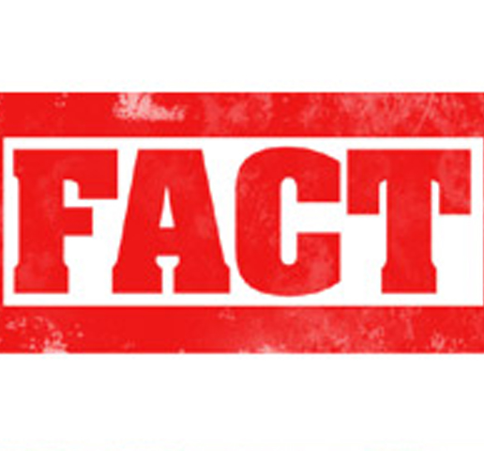
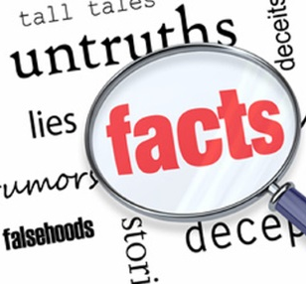
Fact
a statement or assertion of information that can be verified

Slide 34
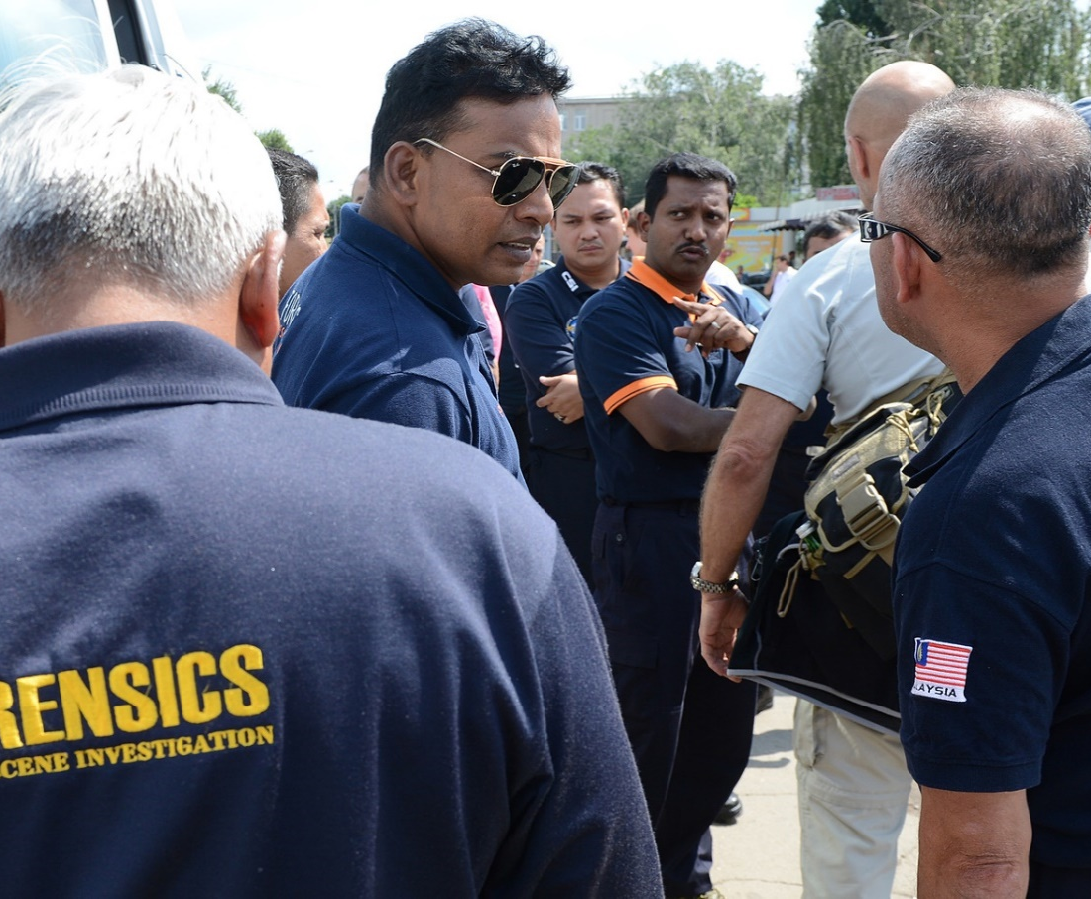
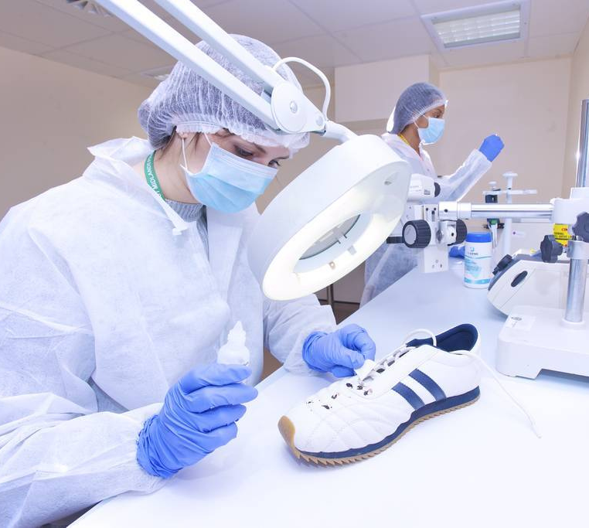
Investigate
Forensic investigation is the gathering and analysis of all crime-related physical evidence in order to come to a conclusion about a suspect. Investigators will look at blood, fluid, or fingerprints, residue, hard drives, computers, or other technology to establish how a crime took place.

Slide 35
How to be a Good Observer
We must make a conscious effort to examine our surroundings systemically.
We need to consciously observe everything, no matter how small or how familiar, no matter what our emotions or previous experiences.
We need to be careful that we concentrate first and foremost on gathering all the available information and leaving the interpretation until we have as much information as possible.
While observing, it is important to write down and photograph as much information as possible.

Slide 36
How to be a Good Observer

Slide 37
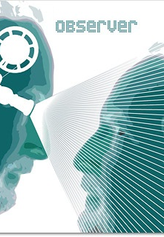
Observations By Witnesses
Observations by witnesses can be faulty, even though a witnesses may be utterly convinced of what he or she saw.
Witness testimony is generally presumed to be more reliable than circumstantial evidence. ... This can occur because of flaws in eyewitness identification (such as faulty observation and recollection, or bias), or because a witness is lying.

Slide 38
Eyewitnesses

Slide 39
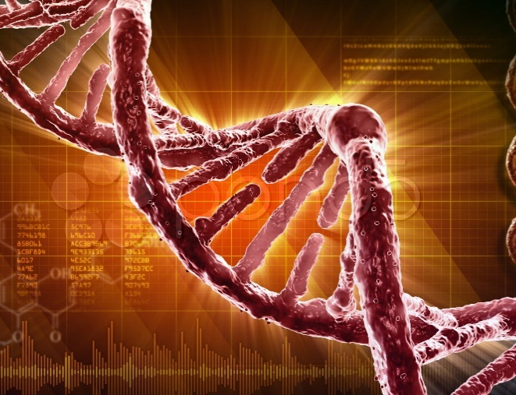
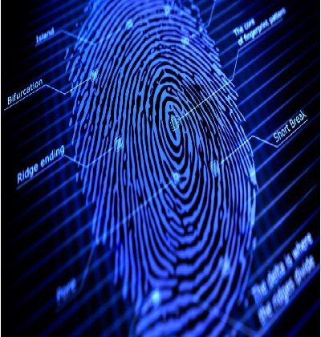
Basic of Forensic Science
Forensic science is strictly concerned
with uncovering evidence that stands as fact.
A forensic investigator is not interested in making the suspect look guilty; he or she
is only interested in collecting and examining physical evidence, reporting this to investigators, and possibly later to the courts.

Slide 40
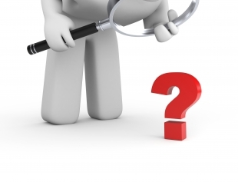
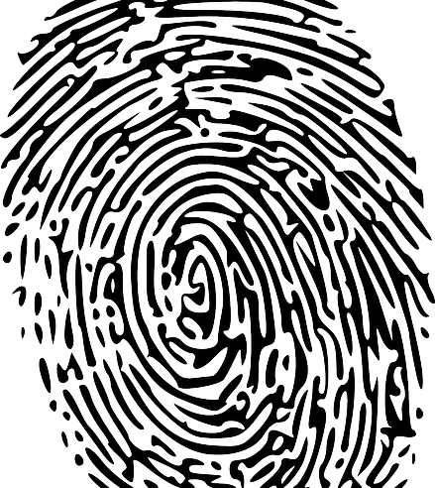
Basic Observations
A Forensic investigator has the ability to observe, interpret, and report observations clearly. Whether observing at a crime scene or examining collected evidence in the laboratory, the forensic investigator must be able to identify the evidence, record it, and determine its significance. The trained investigator collects all available evidence, without making judgments about its potential importance. Knowing which evidence is significant requires the ability to recreate the series of events preceding the crime.

Slide 41
Eyewitness Accounts
What we perceive about a person depends, in part, on his or her mannerisms and gestures. How a person looks, walks, stands, and uses hand gestures all contribute to our picture of his or her appearance.
Eyewitness accounts of crime-scene events vary considerably from one person to another. What you observe depends on your level of interest, stress, concentration, and the amount and kind of distraction that may be present. Our prejudices, personal beliefs, and motives also affect what we see. Memory fades with time, and our brains tend to fill in details that we feel are appropriate but may not be accurate. These factors can decrease an eyewitness’s reliability in reporting a crime. The testimony of an eyewitness can be very powerful in persuading the jury one way or another; knowing the shortcomings of eyewitness testimony is necessary to ensure that justice is carried out appropriately.

Slide 42
Good Observation Skills

