Slide 1
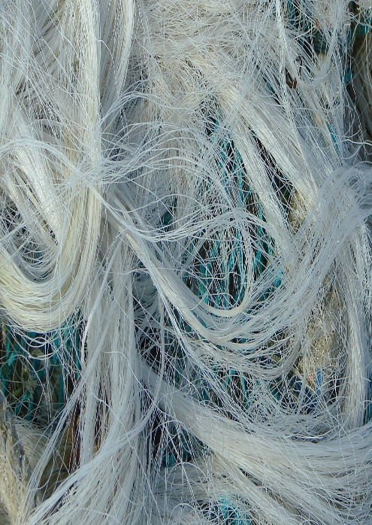
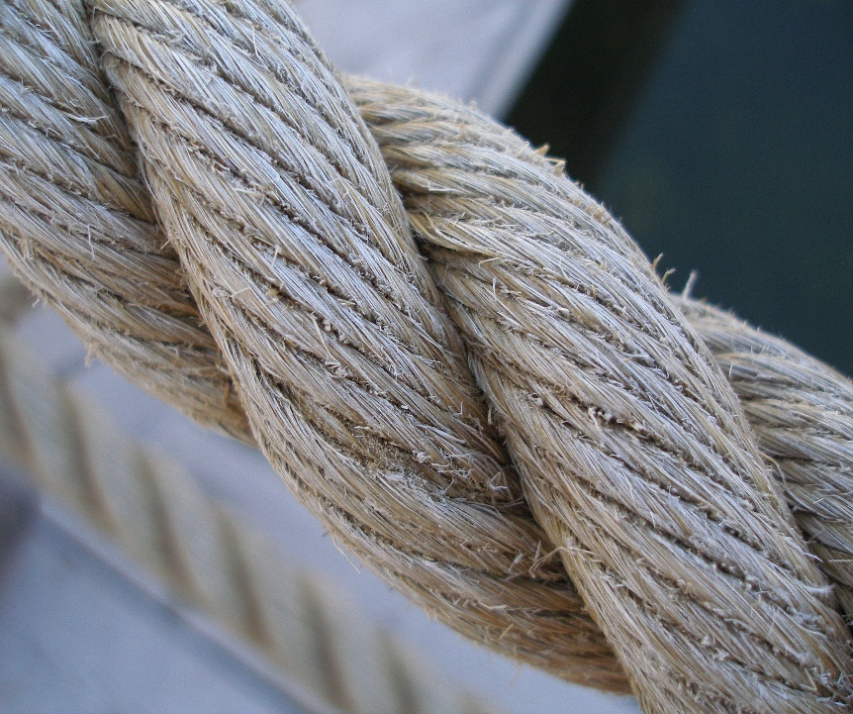
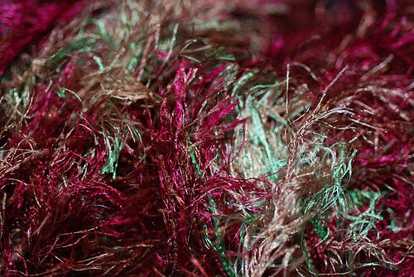
Circumstantial Evidence - (indirect evidence) evidence used to imply a fact but not prove it directly.
Circumstantial Evidence: No one other than the suspect and victim actually sees when circumstantial evidence is left at the crime scene.
Physical Evidence – bullets, weapons, fibers, tool marks
Biological Evidence – body fluids, hair, plant parts
This Photo by Unknown Author is licensed under CC BY-SA

Slide 2
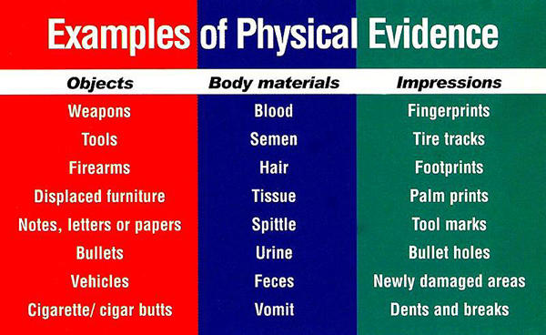
Physical Evidence
3

Slide 3
4. Chain of Custody - the documented and unbroken transfer of evidence.
Maintaining a proper “chain of custody” involves producing and maintaining written documentation which accompanies the evidence and provides an uninterrupted timeline showing the secure location of the evidence from the time that it was discovered until the present time.
Any transfer of evidence from one person or secure location to another must be documented. Maintaining this chain of custody helps to ensure that the evidence has not been contaminated or compromised in any way. If the proper “chain of custody” is not maintained, the breaking of the chain may well provide a potential reason for such evidence to be inadmissible in court.

Slide 4
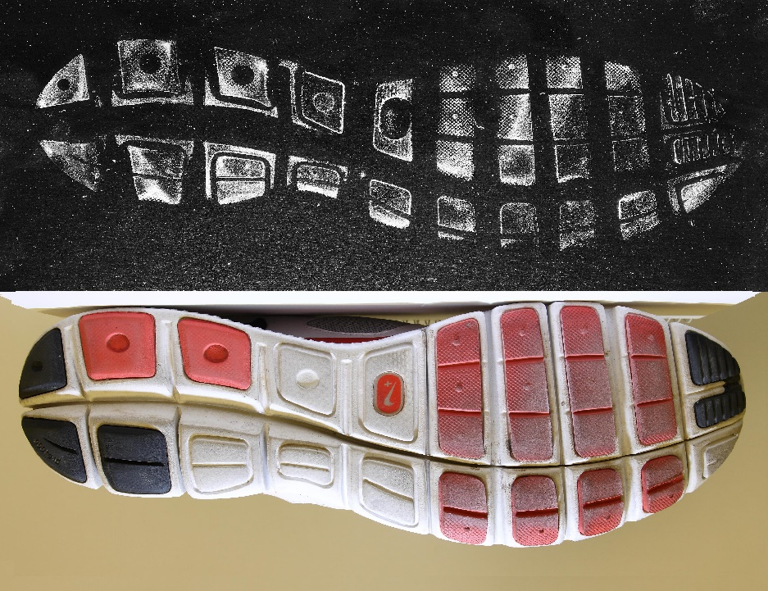
6. Class Evidence material that connects an individual or thing to a certain group.
Class Evidence narrows an identity to a group of persons or things. Knowing the ABO blood type of a sample of blood from a crime scene tells us that one of many persons with that blood type may have been there. It also allows us to exclude anyone with a different blood type.

Slide 5
7. Crime-Scene Investigation - a multidisciplinary approach in which scientific and legal professionals work together to solve a crime.

Slide 6
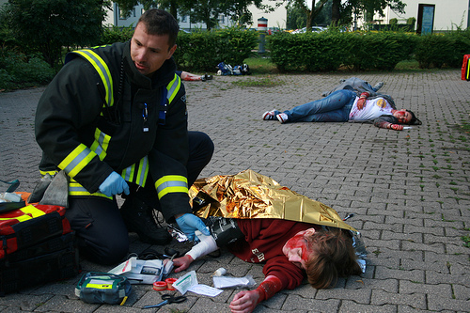
7. First Responder - the first police officer to arrive at a crime scene.

Slide 7
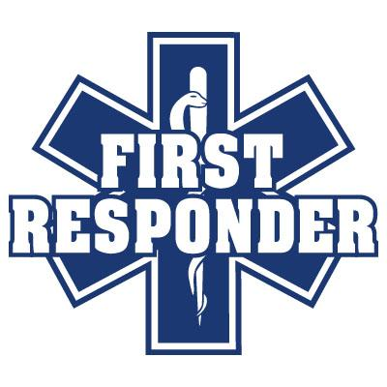
First Responder
8. The first responder(s), be they law enforcement officers, human rights officers or anyone else, play a critical role in the entire crime scene investigation process.
9. Their initial responsibilities are to preserve the integrity of the scene and the evidence. Furthermore, they are responsible for the early documentation of the crime scene, its evidence and all activities at the scene. As in the majority of cases first responders are non-forensic personnel, adequate training to carry out these tasks is critical.

Slide 8
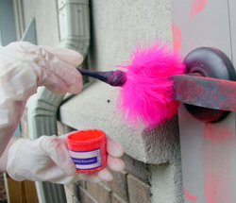
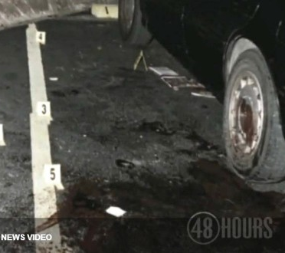
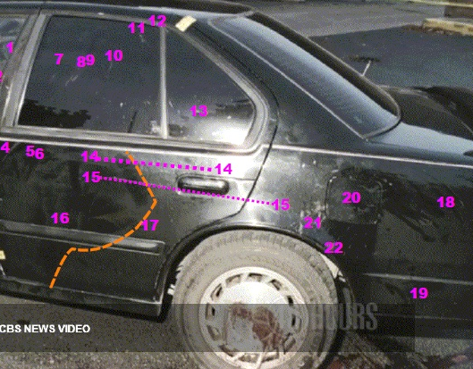
9. Primary Crime Scene - the location where the crime took place.

Slide 9
11. Primary Crime Scene
The place where the crime actually took place
May not necessarily be the location to where officers were called
Normally yield more usable evidence than secondary crime scenes
There will be only ONE primary crime scene

Slide 10
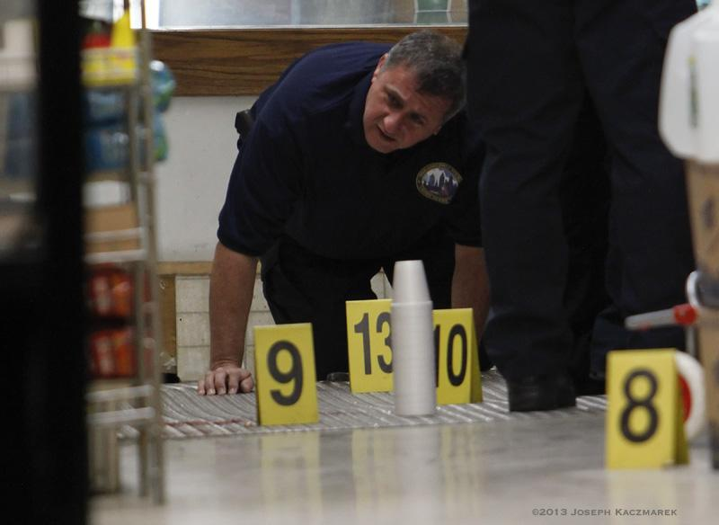
12. Secondary Crime Scene - a location other than the primary crime scene, but that is in some way related to the crime, where evidence is found.

Slide 11
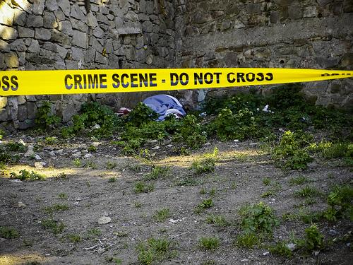
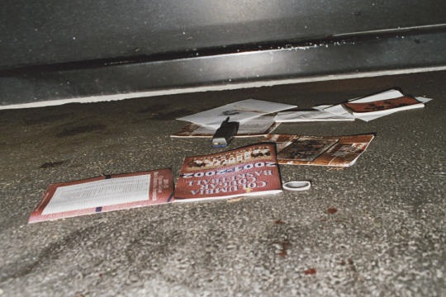
13. Crime-Scene Reconstruction - a hypothesis of the sequence of events from before the crime was committed through its commission.

Slide 12
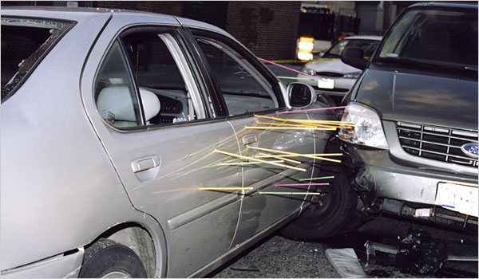
13. Crime Scene Reconstruction
Crime scene reconstruction is the process of determining or eliminating the events and actions that occurred at the crime scene through analysis of the crime scene pattern, the location and position of the physical evidence, and the laboratory examination of the physical evidence. Reconstruction not only involves scientific scene analysis, interpretation of the scene pattern evidence and laboratory examination of physical evidence, but also involves systematic study of related information and the logical formulation of a theory.

Slide 13
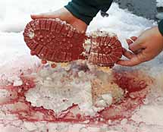
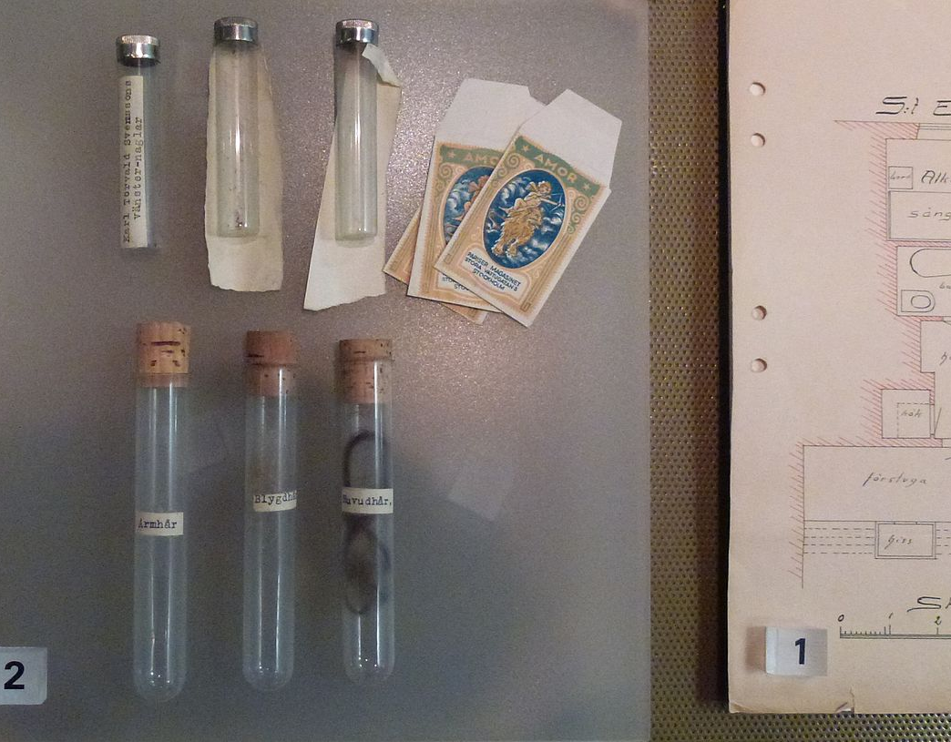
14. Direct Evidence –
evidence that (if true) proves an alleged fact, such as an eyewitness account of a crime.
Direct evidence establishes a fact. Examples of direct evidence are eyewitness statements and confessions.

Slide 14
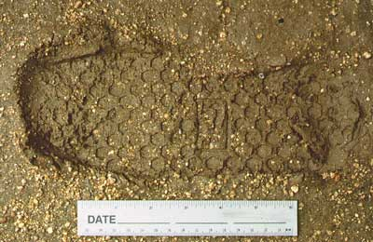
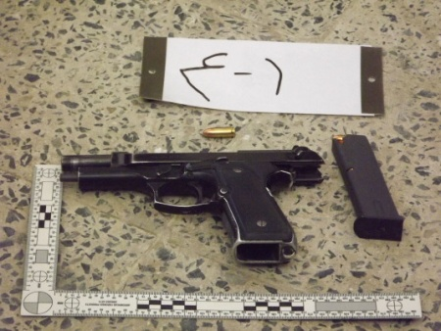
15. Individual Evidence - a kind of evidence that identifies a particular person or thing.
Individual Evidence narrows an identity to a single person or thing. Individual evidence typically has such a unique combination of characteristics that it could only belong to one person or thing, such as a fingerprint.

Slide 15
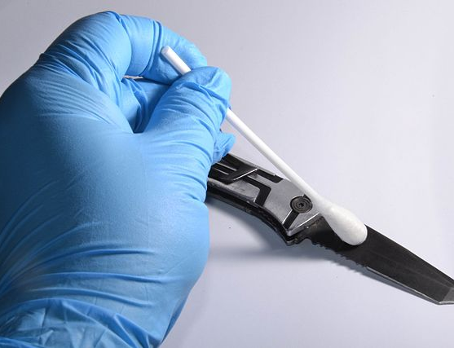
Types of Evidence
15.
Class Evidence – narrows an identity to a group of persons or things;
examples. blood type, shoe size, race, etc.
Individual Evidence – narrows an identity to a single person or thing; usually so unique it could only belong to one person.
Examples DNA

Slide 16
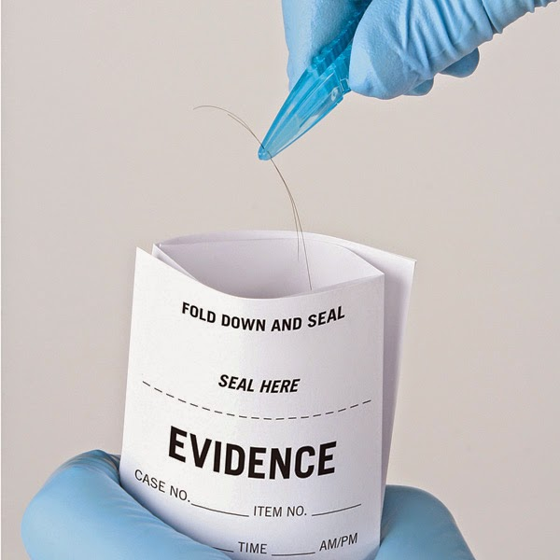
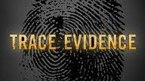
16. Trace Evidence - small but measurable amounts of physical or biological material found at a crime scene.
Trace evidence is a type of circumstantial evidence, examples of which include hair found on a brush, fingerprints on a glass, blood drops on a shirt, soil tracked into a house from shoes, and others.

Slide 17
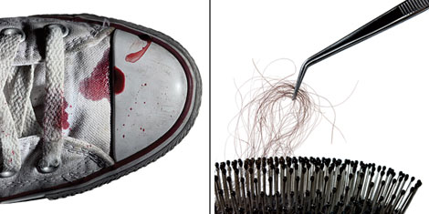
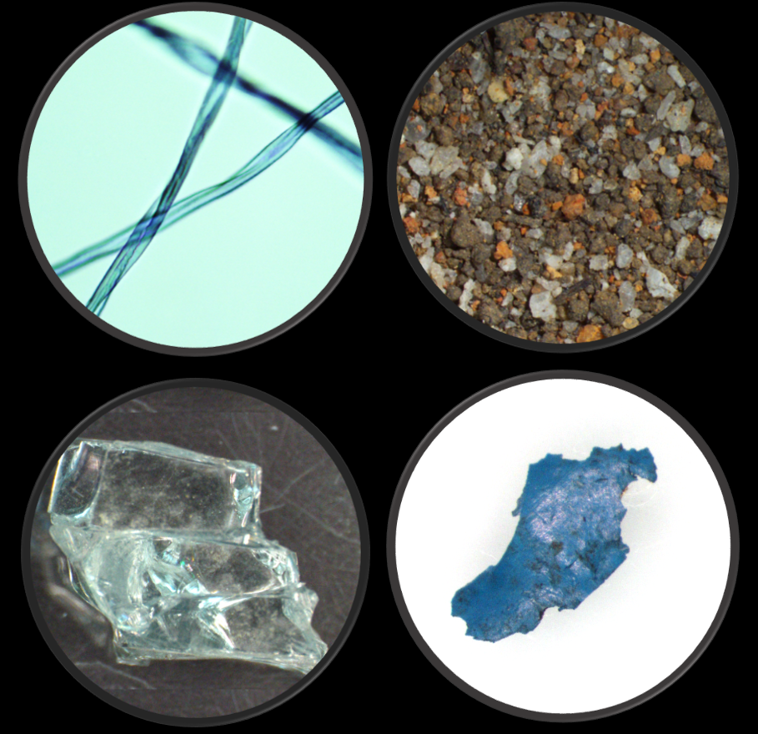
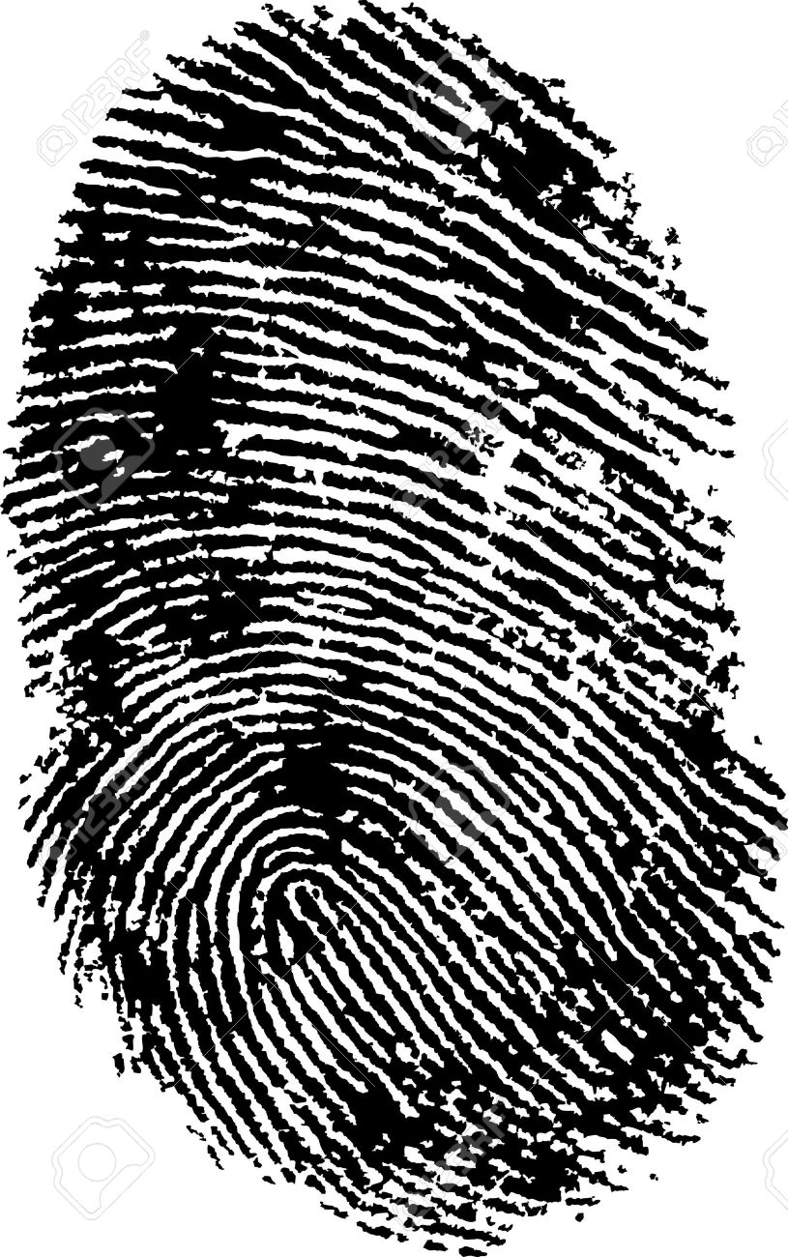
Examples trace evidence:
Pet hair on clothes
Hair on a brush
Fingerprints
Soil
Blood drops
Used facial tissues
Paint chips
Broken glass
Clothing fibers

Slide 18
20. Legal, ethical & human dignity considerations
Legal
While there are general principles related to crime scene investigations, local laws, rules and regulations govern many activities of the crime scene investigation and forensic process. They relate to issues such as how to obtain authority to enter the scene, to conduct the investigation, to handle evidence (e.g. the type of sealing procedure required) and to submit physical evidence to the forensic laboratory. They ultimately determine the admissibility of the evidence collected at the crime scene.

Slide 19
Legal, ethical & human dignity considerations
Ethics and human dignity
20. Regardless of the local laws, rules and regulations, codes of professional conduct outline ethical obligations of personnel working at crime scenes. Such codes typically stress the importance of acting with care and professionalism (due diligence), objectivity (“treat evidence for what it shows not what you think it shows”), open-mindedness and impartiality (“you may not be independent from the police but you are impartial”).

Slide 20
21. Datum point - A point which serves as a reference or base for the measurement of other quantities. Any reference point of known or assumed coordinates from which calculation or measurements may be taken.
22. Triangulation – is the process of determining the location of a point by forming triangles to it from known points.

Slide 21
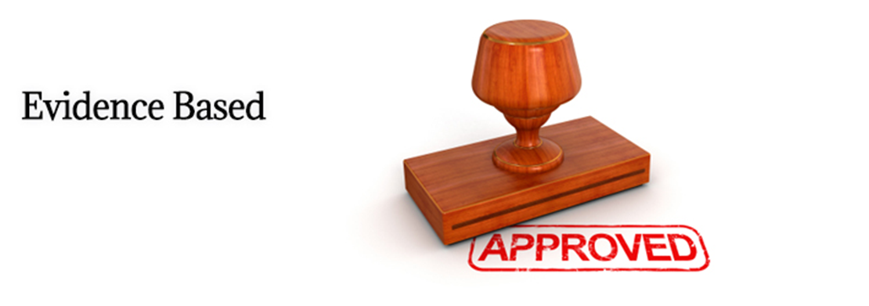
23 Transient evidence is term used in criminal forensics to indicate elements of physical evidence that might be expected to degrade or disappear within a particular time frame.

Slide 22
24.

Slide 23
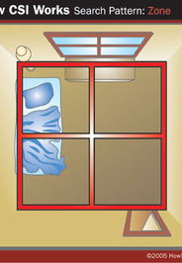
25.
(4) Types of Search Patterns
1. Zone – building or other structure – homicide, home invasion, robbery, or sexual assault. In this type of search method, the person in charge (CSI) splits the crime scene into pieces/sectors and a team member is given a piece of the crime scene each. The team then swap and recover the areas to ensure no evidence has been missed.

Slide 24
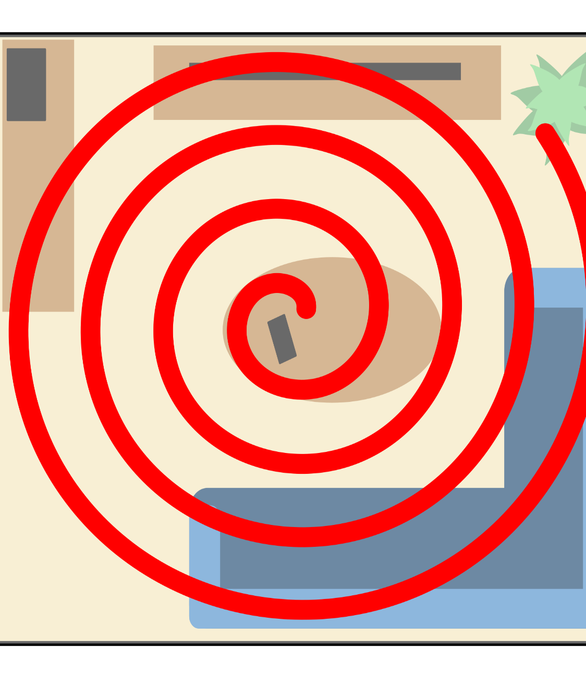
Spiral Search Pattern
2. Spiral – large area – no barriers, open field, kidnapping, homicide.
The Outward Spiral - The investigators at the crime scene start at the center of the scene and work there way outward in a spiral to the edge.
The Inward Spiral - This is the opposite to the outward spiral the investigators start at the edge of the scene and walk to the center in a spiral.

Slide 25
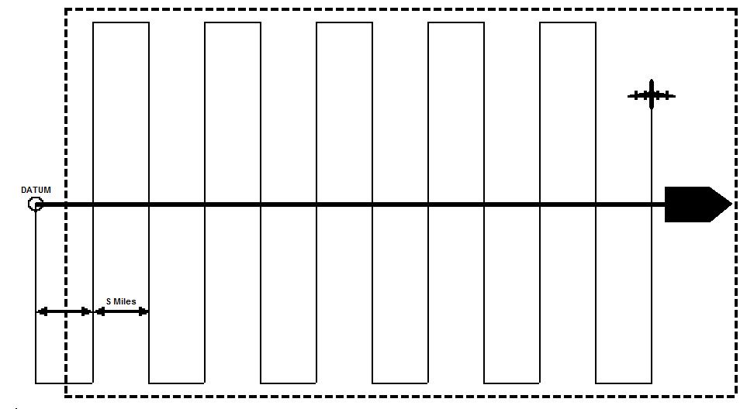
Line Search Pattern
3. Line Search – large area looking for a large object in a single direction – site of plane crash. This search pattern is quite straightforward. the members of the team form a line and walk all at the same speed from one end of the crime scene to the other.

Slide 26
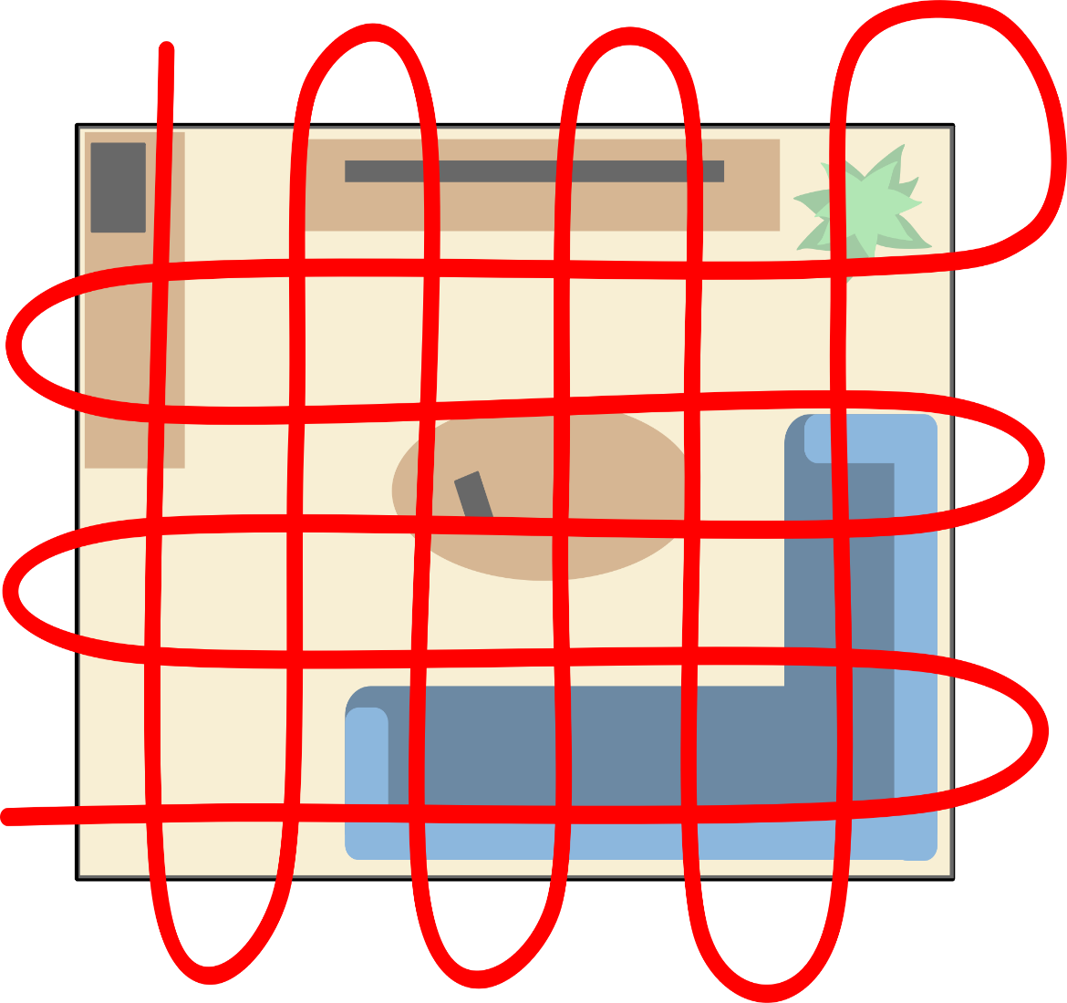
Grid Search Pattern
4. Grid – large area looking for a large object in two directions – arson investigation. This search method is similar to the parallel but is done from different bearings on a 90°degree angle. For example, if the search was from the left to right (West to East) it would then be done from the bottom to top (South to North.)

Slide 27
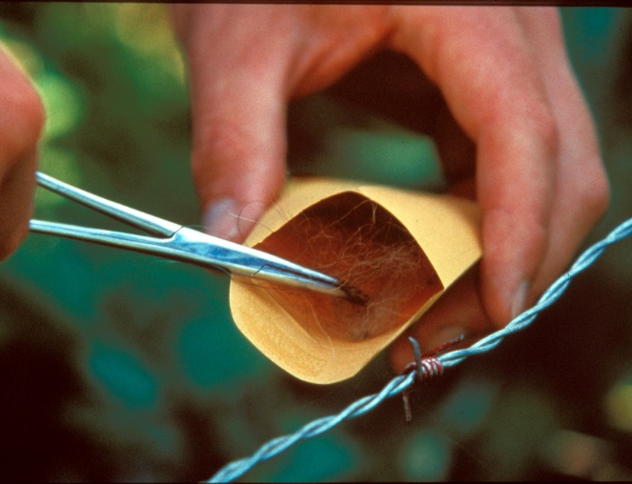
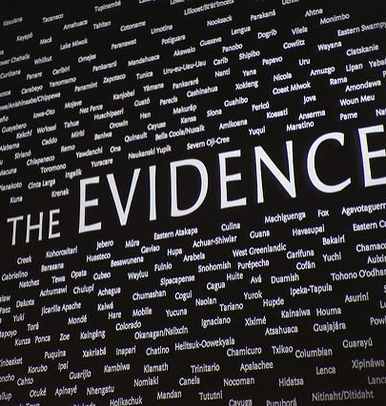
Evidence Collection
26. The three goals of the Crime Scene Investigation Evidence Collection are:
Recognize the evidence
Document the evidence
Interpret the Evidence

Slide 28
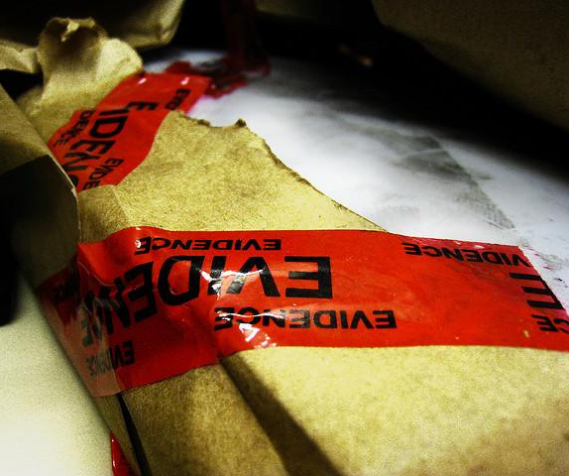
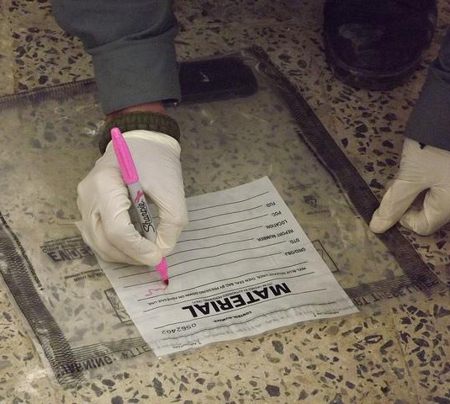
27. Evidence Collection Team
The scene location: interior, exterior, within a vehicle.
The condition of the evidence: either fragile or stable.
Weather conditions which might affect the scene or evidence within.
Scene management considerations which may alter or contaminate the evidence.
Additional processing techniques that may need to be conducted at the scene with specialized personnel.

Slide 29
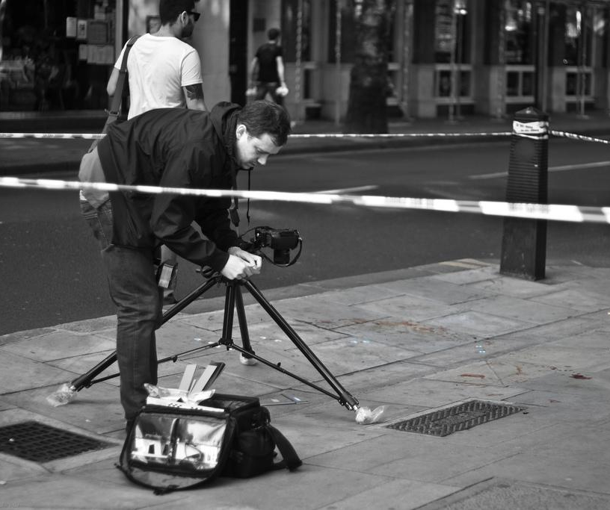
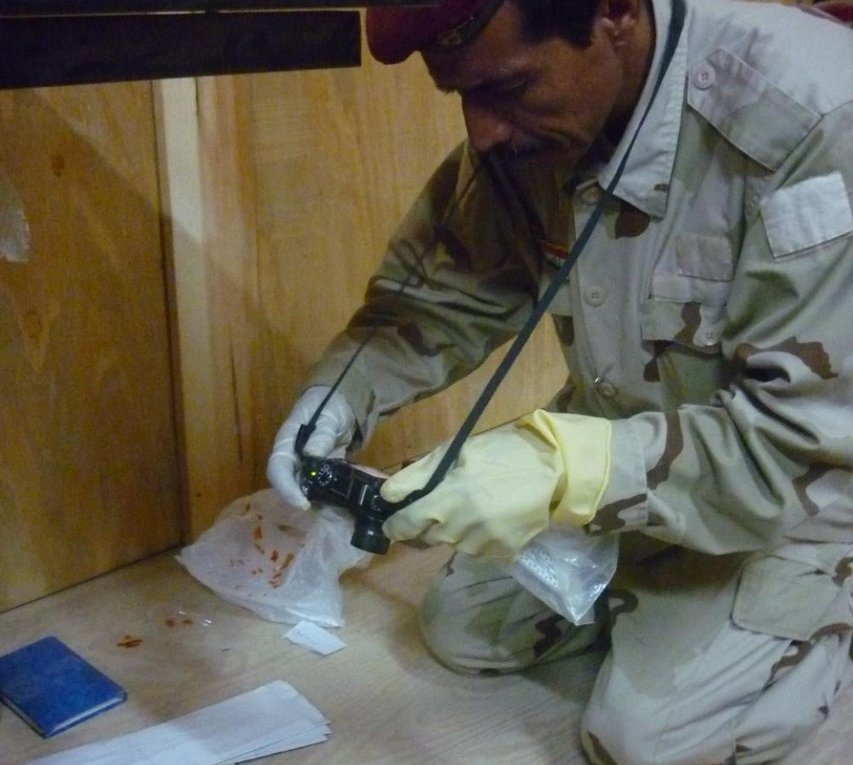
28. Crime Scene Photographer
Takes photos of the overall area of the crime scene & close-ups photos
Crime scene photos from different angles & distances
Photos noting all exits, departures, and entrance points
Photos should include stationary objects used as reference points

Slide 30
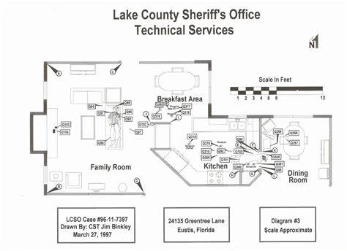
29. A crime scene sketch is a rough drawing/scale model drawing composed by an investigating officer at the crime scene. The crime scene sketch is a simple line drawing that indicates the position of the body in relation to fixed and significant items in the scene (ex: a door, table or window)

Slide 31
29. What is a crime scene sketch?
A sketch whereby the walls (and sometimes the ceiling) are flattened around the floor outline to illustrate the relationship of evidence items in the scene (e.g., bullet hole locations, blood spatter patterns). A rough drawing (not to scale) to show the relative elevations of pertinent locations at or near the crime scene.

Slide 32
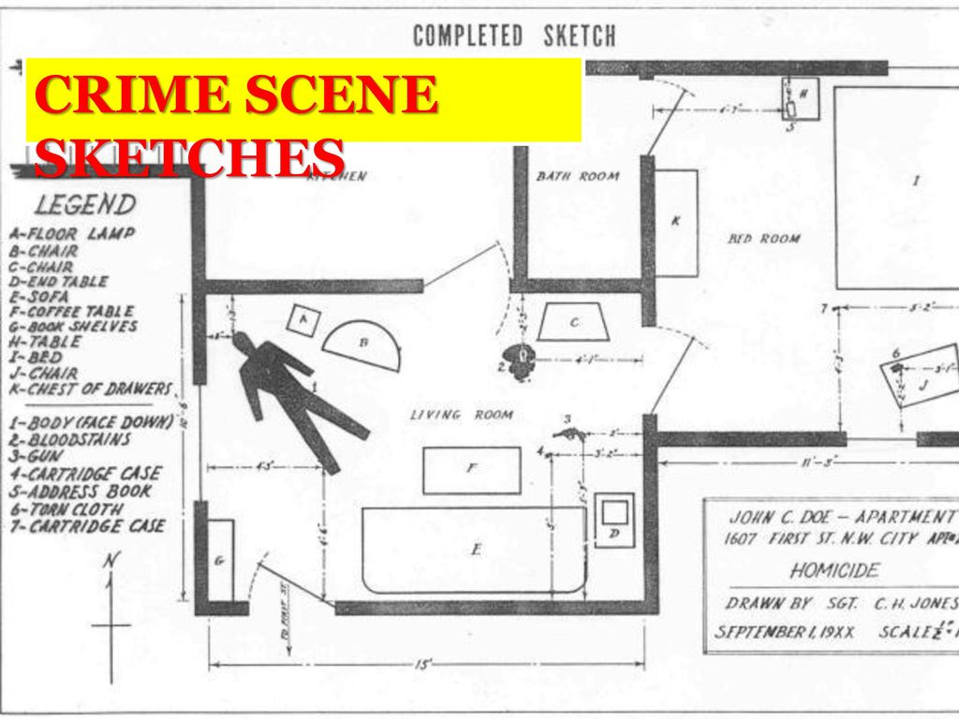
What is a crime scene?
A sketch whereby the walls (and sometimes the ceiling) are flattened around the floor outline to illustrate the relationship of evidence items in the scene (e.g., bullet hole locations, blood spatter patterns).

Slide 33
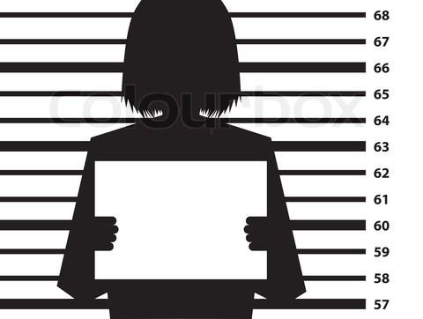
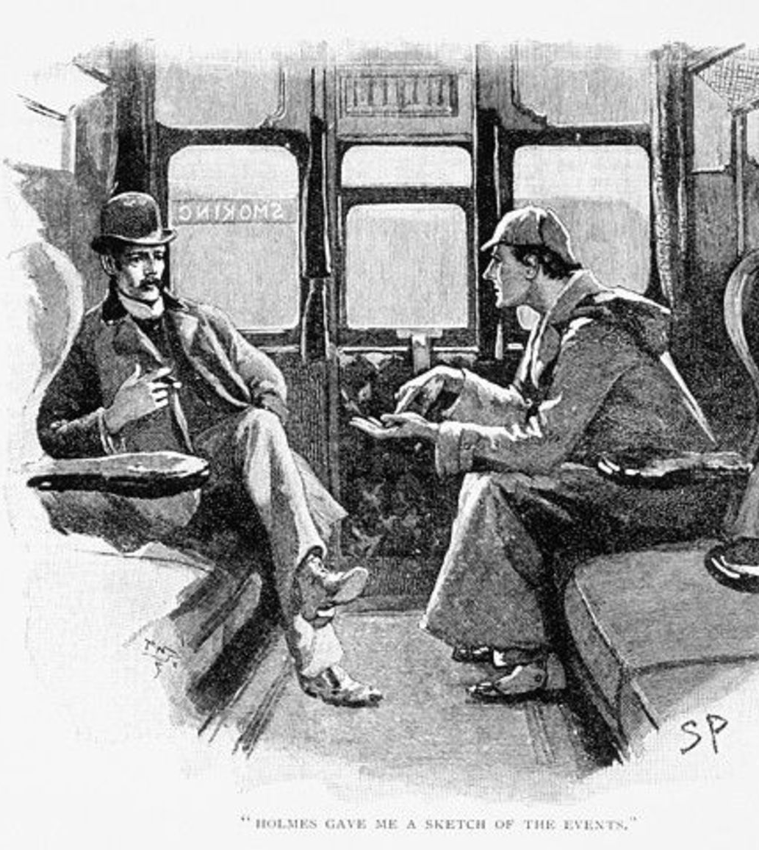
30. Types of Crime Scene Sketches
Overview sketch – consists of a bird’s-eye-view or floor plan sketch of the scene. This is the most common type of sketch and consists of items on the horizontal plane.
Elevation sketch – portrays a vertical plane rather than a horizontal plane. Examples include bloodstain patterns on vertical surfaces such as walls or cabinetry and bullet holes through windows.
Exploded view or cross-projection sketch – consists of a combination of the first two sketches. It is similar to a floor plan except the walls have been laid out flat and objects on them have been shown in their relative positions.
Perspective sketch – depicts the scene or item of interest in three dimensions. It is the most difficult sketch to create and requires some artistic skill.

Slide 34
31. Sketch Artist
Labeling the Sketch
Ambient Temperature, details related to the surroundings
Address or location of scene.
Case Number
Date sketch was made and by whom.
A key to identify the different objects in the sketch.
An arrow to show the direction of north.
Scale used for the sketch or the statement “Not to Scale”.

