Slide 1
Types of Crime Scene Evidence
Edwin P. Davis, M.Ed.

Slide 2
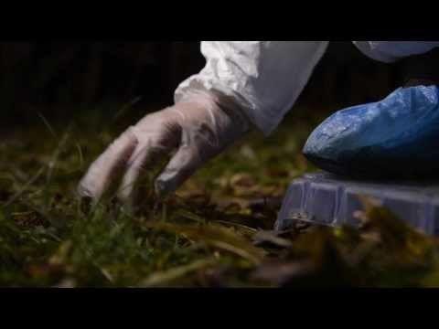
Introduction to Crime Scenes

Slide 3
Types of Evidence

Slide 4
Forensic Evidence Documentation

Slide 5
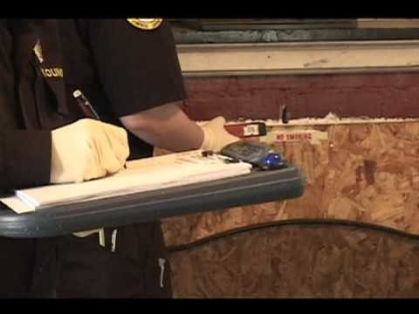
Crime Scene Processing

Slide 6
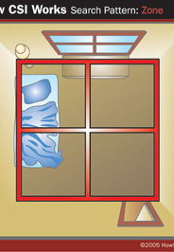
4 Types of Search Patterns
1. Zone – building or other structure – homicide, home invasion, robbery, or sexual assault. In this type of search method, the person in charge (CSI) splits the crime scene into pieces/sectors and a team member is given a piece of the crime scene each. The team then swap and recover the areas to ensure no evidence has been missed.

Slide 7
Spiral Search Pattern
2. Spiral – large area – no barriers, open field, kidnapping, homicide.
The Outward Spiral - The investigators at the crime scene start at the center of the scene and work there way outward in a spiral to the edge.
The Inward Spiral - This is the opposite to the outward spiral the investigators start at the edge of the scene and walk to the center in a spiral.

Slide 8
Line Search Pattern
3. Line Search – large area looking for a large object in a single direction – site of plane crash. This search pattern is quite straight forward. the members of the team form a line and walk all at the same speed from one end of the crime scene to the other.

Slide 9
Grid Search Pattern
4. Grid – large area looking for a large object in two directions – arson investigation. This search method is similar to the parallel but is done from different bearings on a 90°degree angle. For example, if the search was from the left to right (West to East) it would then be done from the bottom to top (South to North.)

Slide 10
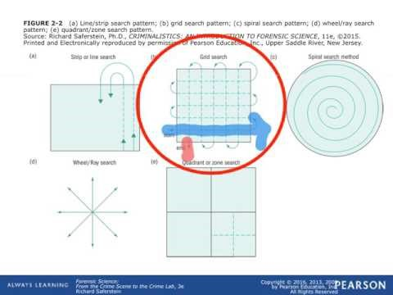
Crime Scene Search Patterns

Slide 11
Faulty, DWI Crime Evidence

