Slide 1
Unit 1: Motion
Physics and Movement

Slide 2
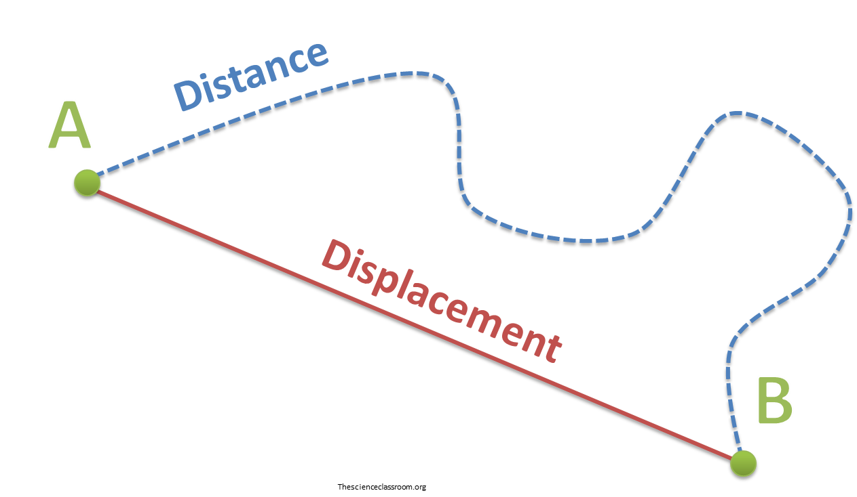
Distance vs. Displacement
Distance: How far an object moves
Displacement: Distance and direction of an object moves from the starting point.
(How far you are from where you started)
Usually measured in meters (m)

Slide 3
Distance vs. Displacement
Example: Diego travels 3 miles east, 5 miles south, 3 miles west, and 1 mile north.
Draw a diagram to show his route:
What distance did the car travel?
What was the car’s displacement?

Slide 4
Frame of Reference
Example 1: A blue Camaro and a black Charger are traveling down the street at 45 mph.
For the driver of the blue Camaro, does the black Charger appear to be moving?
If you are standing by the side of the road, how fast does the Charger appear to be moving?

Slide 5
Frame of Reference
Example 2: A yellow Challenger is speeding down a neighborhood street at 57 mph. A police car is approaching the car and is traveling at a constant speed of 42 mph.
How fast is the police car traveling relative to the ground?
How fast is the police car traveling relative to the Challenger?

Slide 6
Frame of Reference
Practice 1: What would be the best frame of reference to use to determine how fast a bus is moving?
Other cars near the bus
The passengers on the bus
Parked cars on the side of the road
Pedestrians walking down the same street

Slide 7
Frame of Reference
Practice 2: A bus is traveling down the street. Does the bus appear to be moving…
Relative to passengers seated on the bus? _______
Relative to a pedestrian waiting to cross the street? _______
Relative to a bug stuck on the bus’s window? _______
Relative to a passenger walking to the front of the bus? _______

Slide 8
Frame of Reference
Practice 3: A girl is standing by the side of the road.
Give an example of a frame of reference in which she is not moving.
She is not moving relative to __________
Give an example of a frame of reference in which she is moving.
She is moving relative to _____________

Slide 9
Frame of Reference
Practice 4: A fish is swimming upstream at 6 mph.
How fast is the fish swimming?
If the current is moving at 2 mph how fast is the fish traveling relative to the shore?
If the fish reversed direction and was traveling downstream at 6 mph, what would its speed be relative to the shore?

Slide 10
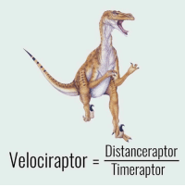
Speed
Speed: The distance an object travels per unit time.
For example: miles per hour or mph
In physics we use meters per sec or m/s.

Slide 11
Units
The unit for speed is meters/sec (m/s)
The unit for distance is usually meters (m) but may also be kilometers (km)
The unit for time is usually seconds (s) but can also be hours (h)

Slide 12
How do you calculate speed and velocity?
Speed is calculated by taking the ratio of distance traveled by an object during a time interval to that interval.
Speed is a scalar quantity that refers to "how fast an object is moving." Speed can be thought of as the rate at which an object covers distance. A fast-moving object has a high speed and covers a relatively large distance in a short amount of time.

Slide 14
Speed Example 1
A car traveling at a constant speed covers a distance of 750 m in 25 s. What is the car’s speed?
s = ?
d = ?
t = ?

Slide 15
Speed Example 2
An ant travels 75 cm in 5 s. What is the ant’s speed?
s = ?
d = ?
t = ?
s = d/t =

Slide 16
Speed Example 3
If it took 6.5 seconds traveling at 4 m/s how many meters were traveled?
s = ?
d = ?
t = ?

Slide 17
Speed Example 4
If a car travels 120 km/h and completes 720 km, how long did the total trip take?
s = ?
d = ?
t = ?

Slide 19
Speed vs. Velocity
We know what speed is, but what is velocity?
Velocity is speed with direction.
Speed – 15 m/s
Velocity – 15 m/s north

Slide 20
Velocity
Velocity, on the other hand, is found by taking the ratio of a displacement interval during a time to that time taken.
V = d/t
In the equation V = d/t, V is the velocity, d is the distance, and t is the time.

Slide 21
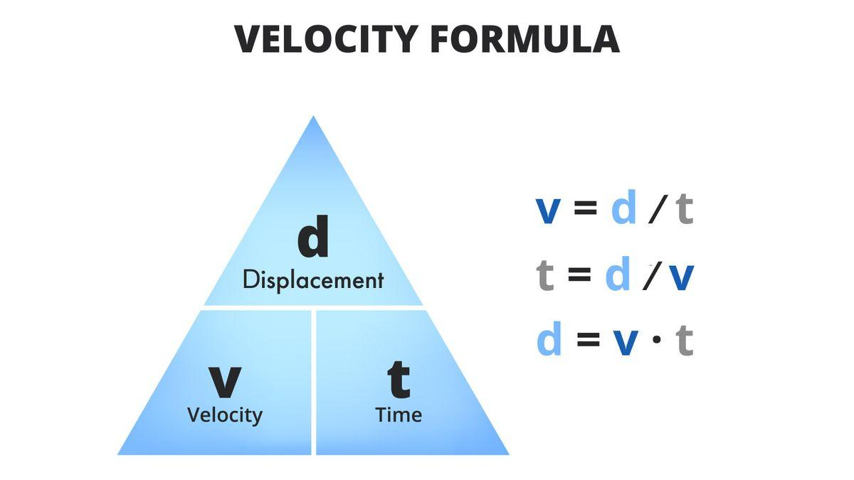

Slide 23
Resultant Velocity
Example 1: A duck paddles down a river at 1.4 m/s. It is swimming against a current going 1.1 m/s. What is the resultant velocity of the duck?

Slide 24
Resultant Velocity
Example 2: A bus is traveling at 12 m/s east.
If DeAnthony, a passenger on the bus, walks towards the front of the bus at a rate of 1.5 m/s what is the resultant velocity of DeAnthony?
After saying hi to the bus driver, he turns around and walks back toward the rear of the bus at the same speed as before. What is his resultant velocity now?

Slide 25
Resultant Velocity
Practice 1: A boat sails northwest at 6 m/s. If the current flows southeast at 2 m/s, what is the resultant velocity of the boat?
Practice 2: Madeline and Dekayla are on a long road trip traveling at 90 km/h. Dekayla is sitting in the front seat of the car and Madeline is in the back seat. Both girls decide to play catch to pass the time while traveling. When Dekayla passes the ball to Madeline at a speed of 5 km/h, what is the resultant velocity?

Slide 26
Resultant Velocity
Practice 3: An airplane flies south at 250 m/s with a tailwind of 30 m/s (a tailwind is in the same direction as the plane’s velocity). What is the resultant velocity?
Practice 4: An airplane flies east at 200 m/s with a headwind of 15 m/s. What is the resultant velocity?

Slide 27
Acceleration

Slide 28
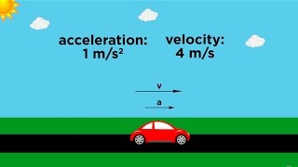

Slide 29
Acceleration, Speed and Velocity
Acceleration is the rate of change of velocity. When the velocity of an object changes, the object is accelerating.
A change in velocity can be either a change in how fast something is moving, or a change in the direction it is moving.
Acceleration occurs when an object changes its speed, it's direction, or both.
Physical Science
‹#›

Slide 30
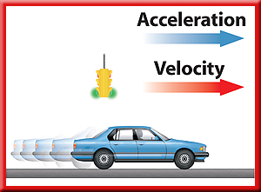
Speeding Up and Slowing Down
If the acceleration is in the same direction as the velocity,
the speed increases and the acceleration is positive.
Physical Science
‹#›

Slide 31
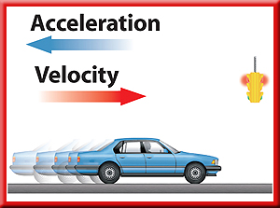
Speeding Up and Slowing Down
If the speed decreases, the acceleration is in the opposite
direction from the velocity, and the acceleration is negative.
Physical Science
‹#›

Slide 32
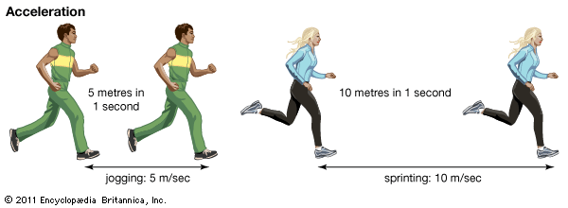
Calculating Acceleration
Then the change in velocity is:
Physical Science
‹#›

Slide 33
Calculating Acceleration
Using this expression for the change in velocity, the acceleration can be calculated from the following equation:
Physical Science
‹#›

Slide 34
Acceleration
Most of you have heard of acceleration before.
If a car is at a stop light, and the light turns green, the car is going to start at 0 m/s and increase speed.
Acceleration: is the rate of change of velocity.

Slide 35
Acceleration
Acceleration can be either positive, if an object is speeding up, or negative, if the object is slowing down.

Slide 36
Acceleration and Direction
If the velocity changes, then the acceleration changes.
There are two ways to change velocity:
1) increases or decrease speed
2) change direction.
If an object is traveling at a constant speed but changes direction, then it is accelerating.

Slide 37
Acceleration and graphs
If acceleration is positive, then the slope of the line will be positive.
If acceleration is negative, then the line will have a negative slope.
If there is no acceleration due to the object moving at a constant velocity, then the line will be flat with no slope.

Slide 39
Calculating Acceleration

Slide 40
Formula Time!
The delta symbol ∆ is used in science and math to represent change.
To calculate the acceleration of an object, you must first know the change in velocity (∆v) or speed.
To find ∆v you must know both the initial velocity (v_{i}) and the final velocity (v_{f}).
Once you have calculated the ∆v, you can calculate the acceleration of an object.

Slide 41
Acceleration
The unit for acceleration is m/s².
a = Δν
t

Slide 42
Acceleration Triangle
t

Slide 43
Calculation acceleration: Example 1
What is the acceleration of an object that goes from 0 m/s to 60 m/s in 5 s?
a = ?
ν_{i} = ?
ν_{f} = ?
t = ?

Slide 44
Calculation acceleration: Example 1
What is the acceleration of an object that goes from 0 m/s to 60 m/s in 5 s?
a = ?
ν_{i} = 0 m/s
ν_{f} = 60 m/s
t = 5 s

Slide 45
The first step is to calculate Δν. We do this by subtracting ν_{i} from ν_{f}.
Δν = ν_{f} – ν_{i}
Δν = 60 m/s – 0 m/s = 60 m/s
Once you have calculated the Δν then you can solve the problem by plugging in the rest of the numbers and solving.

Slide 46
What is the acceleration of an object that goes from 0 m/s to 60 m/s in 5 s?
a = ?
Δν = 60 m/s
t = 5 s
a = 60 m/s = ????
5 s

Slide 47
What is the acceleration of an object that goes from 0 m/s to 60 m/s in 5 s?
a = ?
Δν = 60 m/s
t = 5 s
a = 60 m/s = 12 m/s²
5 s

Slide 48
A ball is dropped from a cliff and has an acceleration of 9.8 m/s². How long will it take for the ball to reach a speed of 24.5 m/s?
a = ?
Δν = ?
t = ?

Slide 49
A ball is dropped from a cliff and has an acceleration of 9.8 m/s². How long will it take for the ball to reach a speed of 24.5 m/s?
a = 9.8 m/s²
Δν = 24.5 m/s
t = ?

Slide 50
Step 1) a = Δν at = Δνt
t t
Step 2) Δν = at Δν = at
a a
t = Δν
a

Slide 51
A ball is dropped from a cliff and has an acceleration of 9.8 m/s². How long will it take for the ball to reach a speed of 24.5 m/s?
a = 9.8 m/s²
Δν = 24.5 m/s
t = ?
t = Δν = 24.5 m/s = ???
a 9.8m/s²

Slide 52
A ball is dropped from a cliff and has an acceleration of 9.8 m/s². How long will it take for the ball to reach a speed of 24.5 m/s?
a = 9.8 m/s²
Δν = 24.5 m/s
t = ?
t = Δν = 24.5 m/s = 2.5 s
a 9.8m/s²

Slide 53
A sprinter leaves the starting blocks with an acceleration of 4.5 m/s². What is the sprinters speed 2 s later?
a = ?
Δν = ?
t = ?

Slide 54
A sprinter leaves the starting blocks with an acceleration of 4.5 m/s². What is the sprinters speed 2 s later?
a = 4.5 m/s2
Δν = ?
t = 2 s

Slide 55
Step 1) a = Δν at = Δνt
t t
Δν = at
Now plug in your numbers and solve.

Slide 56
A sprinter leaves the starting blocks with an acceleration of 4.5 m/s². What is the sprinters speed 2 s later?
a = ?
Δν = ?
t = ?
Δν = at = 4.5m/s² X 2 s = 9 m/s

