Slide 1
UNIT 2: FORCES
Newton’s Laws of Motion

Slide 2
What would happen if a student were to push against a box?
If the student were to apply a force that over came the friction, the box would move.
Would the box move? Why or why not?
If the box moves, then the forces are said to be unbalanced.
If the box does not move, then the forces could be balanced.
What if two students pushed in opposite directions?

Slide 4
Inertia
Have you ever been riding your bike when you try to turn and slide out?
What happened?
Inertia is the tendency to resist a change in its movement.
An object at rest will remain at rest while an object that is moving will resist any change to its movement unless an unbalanced force acts on it.

Slide 5
Inertia
The greater the mass of an object,
→ the greater the inertia.
If a tennis ball was coming at you at 5 m/s you could easily swat it out of the air with a racket. However, if a bowling ball was coming at you at 5 m/s, it would be much harder to swat it out of the air. WHY?
Inertia is directly related to how much mass an object possess.

Slide 6
Newton’s First Law of Motion
Sir Isaac Newton was a British physicist who proposed three rules for how all matter moves including everything from ping pong balls to the planets.
Newton’s First Law of Motion states that an object moving at a constant velocity keeps moving at that velocity until an unbalanced force acts upon it. Sometimes called the Law of Inertia.

Slide 8
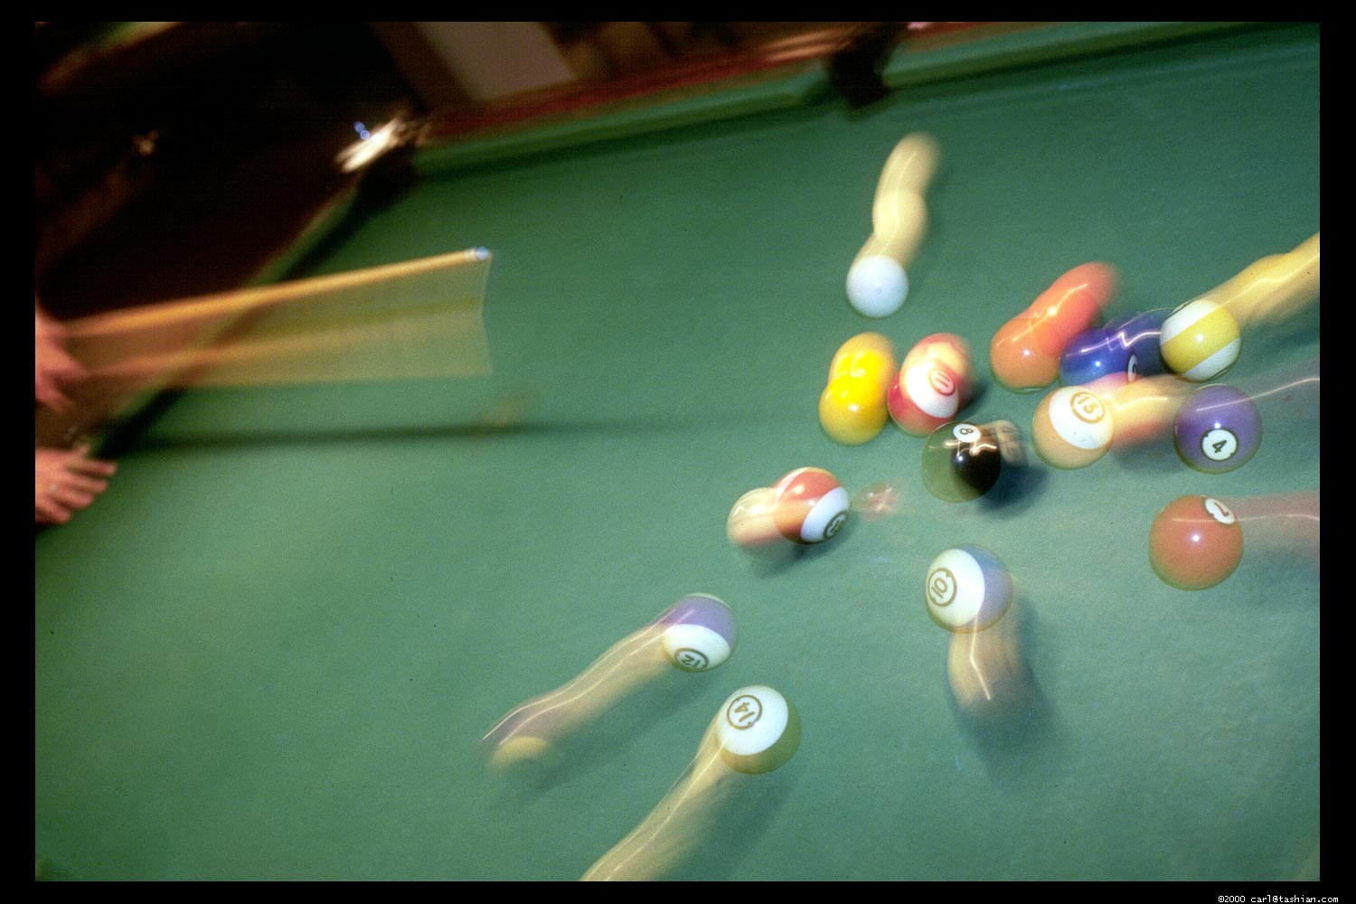
Objects at Rest:
What happens to the billiard balls on a break shot?
Are the balls at rest?
Do they remain at rest?
Did an unbalanced force act upon them?
What was the unbalanced force?

Slide 9
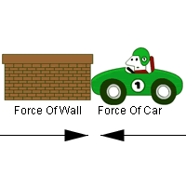
Objects in Motion:
What happens in a car crash?
Say your car is traveling 65 mph down a road, and you suddenly slam into an object. Any person not wearing their seat belt will continue to move at 65 mph and will not stop until an unbalanced force like a dashboard or windshield slows them down.

Slide 10
Inertia is the tendency of an object to resist a change in its motion.
Sometimes Newton’s 1st Law of Motion is called the Law of Inertia.

Slide 11
NEWTON’S SECOND LAW OF MOTION

Slide 13
The acceleration of an object is inversely proportional to the mass of the object.
Acceleration is LARGER when mass is SMALLER (and vice versa)
If you throw a baseball and a bowling ball with the same force one travels faster, which one?
A baseball has less mass than an softball which means that with the same force a baseball will travel faster than a softball upon release.

Slide 14
Newton’s Second Law of Motion
Newton’s Second Law of Motion states that force, mass and acceleration are all related. The net force of an object is in the same direction as the acceleration of an object.
F = ma

Slide 15
Force Triangle
F = ma
a is acceleration – m/s²
F is force – N (newton)
m is mass – kg (kilogram)
a

Slide 16
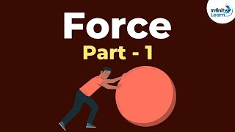

Slide 17
Forces – Example 1
You push a friend on a sled. Your friend and the sled have a combined mass of 70 kg. If you push your friend with a force of 35 N, what is the acceleration?
F_{net} = ???
m = ???
a = ???

Slide 18
Forces – Example 2
If the mass of a helicopter is 4,500 kg. and the net force on it is 18,000 N, what is the helicopter’s acceleration?
F_{net} = ???
m = ???
a = ???

Slide 19
Forces – Example 3
What is the force on a drag car with a mass of 900 kg if its acceleration is 32 m/s²?
F_{net} = ???
m = ???
a = ???

Slide 20
Forces – Example 4
A car is being towed by a tow truck. What is the car’s mass if the net force on the car is 3,000 N and it has an acceleration of 2.0 m/s²?
F_{net} = ???
m = ???
a = ???

Slide 21
Which formula do you use?
a = F
m
F = ma
m = F
a
a

Slide 22
NEWTON’S 3RD LAW OF MOTION
Action vs. Reaction

Slide 23
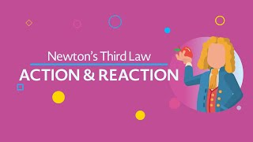

Slide 24
3rd Law of Motion
The forces of action and reaction between two bodies are equal, opposite and collinear.
This means that whenever a first body exerts a force on a second body, the second body exerts a force on the first body.
The forces are equal in magnitude and opposite in direction.

Slide 25
3rd Law of Motion
In short, for every action there is an equal and opposite reaction.
Think about standing on skates and pushing against a friend who is also on skates…
When you push against the friend, the friend also pushes back against you.
What happens to you? To the friend?

Slide 26
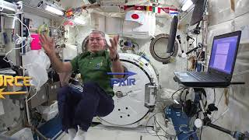

Slide 28
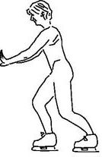
3rd Law of Motion

Slide 29
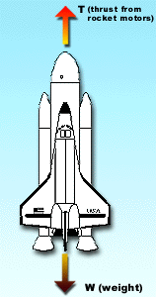
3rd Law of Motion

Slide 30
WEIGHT
Unit 2 – Topic 2

Slide 31
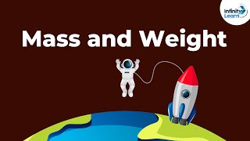

Slide 32
Weight

Slide 33
MOMENTUM
Unit 2 – Topic 3

Slide 35
Momentum
Momentum is a commonly used term in sports.
A team that has the momentum is on the move and is going to take some effort to stop. A team that has a lot of momentum is really on the move and is going to be hard to stop.
Momentum is a physics term; it refers to the quantity of motion that an object has.
A sports team that is on the move has the momentum.
If an object is in motion (on the move), then it has momentum.
Momentum can be defined as mass in motion.
All objects have mass.
So, if an object is moving, then it has momentum – its mass is in motion.
The amount of momentum that an object has is dependent upon two variables:
mass and velocity

Slide 36
Momentum
Momentum depends upon the variables mass and velocity
The momentum of an object is equal to the mass of the object times the velocity of the object.
Momentum = mass • velocity
In physics, the symbol for the quantity momentum is the lower-case p. Thus, the equation for momentum can be rewritten as
p = m • v
where m is the mass, v is the velocity, p is the momentum
The equation illustrates that momentum is directly proportional to an object's mass and directly proportional to the object's velocity.
More mass or speed = greater momentum
Less mass or speed = less momentum
The units for momentum are mass units times velocity units.
The standard metric unit of momentum is the kg•m/s.

Slide 38
FRICTION
Unit 2 – Topic 4

Slide 39
According to Newton’s First Law of Motion if you push a skateboard then the skateboard should keep moving at a constant speed in a straight line. Does that really happen?
Why not?

Slide 41
Friction
The answer is friction!
Friction is the force that opposes the sliding motion of two surfaces that are touching each other.
Even highly polished surfaces have bumps and grooves in them which interact with and “stick to” the bumps and grooves in other surfaces.

Slide 42
Static Friction
When you try to push a heavy object and it does not move, another force applied canceled out your force. What was the other force? FRICTION!
Static friction is the force that prevents two surfaces from sliding past one another.
For example, a box that does not move when you push it.

Slide 44
Sliding Friction
What happens if you push a box, and it begins to move?
You supplied enough of a force to overcome the friction. When you stop pushing the box, you should notice that it comes to a stop quickly.
Sliding friction is the force that opposes two surfaces sliding past one another.

Slide 45
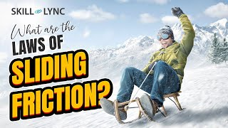

Slide 46
Rolling Friction
Rolling friction takes place where the wheel touches a surface and is present while the object is moving.

Slide 47
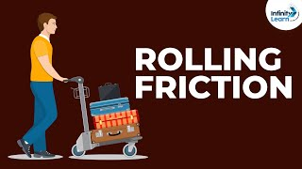

Slide 48
If you were to drop a feather and a hammer which would hit the ground first?
What about on the moon?
What does earth have that the moon does not have?
Feather & Hammer Drop on the Moon

Slide 49
Air Resistance
Air resistance is a frictional force that opposes the motion of an object while it travels through air.
Air resistance works in the opposite direction of the direction that the object is traveling.
Wing Suit Base Jumping

Slide 50
Terminal Velocity
If a skydiver were to fall for 2,000 m with no air resistance, then the speed of the skydiver would be about 200 m/s (700 km/h)
This is not the case. As a falling object increases in speed due to gravity, the air resistance also increases.
Eventually the air resistance will equal the force of gravity, and the object will no longer accelerate.

Slide 51
Terminal Velocity
When the object stops accelerating, it falls at a constant speed. This constant speed is called the terminal velocity.
Terminal Velocity is the maximum speed a falling object will reach due to air resistance.
240 mph Falcon

Slide 52
Fluid Friction
Fluid Friction is the friction present when a solid object moves through a fluid
(for example, water)
If the fluid is “slippery”, the friction force will be low
If it is a “thick” fluid, then the force will be very high, and the object may have great difficulty moving through the fluid.

