Slide 1
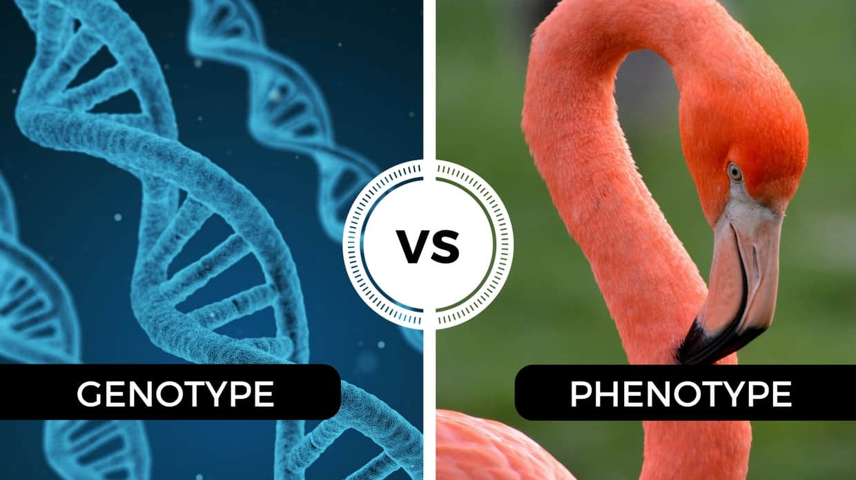
Mendelian Genetics – Part II
Mr. Davis

Slide 2
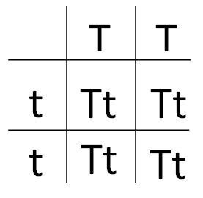
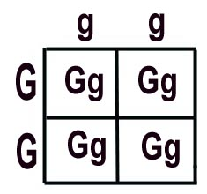
Homozygous
having two identical alleles of a particular gene or genes.

Slide 3
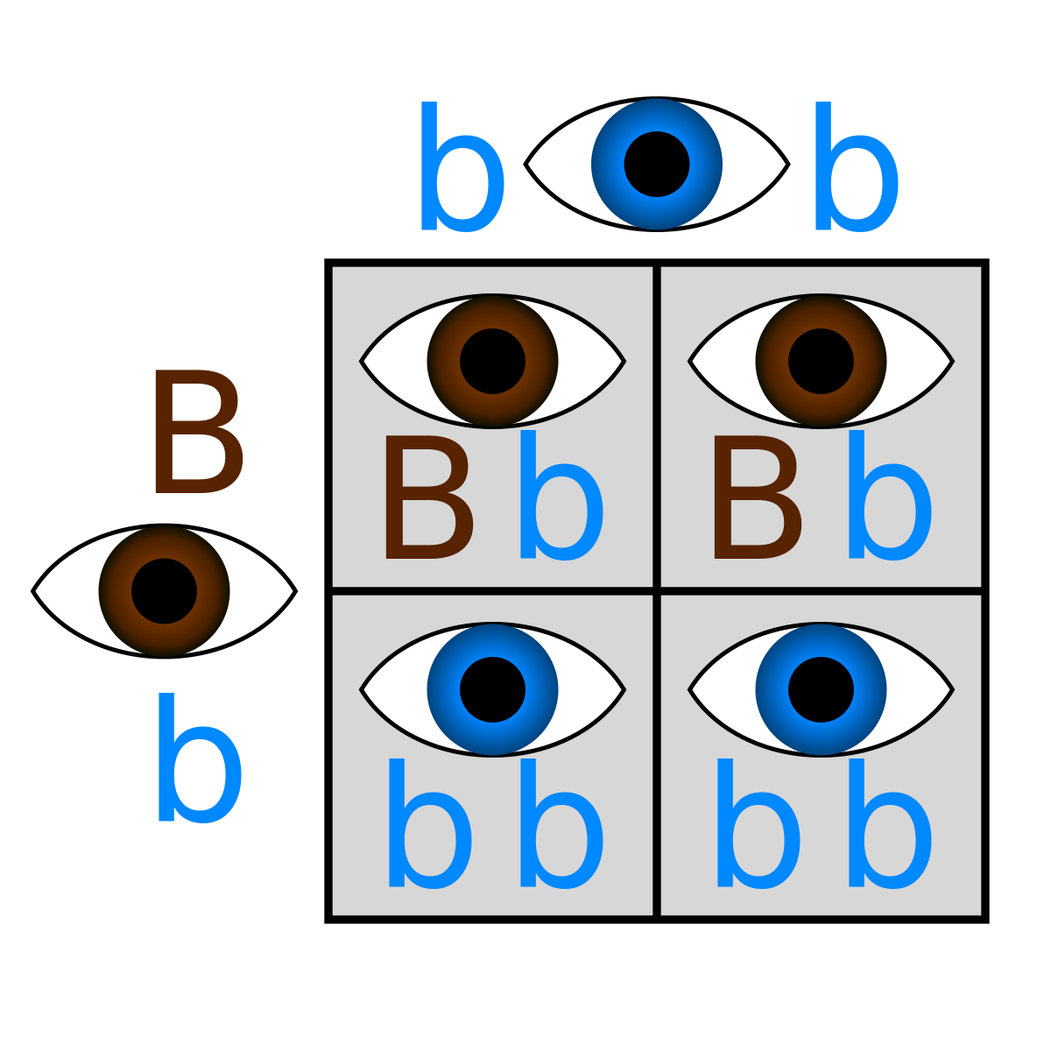
Homozygous
Homozygous also refers to a genotype consisting of two identical alleles of a gene for a particular trait. An individual may be homozygous dominant (AA) or homozygous recessive (aa).

Slide 4
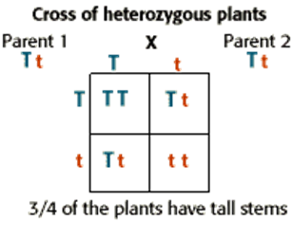
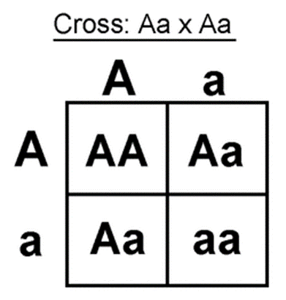
Heterozygous
individuals who are heterozygous for a trait are referred to as heterozygotes

Slide 5
Heterozygous
Heterozygous means having one each of two different alleles.

Slide 6
Simple Punnett Square Crosses

Slide 7
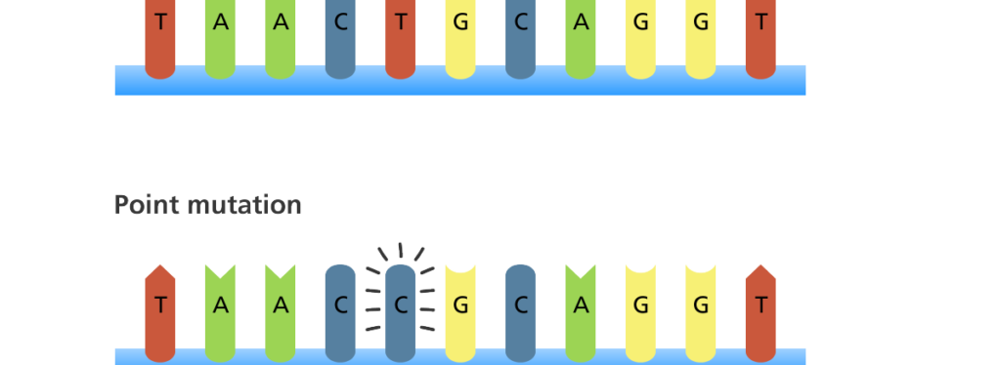
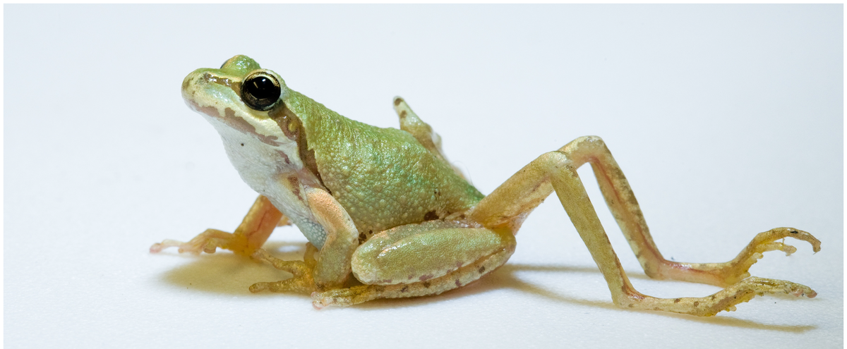
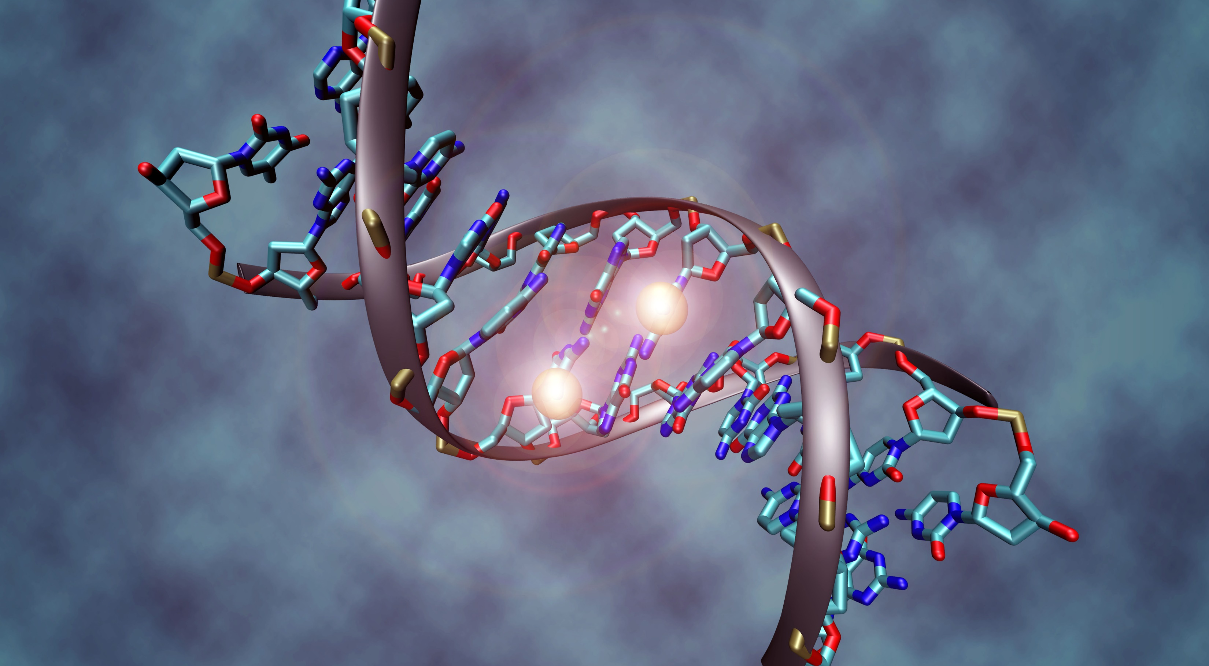
Mutations
Mutations are mistakes that occur in copying their own DNA. Mutations are changes in the genetic material. Gene mutations result from changes in a single gene. Genetic mutations affect the amino acid sequences of the proteins for which they code.

Slide 8
Kinds of Mutations
Gene Mutations
Point Mutation - A point mutation or substitution is a genetic mutation where a single nucleotide base is changed, inserted or deleted from a sequence of DNA or RNA.

Slide 9
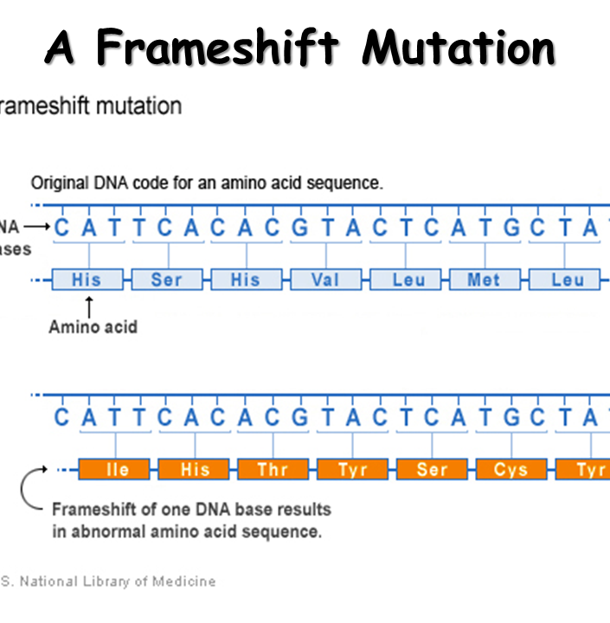
Kinds of Mutations
2. A frameshift mutation (also called a framing error or a reading frame shift) is a genetic mutation caused by indels (insertions or deletions) of a number of nucleotides in a DNA sequence that is not divisible by three.

Slide 10
Chromosomal Mutations
Deletion
Duplication
Inversion
Translocation

