Slide 1
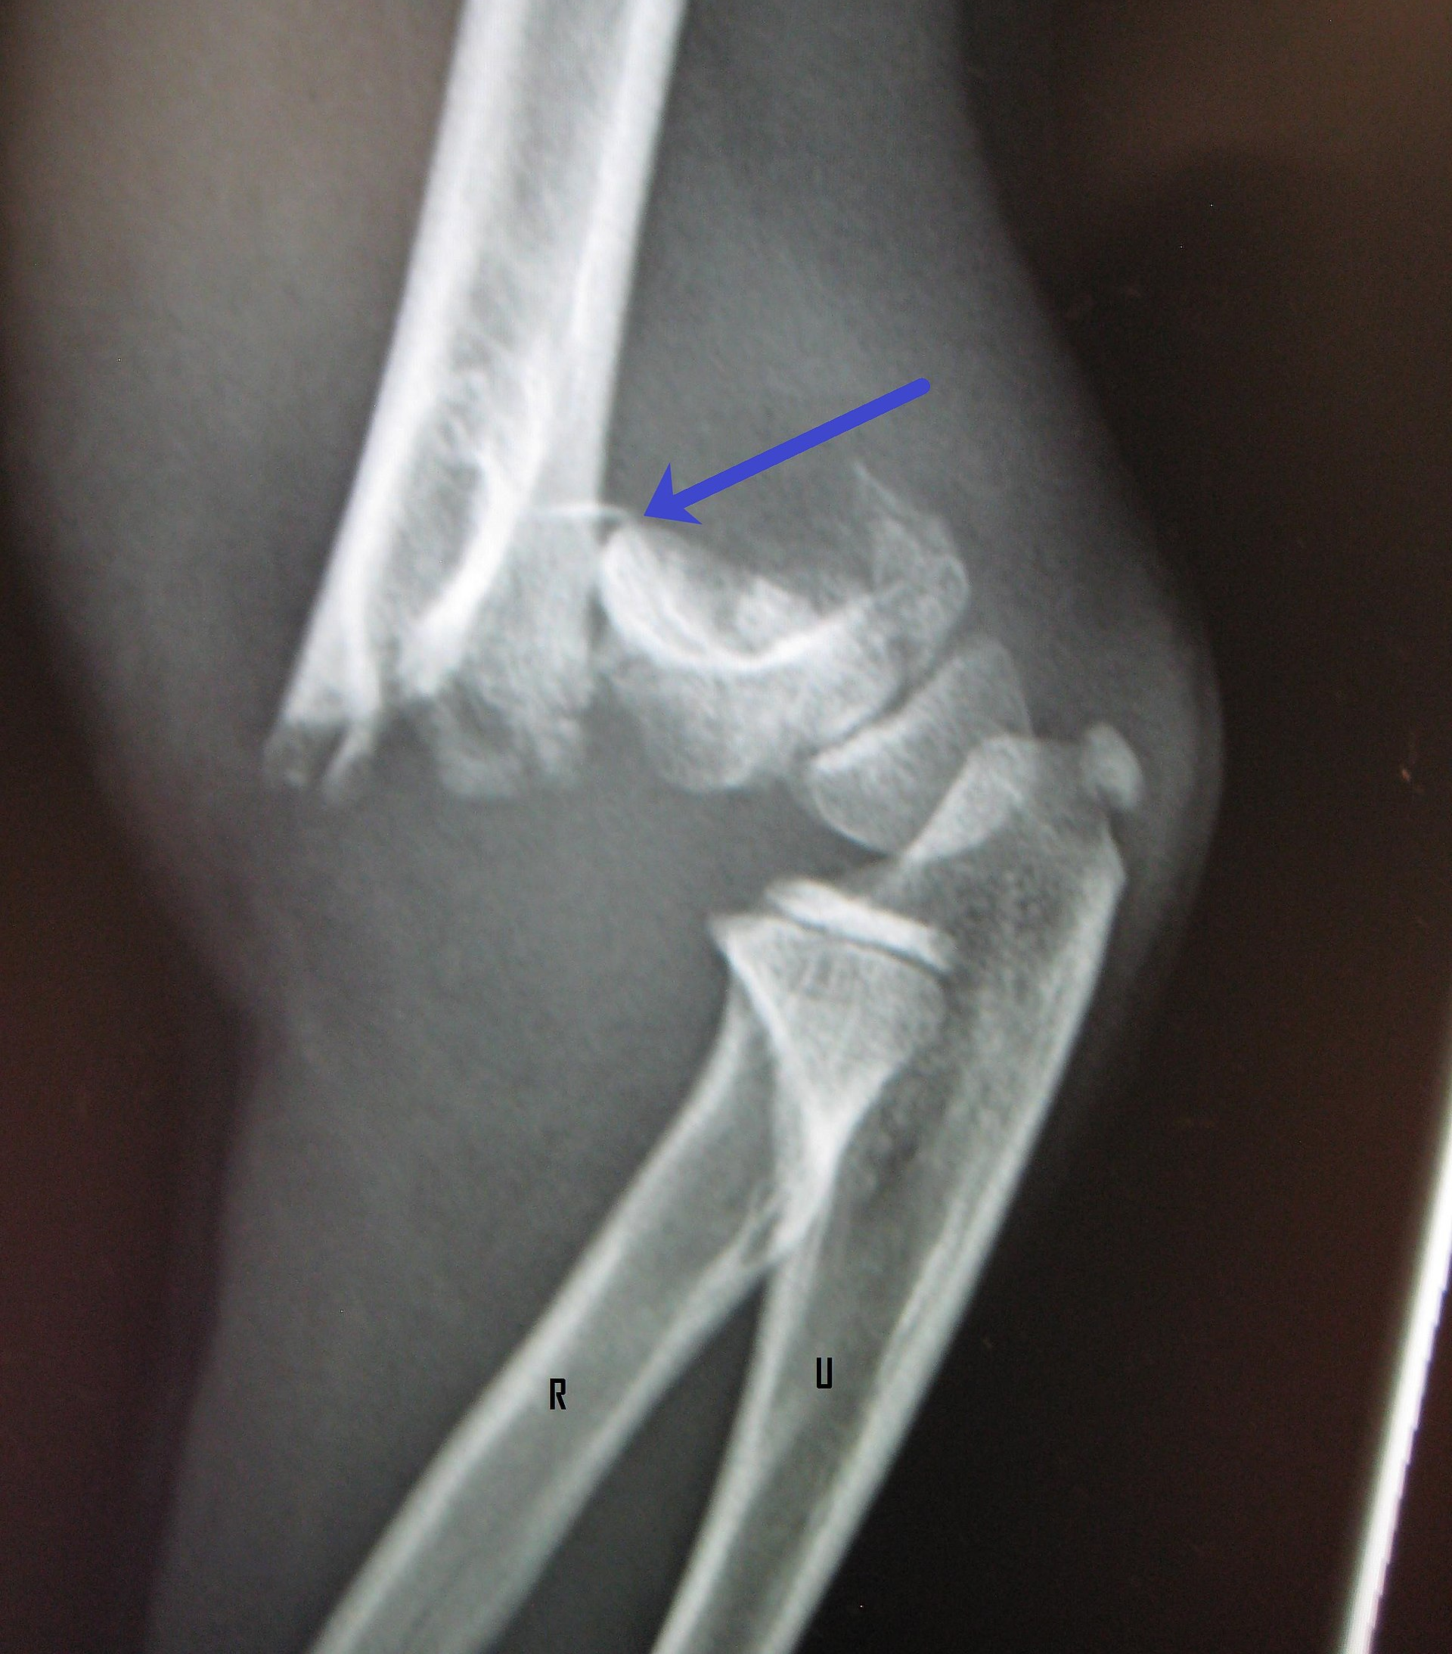
Classification of Trauma
Mr. Davis

Slide 2
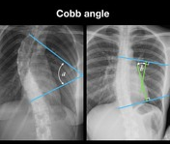
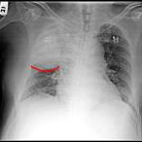
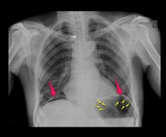
Classification of Trauma
Traumatic deaths may be classified as
Mechanical
Chemical
Thermal
Electrical

Slide 3
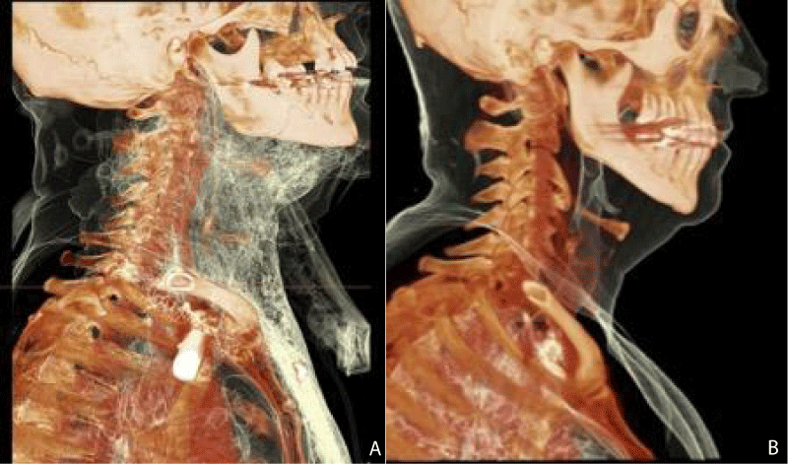
Mechanical Trauma
Occurs when the force applied to a tissue, such as skin or bone, exceeds mechanical or tensile strength of that tissue. Mechanical Trauma examples:
Sharp force refers to injuries caused by sharp implements, such as knives, axes, or ice picks.
Blunt force trauma is caused by dull or non-sharp objects, such as baseball bats, bricks, or lamps.

Slide 4
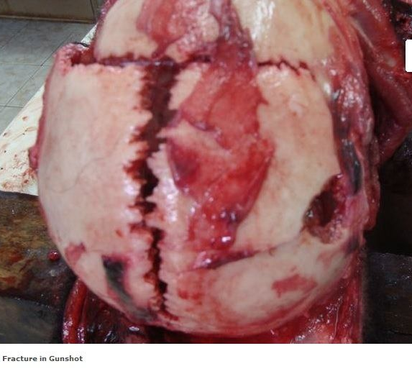
Blunt Force Trauma
Blunt objects produce laceration, or tears in the tissue.
Whereas sharp objects produce incised wounds, a wound that has more depth than length or width.

Slide 5
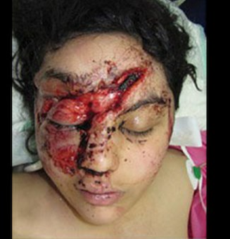
Blunt Force Trauma
A contusion is an accumulation of blood in the tissue outside the normal blood vessels and is most often the result of a blunt force trauma impact.
Death from blunt and sharp trauma result from multiple damage to the brain leading to a fatal loss of blood. Exsanguination occurs when a major artery or the heart is damage .

Slide 6
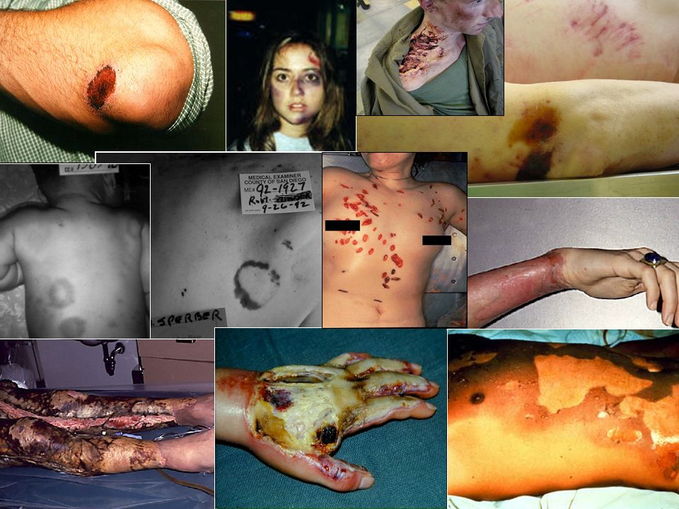
Blunt Force Trauma

Slide 8
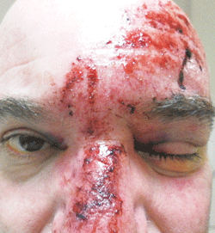
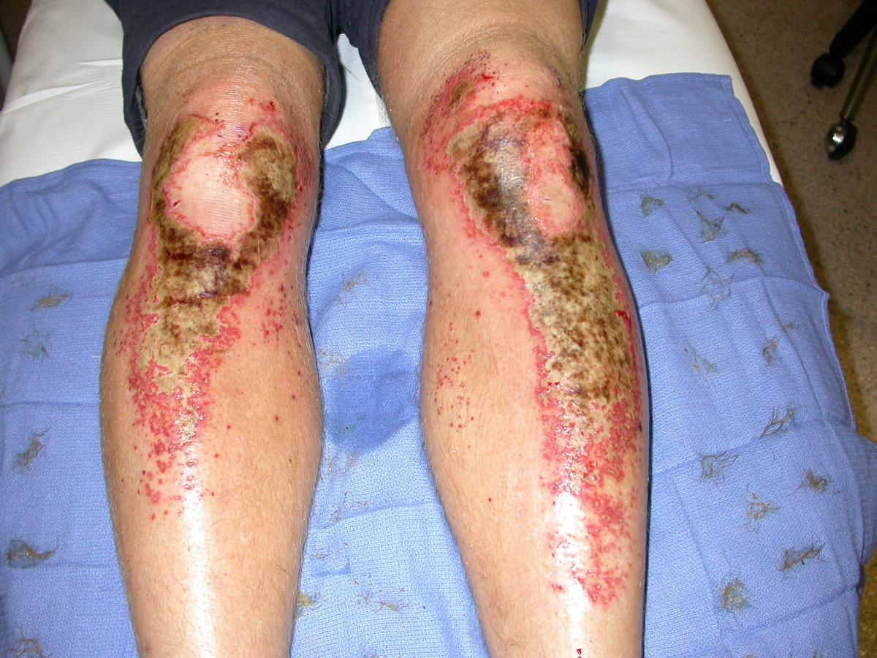
Chemical Trauma
Refers to damage and death that results from the interaction of chemicals with the human body.
A chemical burn occurs when living tissue is exposed to a corrosive substance such as a strong acid or base. Chemical burns follow standard burn classification and may cause extensive tissue damage.

Slide 10
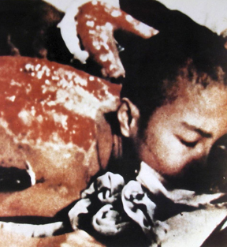
Thermal Trauma
Extreme heat or cold may produce death.
Hypothermia is too much exposure to cold.
Hyperthermia is exposure to excessive heat.
Thermal burns tend to be localized; persons who die in a fire do so generally because of lack of Oxygen (Asphyxia).
Both conditions interfere with the normal physiological mechanisms that keep body temperature at about 98°F / 37°C.

Slide 12
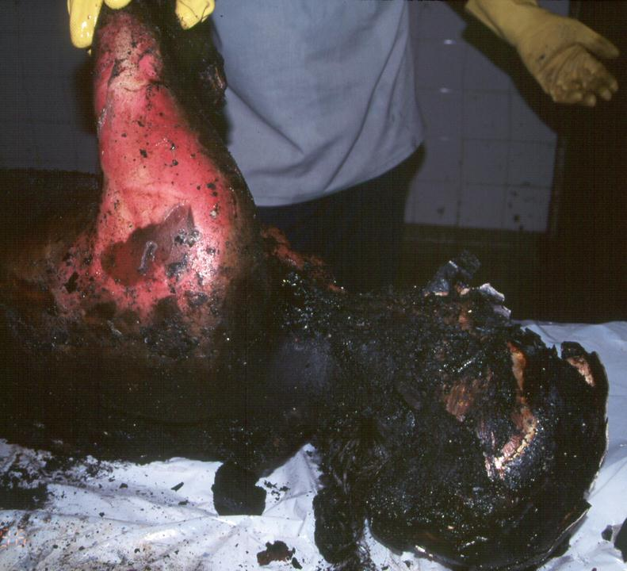
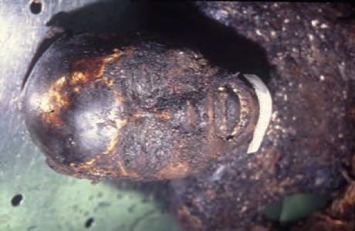

Slide 13
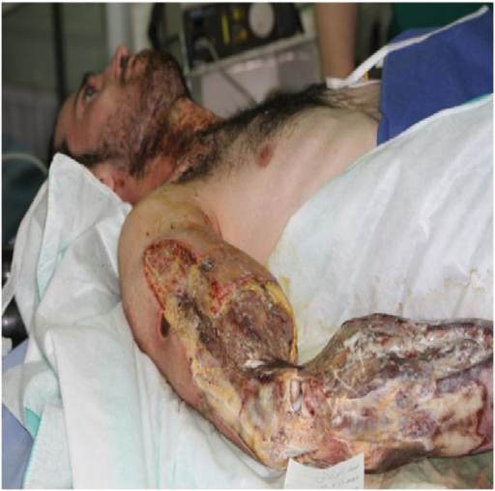
Electrical Trauma
Electricity can cause death .
At high voltages, the amount of current causes the heart to stop beating ( it becomes the defibrillator) pushing the heart tetany, a sustained contraction that is broken only when the circuit is broken.

Slide 14
