Slide 1
Chapter 1 Observation Skills
Forensic Science
Mr. Davis

Slide 2
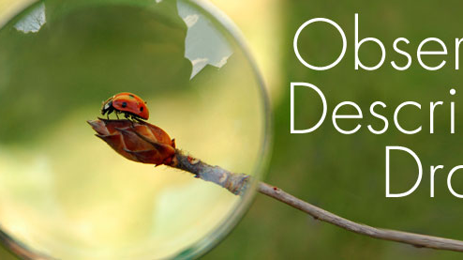
Observation vs. perception
Observation – what a person perceives using his or her senses. Every moment we gather information though our senses: sight, taste, hearing, smell, and touch.
Perception – the way we view our surroundings may not accurately reflect what is really there. Perception is faulty, it is not always accurate, and it does not always reflect reality.

Slide 3
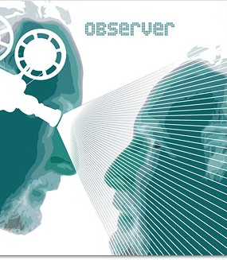
Observations By Witnesses
Observations by witnesses can be faulty, even though a witnesses may be utterly convinced of what he or she saw.
Witness testimony is generally presumed to be more reliable than circumstantial evidence. ... This can occur because of flaws in eyewitness identification (such as faulty observation and recollection, or bias), or because a witness is lying.

Slide 4
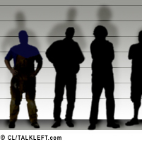
Eyewitness Accounts
Eyewitness – a person who has seen someone or something related to a crime and can communicate his or her observations.
A percipient witness or eyewitness is one who testifies what they perceived through his or her senses (ex: seeing, hearing, smelling, touching). That perception might be either with the unaided human sense or with the aid of an instrument, ex: microscope or stethoscope, or by other scientific means, ex: a chemical reagent which changes color in the presence of a particular substance.

Slide 5
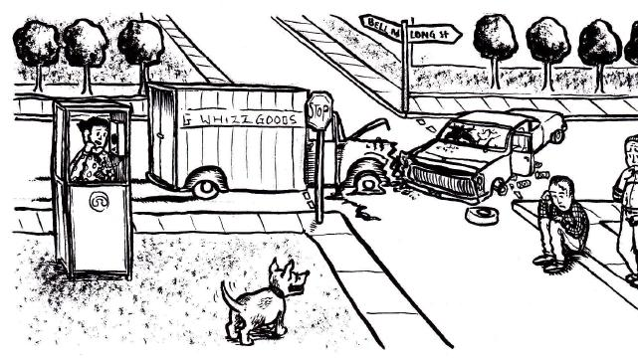
How to be a Good Observer
We must make a conscious effort to examine our surroundings systemically.
We need to consciously observe everything, no matter how small or how familiar, no matter what our emotions or previous experiences.
We need to be careful that we concentrate first and foremost on gathering all the available information and leaving the interpretation until we have as much information as possible.
While observing, it is important to write down and photograph as much information as possible.

