Slide 1
History of Forensics Science
Mr. Davis

Slide 2
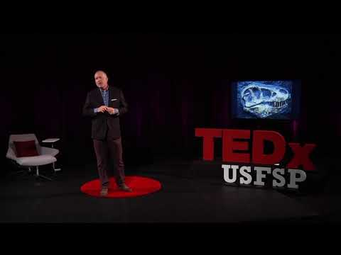

Slide 3
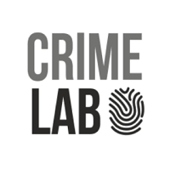
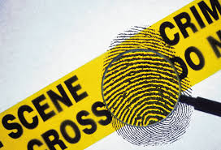
What is Forensics?
“Forensic” comes from the Latin word “forensis” meaning forum.
During the time of the Romans, a criminal charge meant presenting the case before the public.
Both the person accused of the crime & the accuser would give speeches based on their side of the story.
The individual with the best argument would determine the outcome of the case.

Slide 4
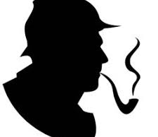
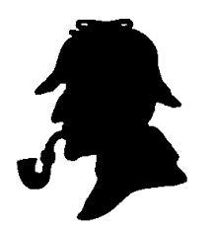
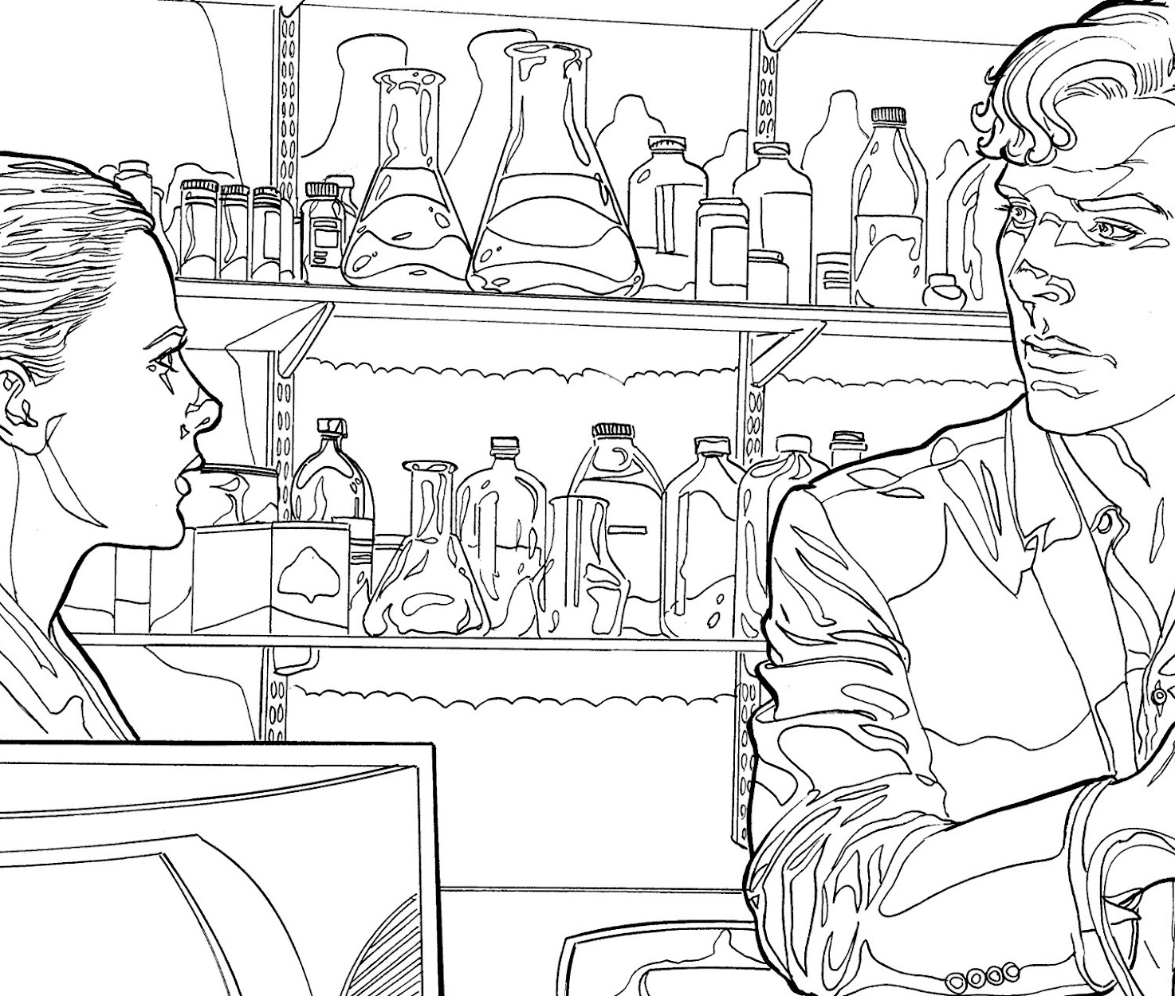
2. Sir Arthur Conan Doyle
Mystery author in late 1800’s
Popularized scientific crime-detection methods through his fictional character ‘Sherlock Holmes.’

Slide 5
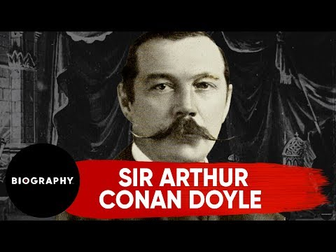
Sir Arthur Conan Doyle

Slide 6
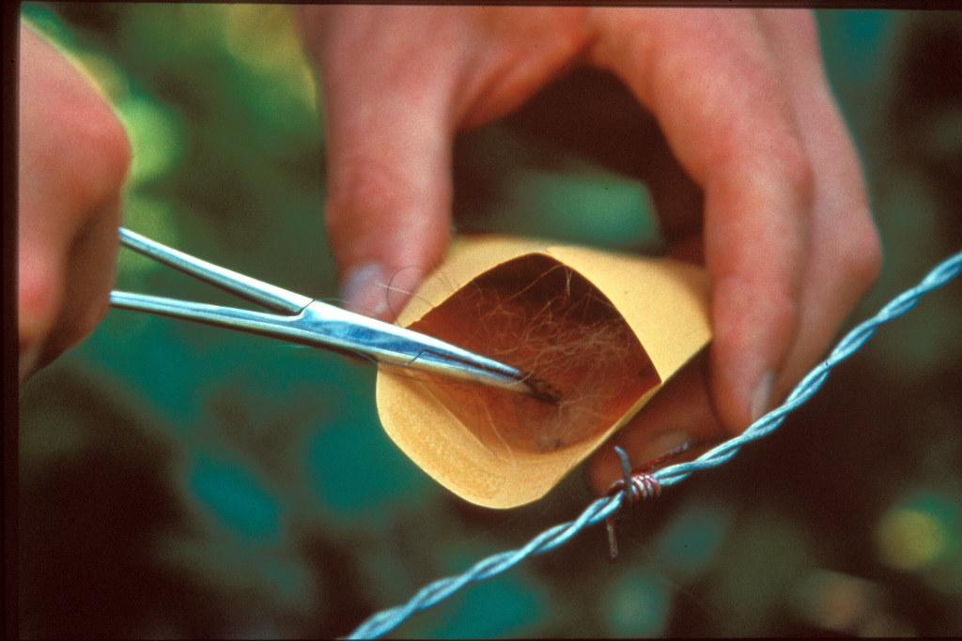
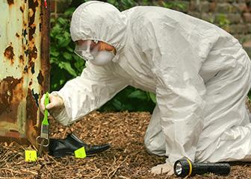
Forensics History
3. Mathieu Orfila - The father of forensic toxicology.
4. Alphonse Bertillion - Devised the first scientific system of personal identification in 1879.
5. Francis Galton - Conducted the first definitive study of fingerprints and their classification.
6. Leone Lattes - Developed a procedure to determine blood type from dried bloodstains.

Slide 7
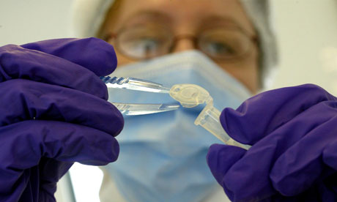
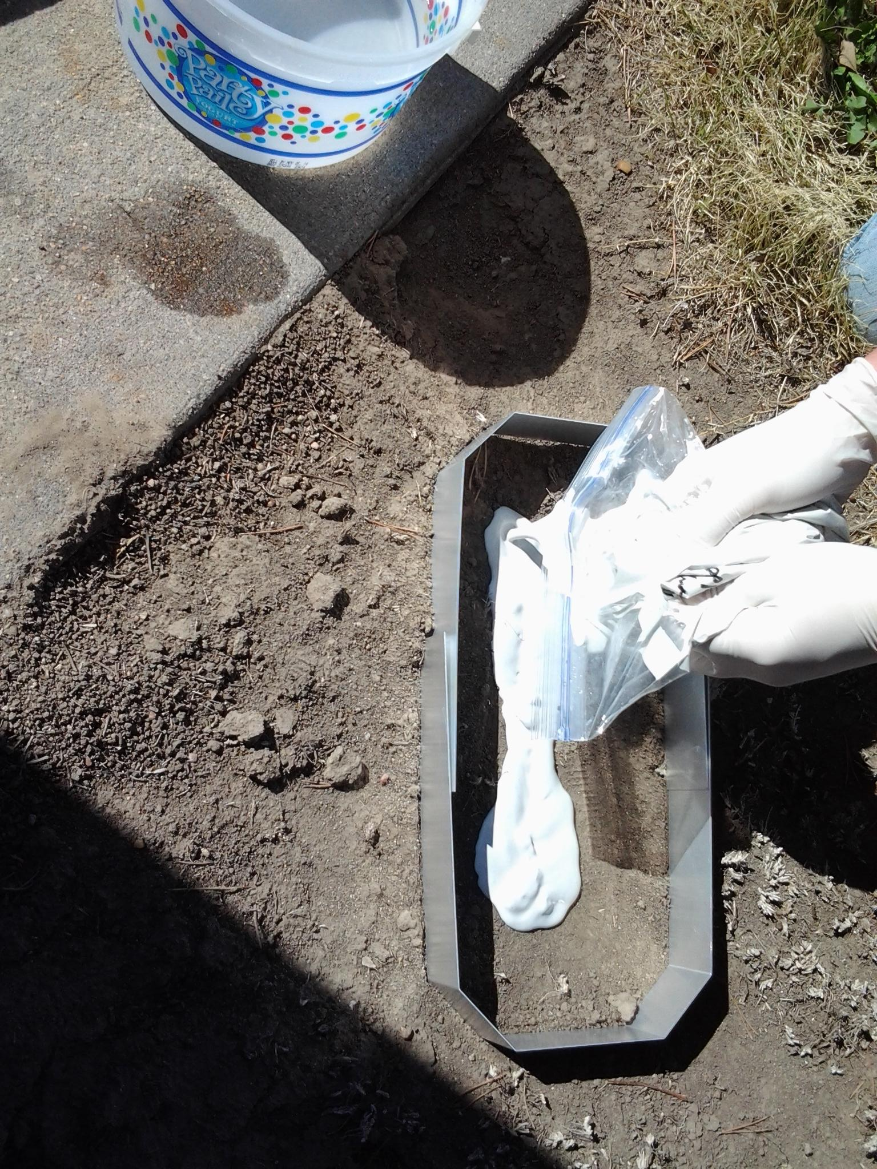
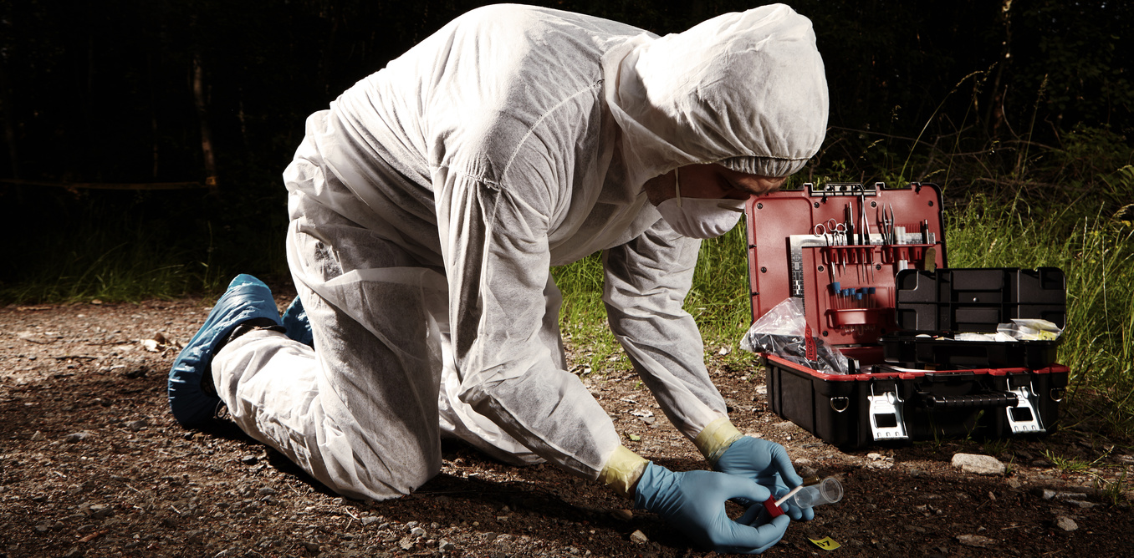
Forensics History
7. Calvin Goddard - Used a comparison microscope to determine if a particular gun fired a bullet.
8. Albert Osborn - Developed the fundamental principles of document examination.
9. Walter McCrone - Utilized microscopy and other analytical methodologies to examine evidence.
10. Hans Gross - Wrote the first treatise describing the application of scientific principles to the field of criminal investigation.

Slide 8
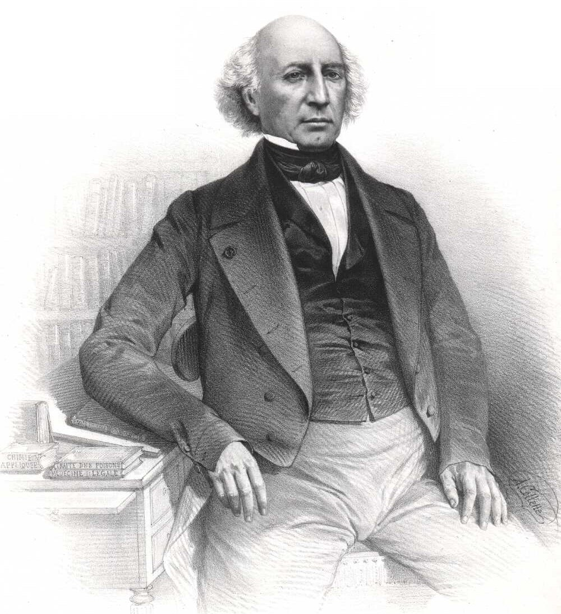
Mathieu Orfila - (1787-1853)
“Father of Toxicology”
Wrote about the detection of poisons & their effects on animals.

Slide 9
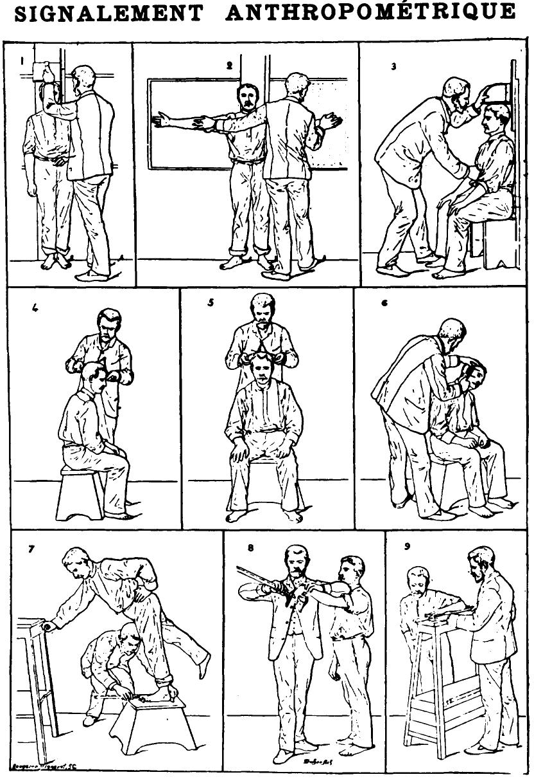
Alphonse Bertillon - (1853-1914)
“Father of Anthropometry”
Developed a system to distinguish one individual person from another based on certain body measurements.

Slide 11
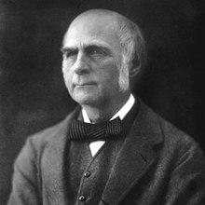
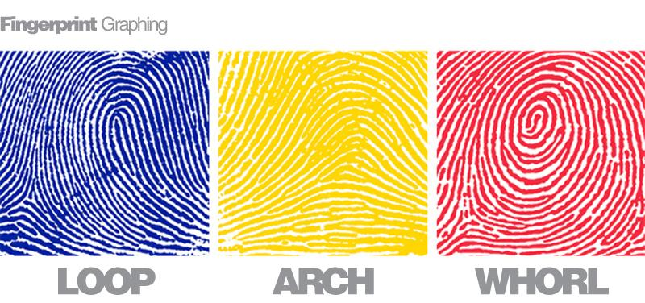
Francis Galton - (1822-1911)
“Father of Fingerprinting”
Developed fingerprinting as a way to uniquely identify individuals.

Slide 12
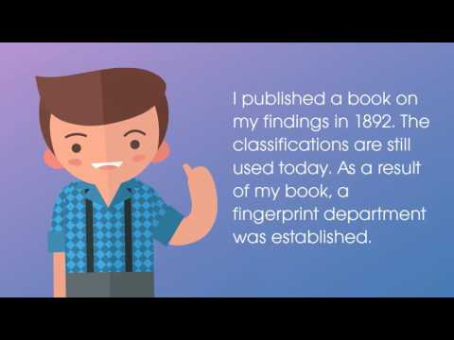

Slide 13
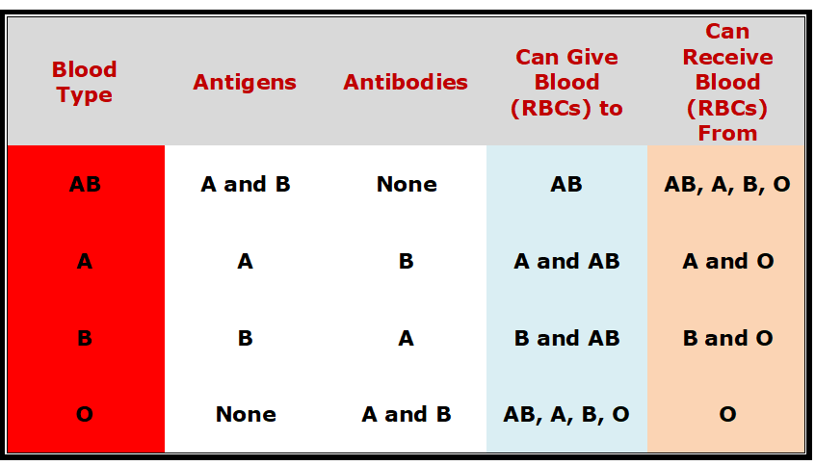
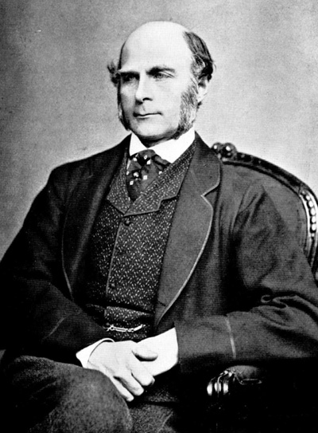
Leone Lattes - (1887-1954)
“Father of Bloodstain Identification”
He developed a procedure for determining the blood type (A, B, AB, or O) of a dried blood stain.

Slide 14
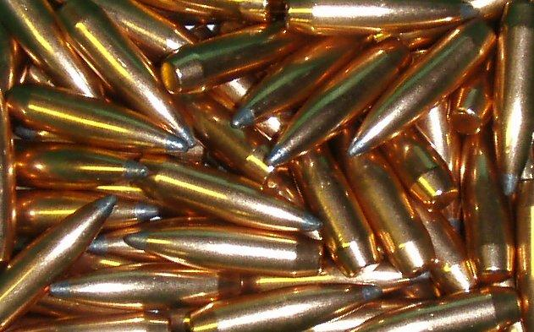
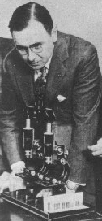
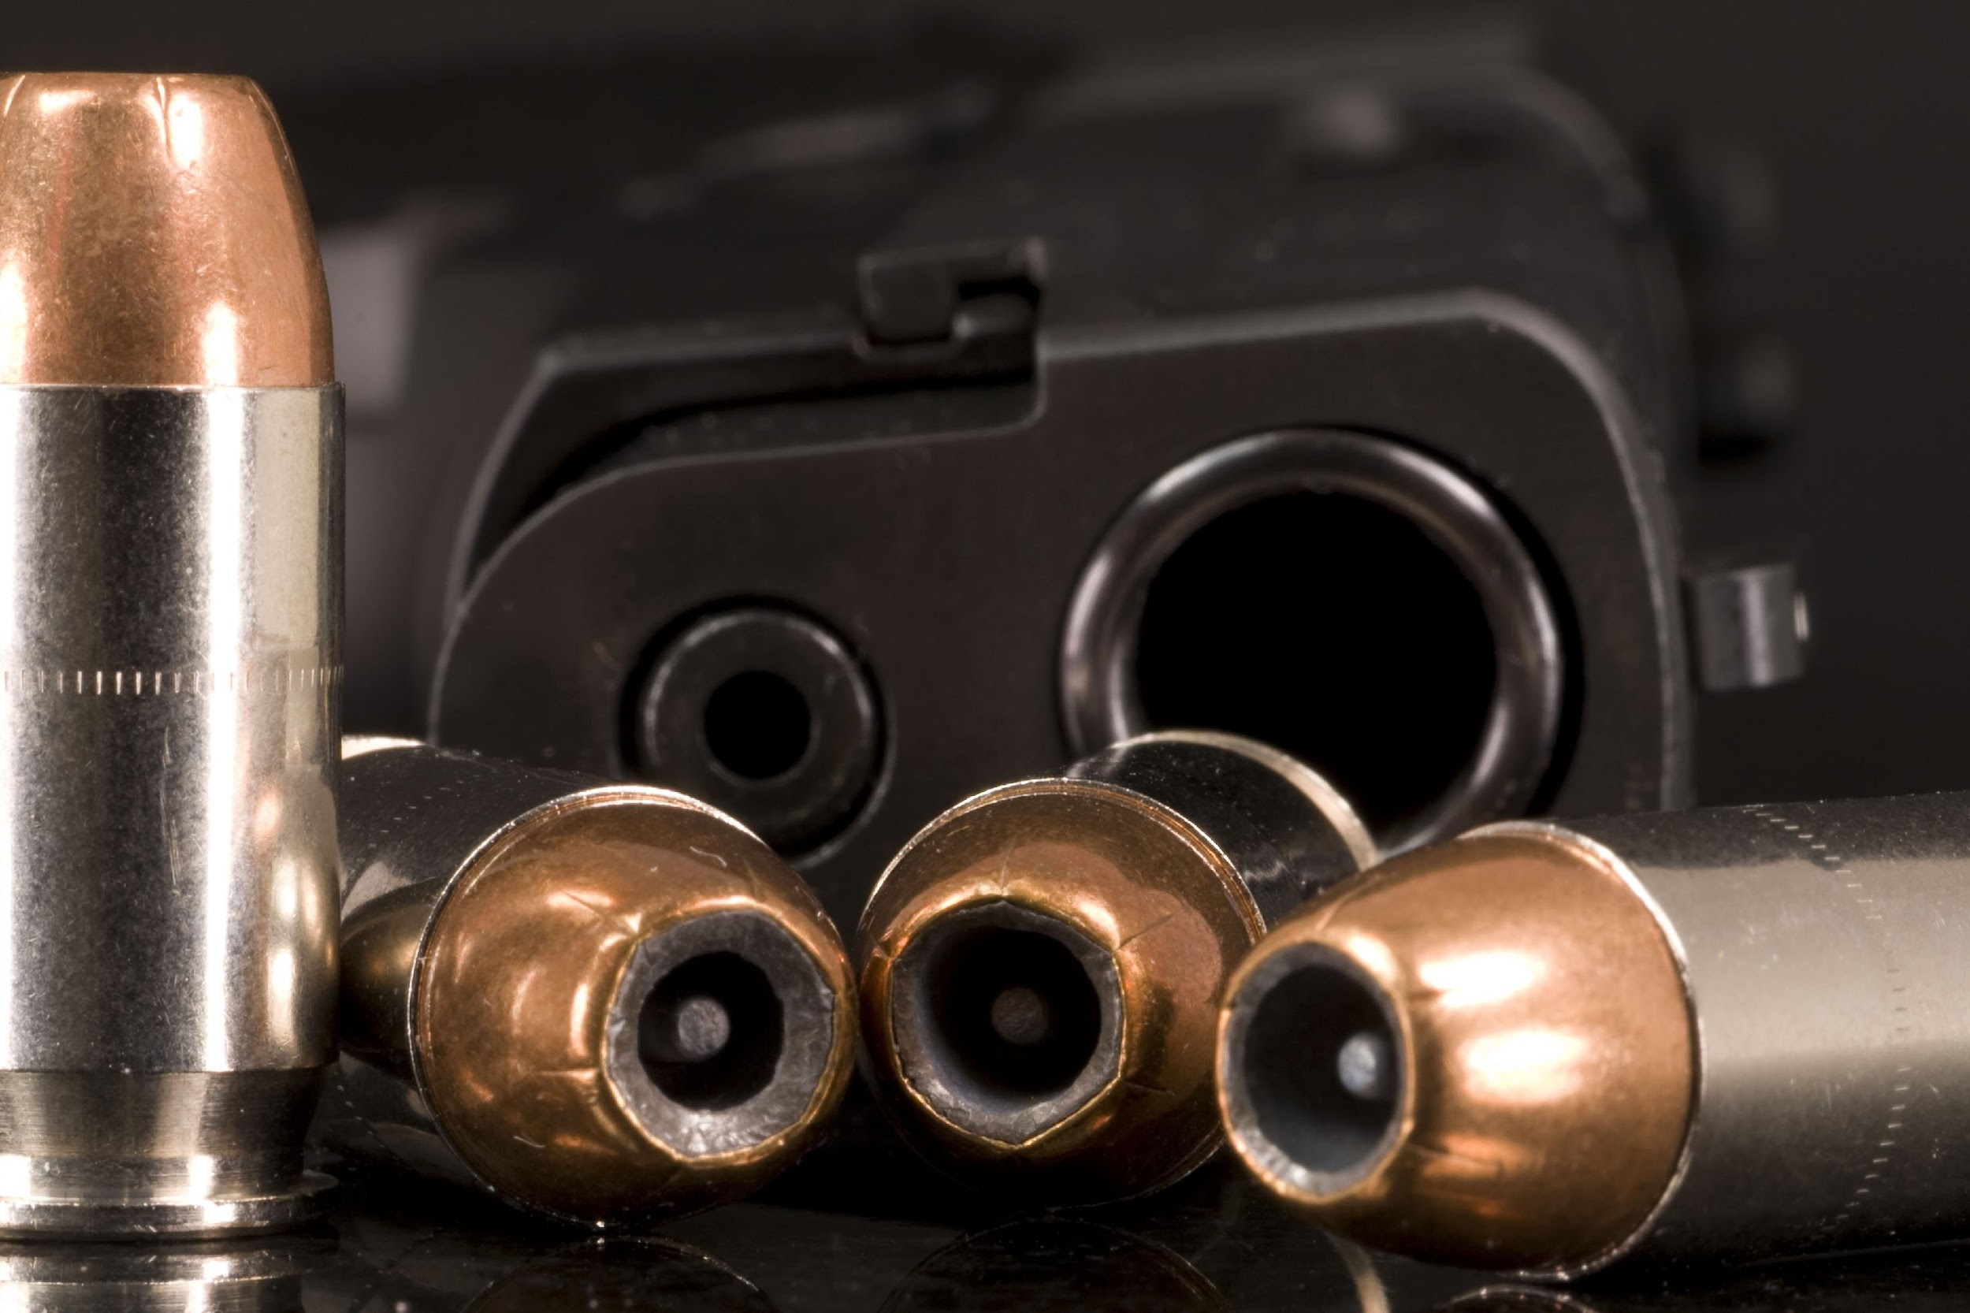
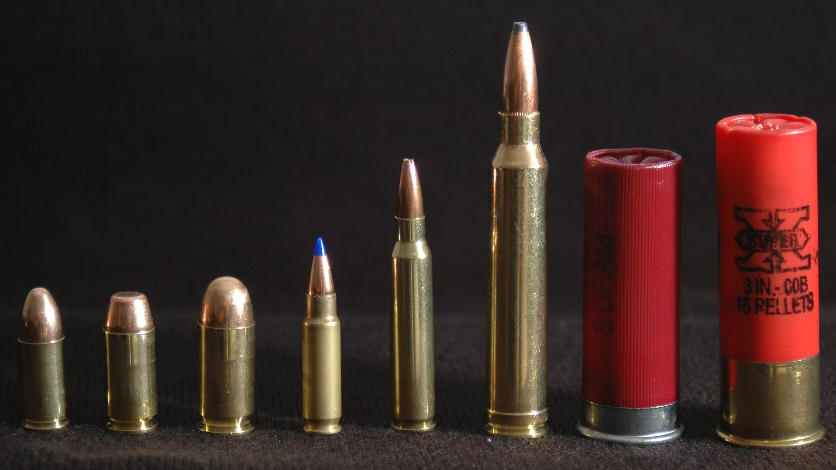
Calvin Goddard - (1891-1955)
Father of Ballistics”
Developed the technique to examine bullets, using a comparison microscope, to determine whether or not a particular gun fired the bullets.

Slide 15
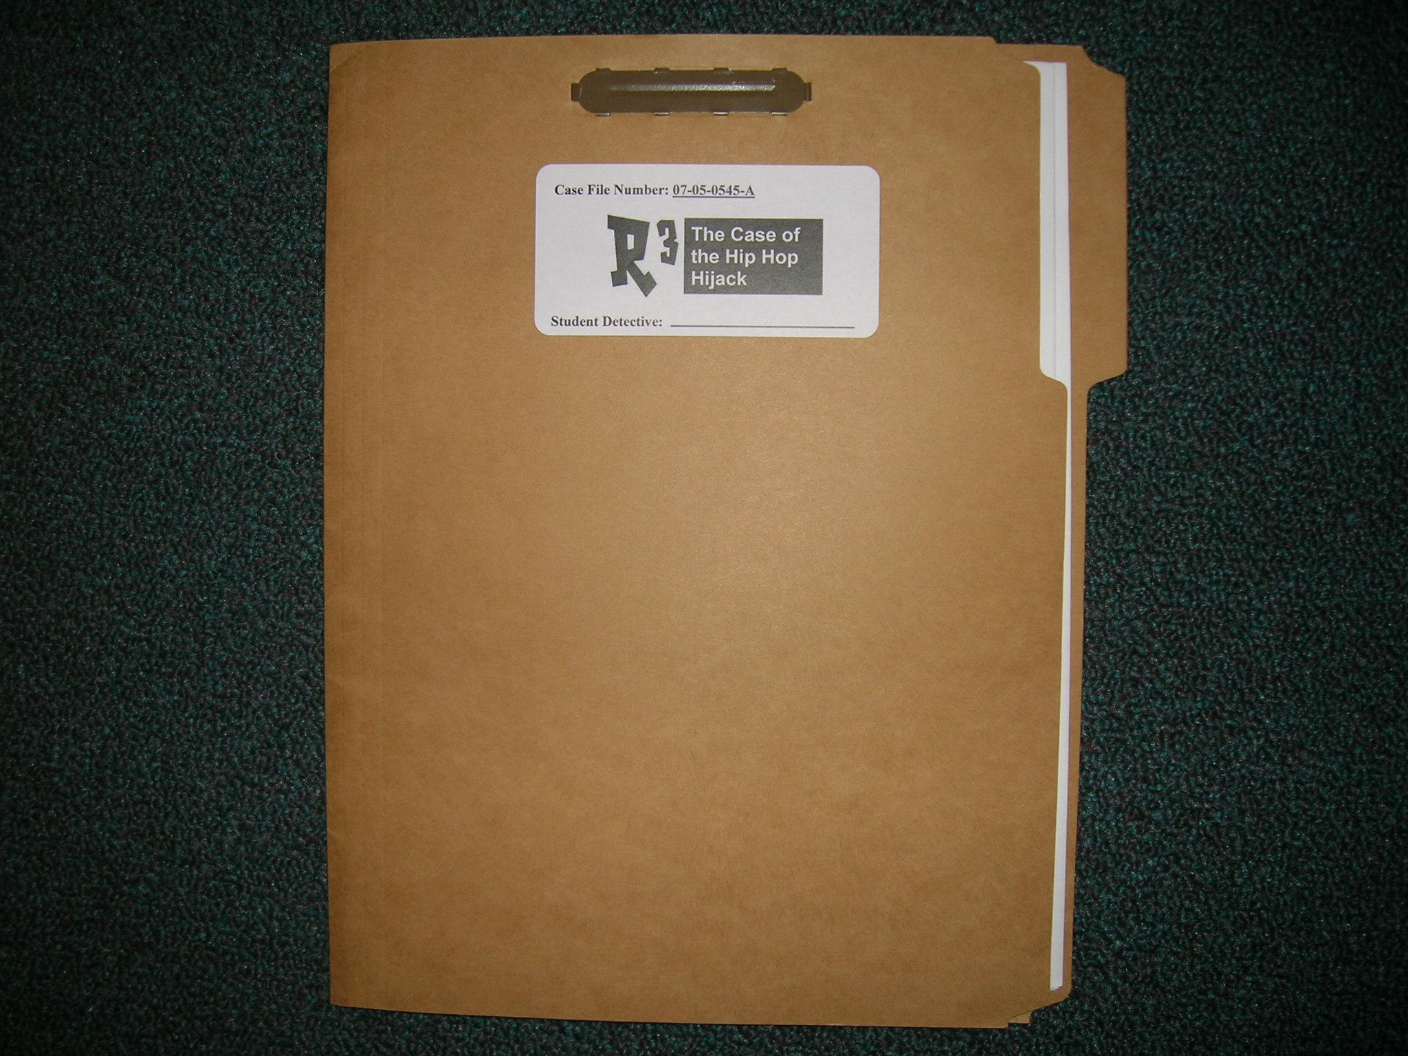
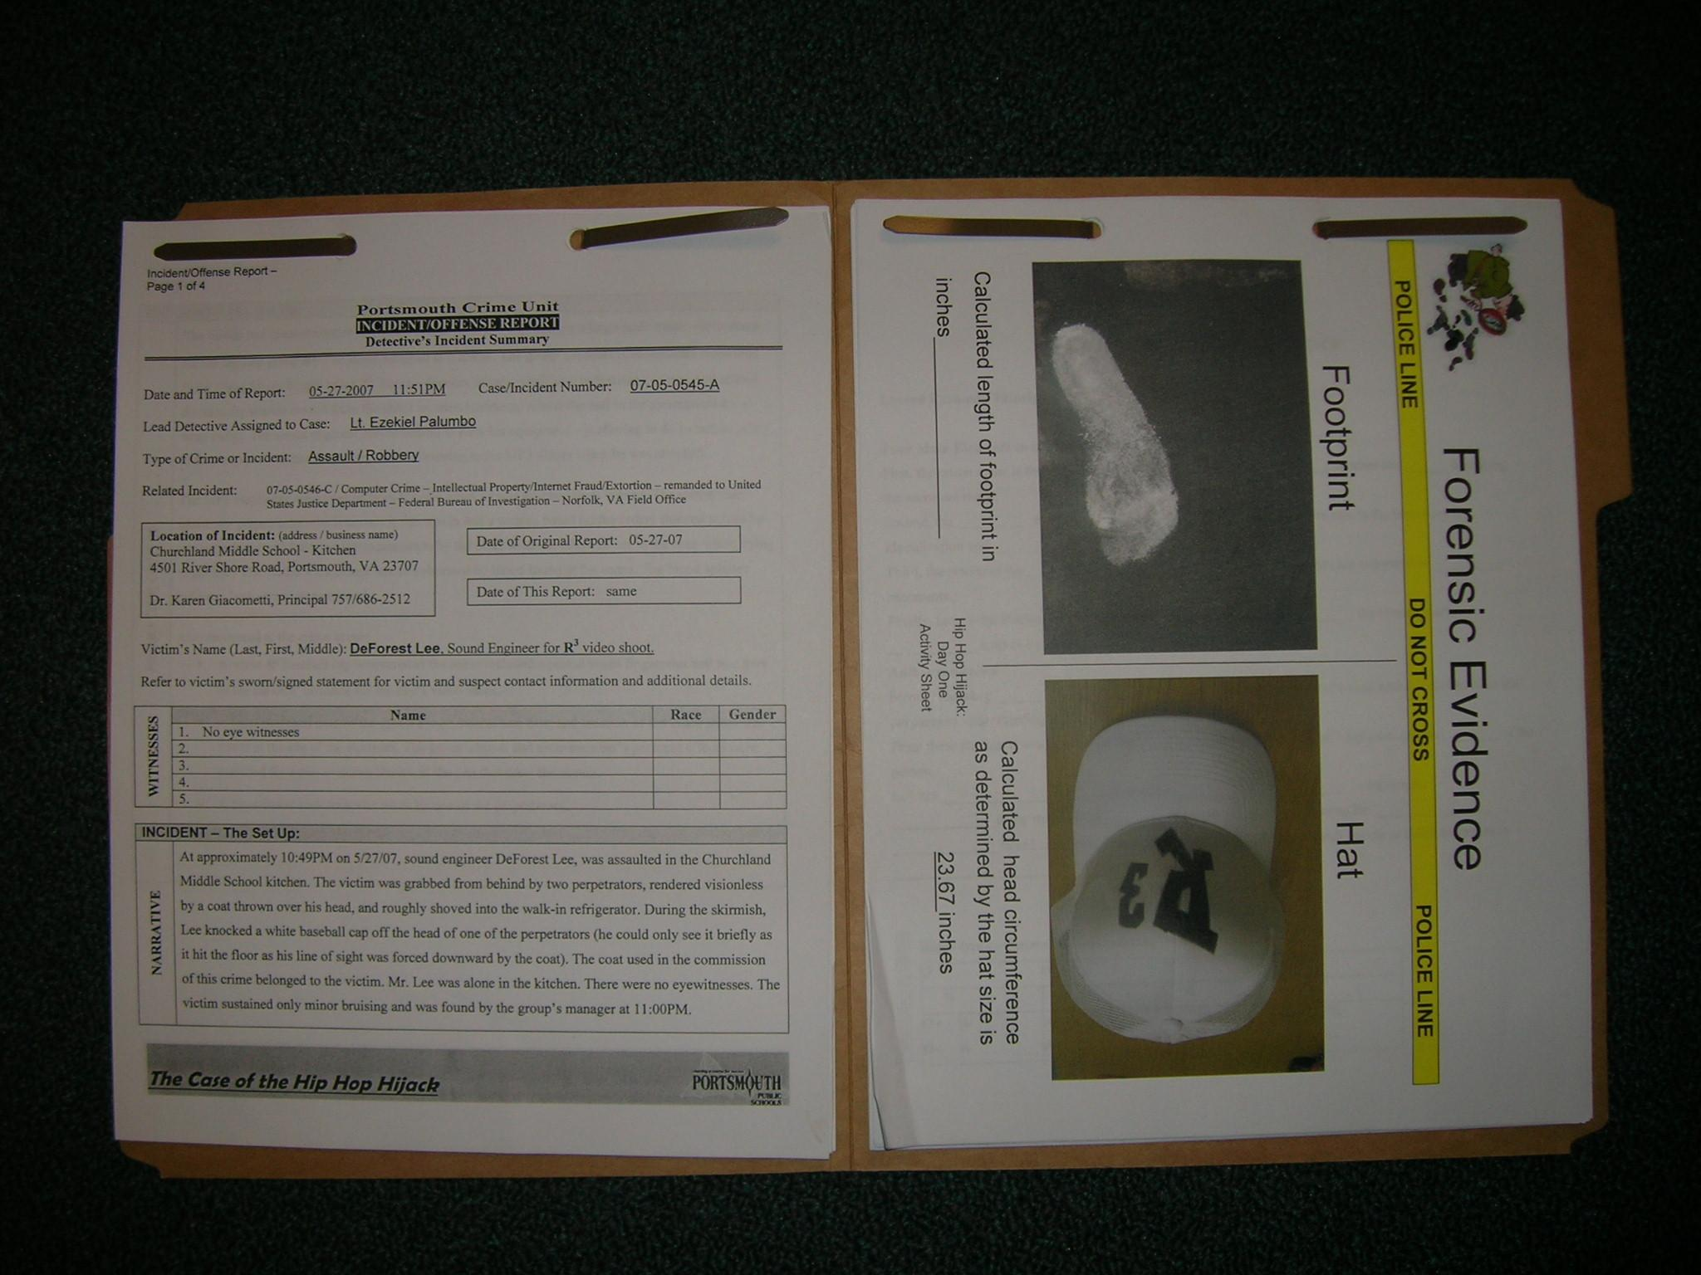
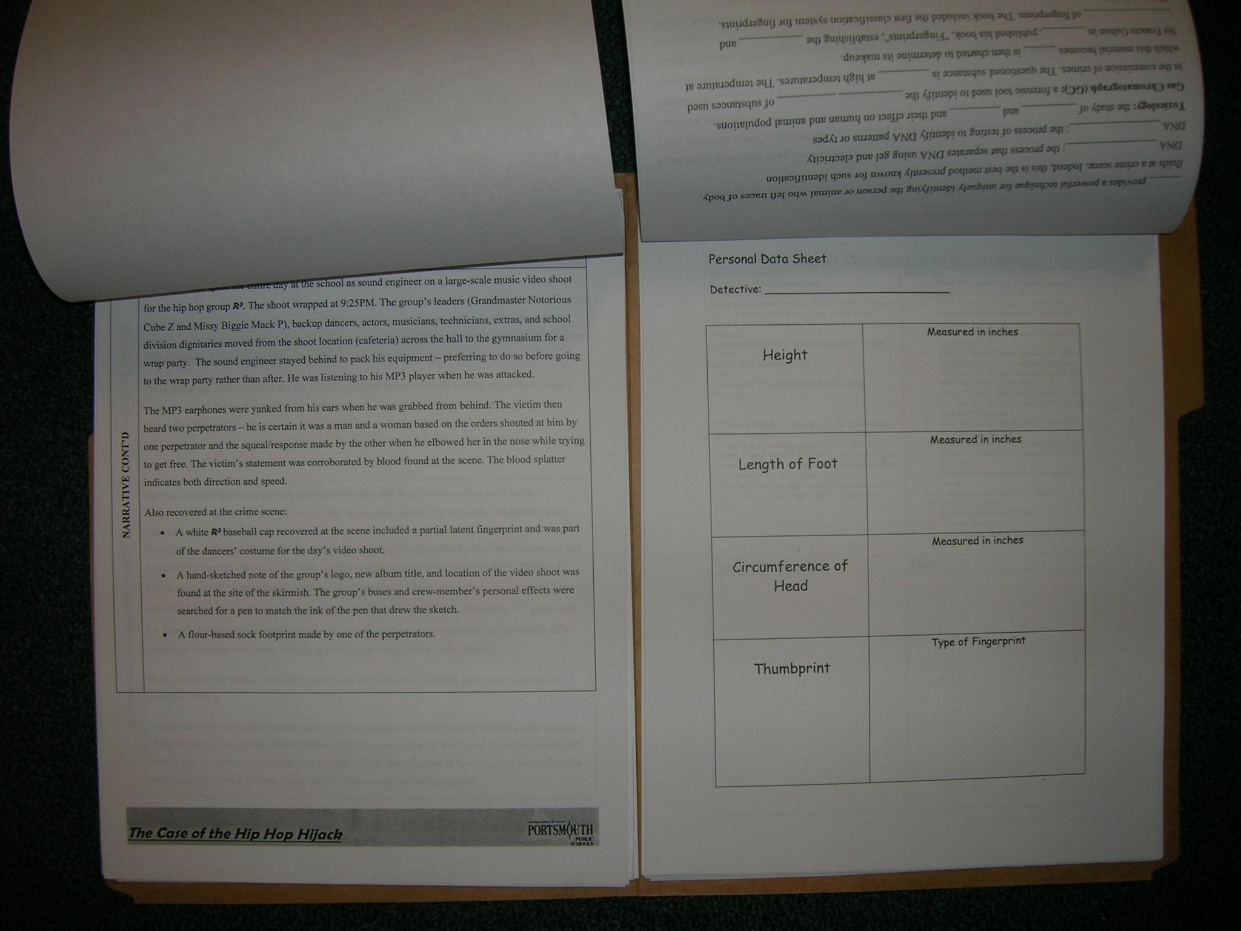
Albert Osborn - (1858-1946)
“Father of Document Examination”
His work led to the acceptance of documents as scientific evidence by the courts.

Slide 16
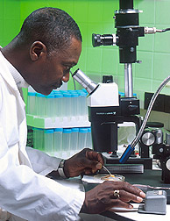
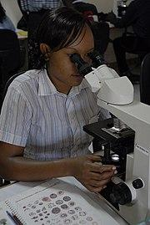
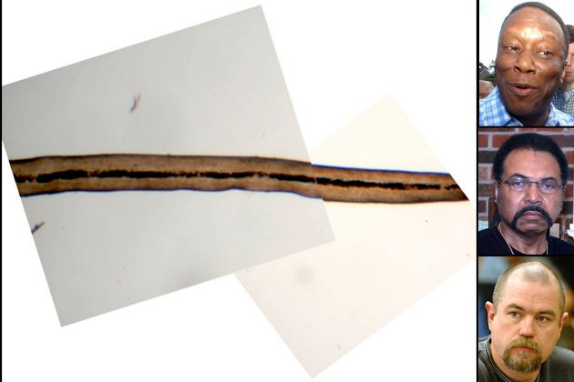
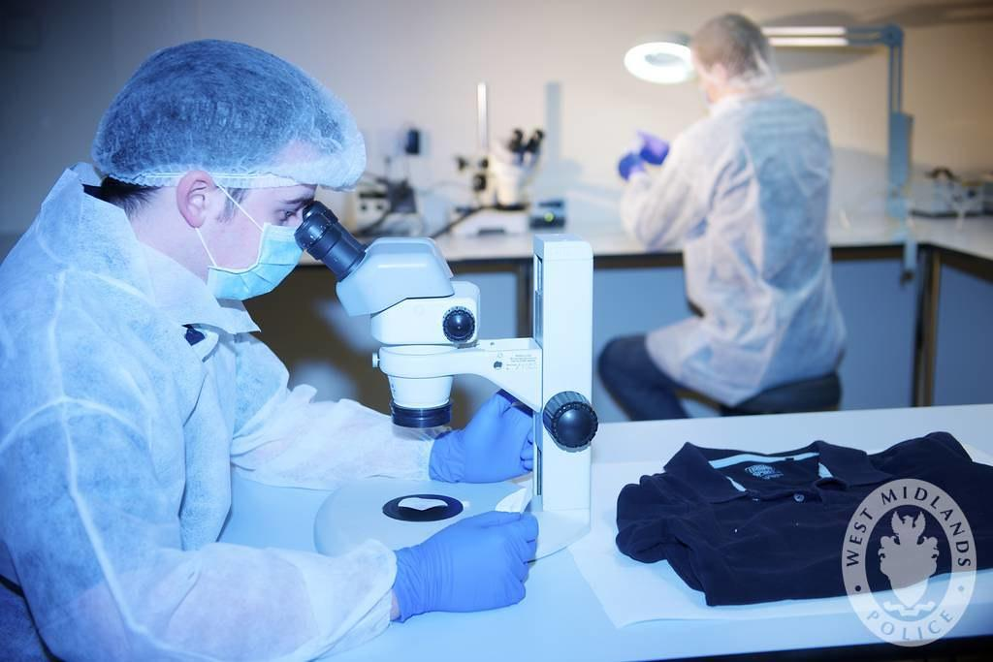
Walter McCrone - (1916-2002)
“Father of Microscopic Forensics”
He developed & applied his microscope techniques to examine evidence in countless court cases.
Hair, Fibers, etc.

Slide 17
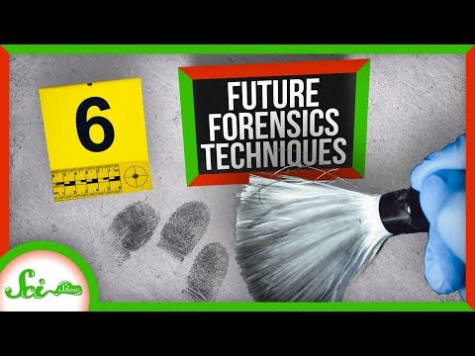

Slide 18
Hans Gross - (1847-1915)
“Father of Forensic Publications”
Wrote the book on applying all the different science disciplines to the field of criminal investigation.

Slide 19
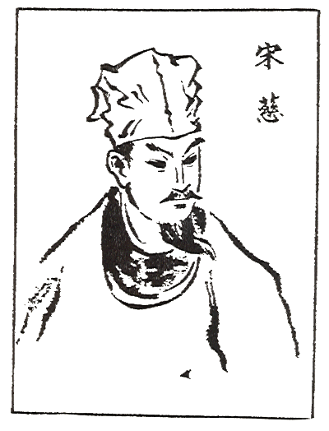
12. Song Ci
Song Ci -(1186–1249) was a Chinese physician, judge, forensic medical scientist, anthropologist, and writer of the Southern Song dynasty.
He is most well known for being the world's first forensic entomologist, having recorded his experience examining bodies for judicial cases in the Collected Cases of Injustice Rectified

Slide 20
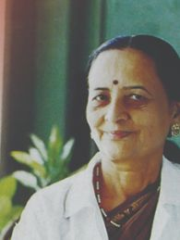
13. Dr. Vasuda Apte
Dr. Vasudha Apte is the former head of the department of 'Forensic Medicine and Toxicology' of the Nair Hospital and the Topiwala Medical College in Mumbai. Having done her M.B.B.S. and then M.D., Dr. Apte chose Forensic Medicine as her field of work and in order to enhance her knowledge in the field, graduated in law.

Slide 21
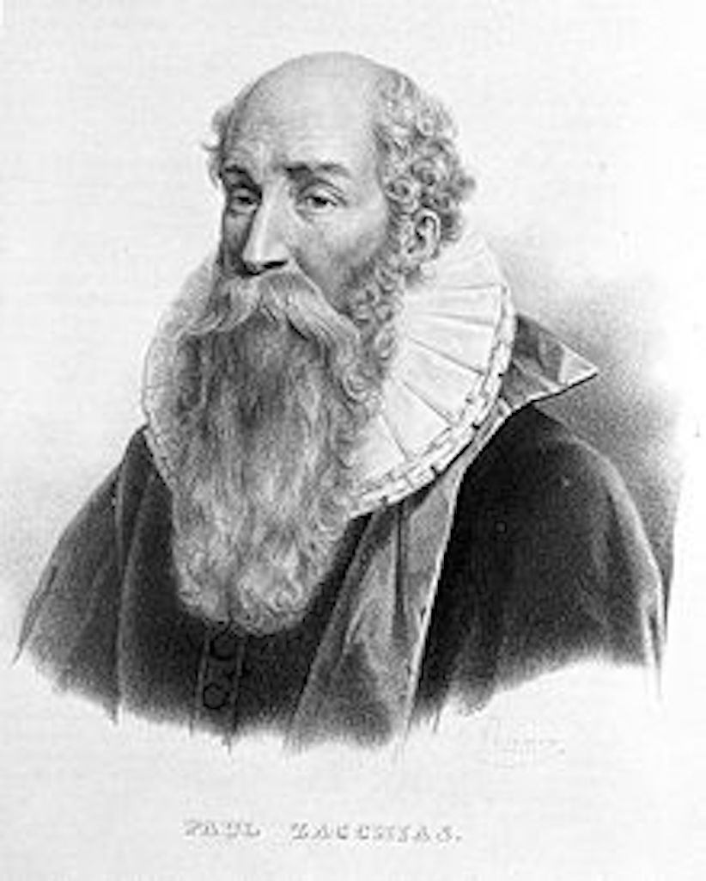
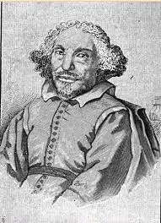
14. Fortunato Fidelis & Paolo Zacchia
Two Italian surgeons, Fortunato Fidelis and Paolo Zacchia, laid the foundation of modern pathology by studying changes that occurred in the structure of the body as a result of disease. In the late 1700s, writings on these topics began to appear.

Slide 22
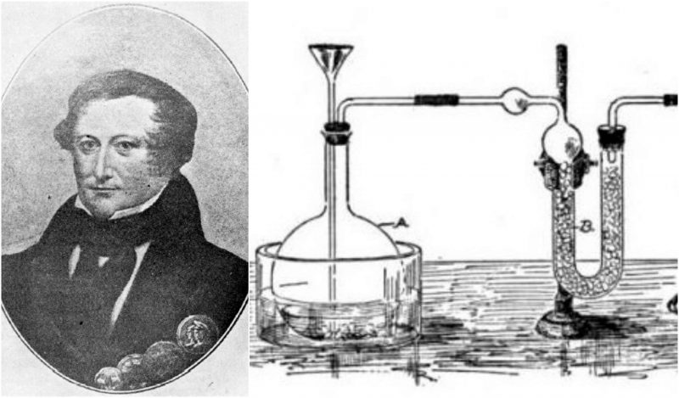
16. James Marsh
James Marsh (2 September 1794 – 21 June 1846) was a British chemist who invented the Marsh test for detecting arsenic.
In 1832 police arrested John Bodle for lacing his grandfather's coffee with poison. Chemist James Marsh tested the drink in his laboratory, and confirmed the presence of arsenic by producing a yellow precipitate of arsenic sulfide.

Slide 23
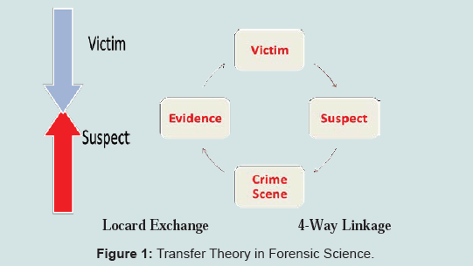
11. Edmond Locard - (1877-1966)
“Father of the Crime Lab”
In 1910, he started the 1st crime lab in an attic of a police station in Paris, France.
With few tools, he quickly became known world-wide to forensic scientists & criminal investigators & eventually founded the Institute of Criminalistics in France.
His most important contribution was the “Locard’s Exchange Principle”

Slide 24
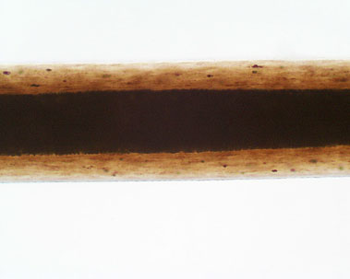
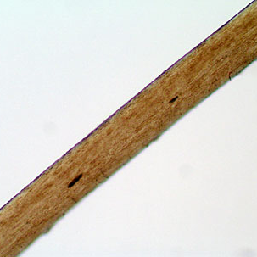
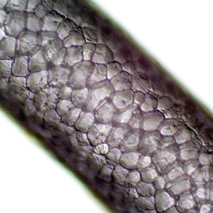
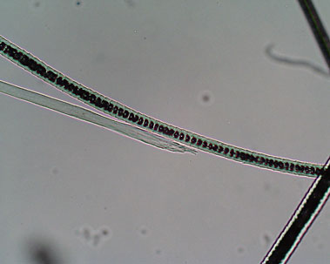
Locard’s Exchange Principle
“Every Contact Leaves a Trace.”
He believed that every criminal can be connected to a crime by particles carried from the crime scene.
When a criminal comes in contact with an object or person, a cross-transfer of evidence occurs.

Slide 25
Locard’s Exchange Principle

Slide 26
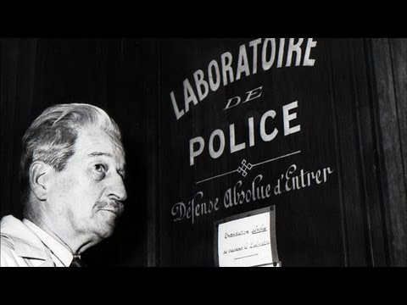
Locard’s Exchange Principle

Slide 27
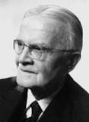
17. Paul Uhlenhuth
a German bacteriologist and immunologist, and Professor at the University of Strasbourg.
He is famous in the annals of forensic science for developing the species precipitin test, known as the Uhlenhuth test, which could distinguish human blood from animal blood in 1901, a discovery which had tremendous importance in criminal justice in the 20th century.

Slide 28
18. Archibald Reiss
was a German–Swiss criminology-pioneer, forensic scientist, professor and writer.
He had received a Ph.D. in chemistry at the age of 22 and was an expert in photography and forensic science. In 1906 he was appointed a professor of forensic science at the University of Lausanne. In 1909, he was the founder of the first academic forensic science programme and of the "Institut de police scientifique" at the University of Lausanne.

Slide 29
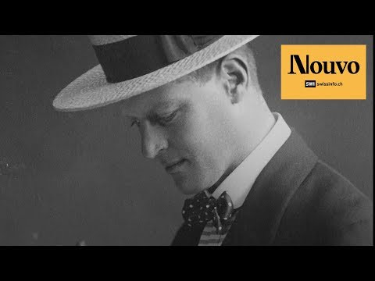

Slide 30
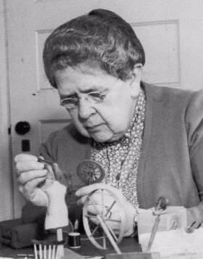
19. Frances Glessner Lee
was an American forensic scientist.
She was influential in developing the science of forensics in the United States. To this end, she created the Nutshell Studies of Unexplained Death, 20 true crime scene dioramas recreated in minute detail at dollhouse scale, used for training homicide investigators.
Lee also helped to establish the Department of Legal Medicine at Harvard, and endowed the Magrath Library of Legal Medicine there.
She became the first female police captain in the United States, and is known as the "mother of forensic science.”

Slide 31
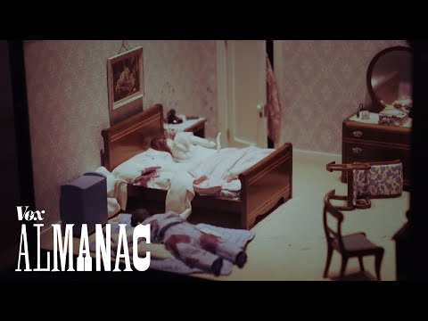

Slide 32
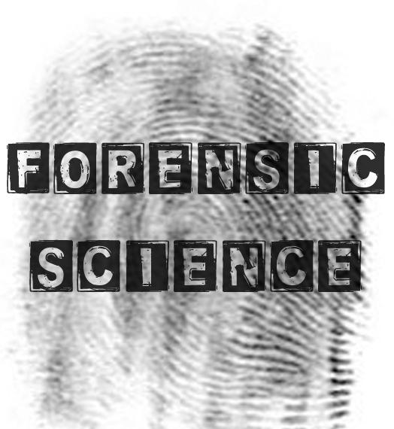
Education, Training, & Certification
Crime scene investigators are law enforcement officials, so studying criminal justice often is the best start to becoming qualified for such a career. Many colleges and universities offer the opportunity to major in criminal justice with an emphasis on crime scene investigation. Some of the key areas of study include:
Forensics: This area requires a solid foundation in biology and chemistry.
Criminology: This field covers the basics of law enforcement techniques and criminal behavior and patterns.
Crime scene analysis: Everything from photography to handling evidence and fingerprints to dealing with violent crime scenes is included here.
Criminal law: It's important for anyone working in law enforcement to have a basic understanding of criminal law.
Criminal justice ethics: As much as the law is important, it's also necessary for those in law enforcement to have a strong sense of what is ethical.

Slide 33
Quick Facts: Forensic Science Technicians
2018 Median Pay | $58,230 per year $27.99 per hour
Typical Entry-Level Education | Bachelor's degree
Work Experience in a Related Occupation | None
On-the-job Training | Moderate-term on-the-job training
Number of Jobs, 2016 | 15,400
Job Outlook, 2016-26 | 17% (Much faster than average)
Employment Change, 2016-26 | 2,600
The median annual wage for forensic science technicians was $58,230 in May 2018.
In May 2018, the median annual wages for forensic science technicians in the top industries in which they worked were as follows:
Crime scene investigators may work staggered day, evening, or night shifts and may have to work overtime because they must always be available to collect or analyze evidence. Technicians working in laboratories usually work a standard workweek, although they may have to be on call outside of normal business hours if they are needed to work immediately on a case.

Slide 34
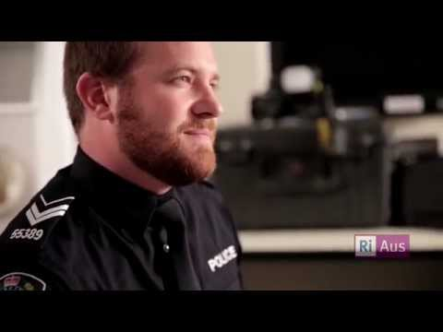

Slide 35
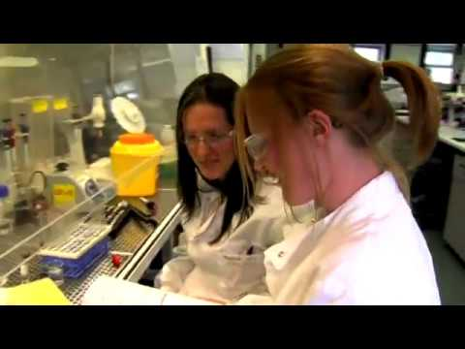

Slide 36
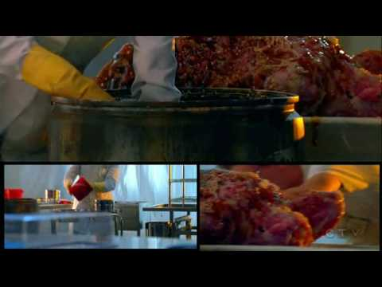

Slide 38
23.What was the Frye vs US case?
United States, 293 F. 1013 (D.C. Cir. 1923), a case discussing the admissibility of systolic blood pressure deception test as evidence. The Court in Frye held that expert testimony must be based on scientific methods that are sufficiently established and accepted.

Slide 39
Why is the Frye Standard Important?
The ruling set a standard for the acceptance of expert testimony in court that, by the early 1970s, was adopted by almost all state and federal courts. The sole basis of Frye's appeal was the failure of the trial court to admit the deception test. ...

Slide 40
When was the decision for Frye v United States issued?
1923
Citing Frye v. United States, 54 App. D.C. 46, 47, 293 F. 1013, 1014 (1923), the court stated that expert opinion based on a scientific technique is inadmissible unless the technique is "generally accepted" as reliable in the relevant scientific community.

Slide 43
24. Daubert v. Merrell Dow Pharmaceuticals
In its 1993 decision Daubert v. Merrell Dow Pharmaceuticals, Inc., the US Supreme Court established the Daubert Standard for evaluating the admissibility of scientific knowledge as evidence in US federal courts.
Merrell Dow Pharmaceuticals, Inc. was a United States Supreme Court case that recognized what kind of scientific testimony would be admissible in federal court following the passage of the Federal Rules of Evidence.

Slide 45
This was a case brought by two children born with birth defects that they claimed were caused by an anti- nausea drug, Bendectin. ... The Daubert case turned on whether Bendectin, a anti- nausea drug for pregnant women, caused non-specific birth defects.
Under the Daubert standard, the factors that may be considered in determining whether the methodology is valid are:

Slide 46
The expert’s scientific, technical, or other specialized knowledge will help the trier of fact to understand the evidence or determine a fact in issue,
The testimony is based on sufficient facts or data,
The testimony is the product of reliable principles and methods,
The expert has reliably applied the principles and methods to the facts of the case, and
In some federal courts, a Daubert challenge must occur regarding any review of an expert.

Slide 49
25. Coppolino v. State of Florida
The defendant, Carl Coppolino, was tried upon an indictment charging him with the first degree murder of his wife Carmela. The jury found defendant guilty of murder in the second degree and pursuant to this verdict judgment and sentence were entered. From this judgment and sentence defendant appeals.

Slide 50
Coppolino v. State of Florida
Defendant's trial was a lengthy and involved one wherein medical and scientific witnesses were introduced by both sides. The witnesses presented a vast amount of complex and conflicting scientific testimony regarding the cause of death of Carmela Coppolino. The defendant in his second point on appeal states in reference to the scientific testimony presented by the State, "the verdict is not supported by sufficient evidence and is against the weight of the evidence.

Slide 52
26. Mapp v. United States
Mapp v. Ohio, case in which the U.S. Supreme Court on June 19, 1961, ruled (6–3) that evidence obtained in violation of the Fourth Amendment to the U.S. Constitution, which prohibits “unreasonable searches and seizures,” is inadmissible in state courts.

Slide 53
Case Summary of Mapp v. Ohio:
Mapp’s home was searched absent a warrant.
The search yielded the discovery of material classified as “obscene” under Ohio state law.
The Supreme Court held that evidence obtained from an unreasonable search and seizure could not be used against the accused in criminal state court.
The court made a point of noting the inconsistency of state courts being permitted to introduce evidence that the federal courts have held to be a violation since both the state and federal government follow the U.S. Constitution.

Slide 54
Case Summary of Mapp v. Ohio:
Mapp’s home was searched absent a warrant.
The search yielded the discovery of material classified as “obscene” under Ohio state law.
The Supreme Court held that evidence obtained from an unreasonable search and seizure could not be used against the accused in criminal state court.
The court made a point of noting the inconsistency of state courts being permitted to introduce evidence that the federal courts have held to be a violation since both the state and federal government follow the U.S. Constitution.

Slide 57
27. People v. Williams
In Williams’s (D) forcible rape case, a request was made by both prosecution and defense that the trial court instruct the jury to find that the defendant had reasonable and good faith but mistaken belief as to the victim’s consent. The court refused, and the jury convicted Williams of forcible rape.

Slide 58
People v. Williams
Williams (D) was convicted of forcibly raping Deborah. Deborah and Williams had gone together to a hotel room, according to Deborah’s testimony, to watch television. In the room they had intercourse after Williams, who was much larger and heavier than her, hit her and prevented her from leaving, threatening her if she refused to have sex with him. Williams testified that Deborah had willingly come with him to the hotel room, had initiated sexual contact and demanded money, which he refused to pay, resulting in her becoming angry. Both parties asked for the jury to be instructed to find the defendant had reasonable and good faith but mistaken belief that the victim had consented, but the trial court refused to give such instruction. The state intermediate court of appeals reversed the verdict, holding that there was substantial evidence to support the request for such jury instruction regarding mistake-of-fact.
Issue. In a case of forcible rape, may the jury be given an instruction on the defendant having had reasonable and good faith but mistaken belief as to the victim’s consent unless there is substantial evidence that the victim showed equivocal conduct which could have resulted in a reasonable and good faith though mistaken belief on the defendant’s part as to the victim’s consent.

Slide 59
Melendez-Diaz v. Massachusetts

Slide 61
28. Melendez-Diaz v. Massachusetts
Melendez-Diaz v. Massachusetts, is a United States Supreme Court case in which the Court held that it was a violation of the Sixth Amendment right of confrontation for a prosecutor to submit a chemical drug test report without the testimony of the person who performed the test.
While the court ruled that the then-common practice of submitting these reports without testimony was unconstitutional, it also held that so called "notice-and-demand" statutes are constitutional.

Slide 62
Melendez-Diaz v. Massachusetts
A state would not violate the Constitution through a "notice-and-demand" statute by both putting the defendant on notice that the prosecution would submit a chemical drug test report without the testimony of the scientist and also giving the defendant sufficient time to raise an objection.

